Slide 1
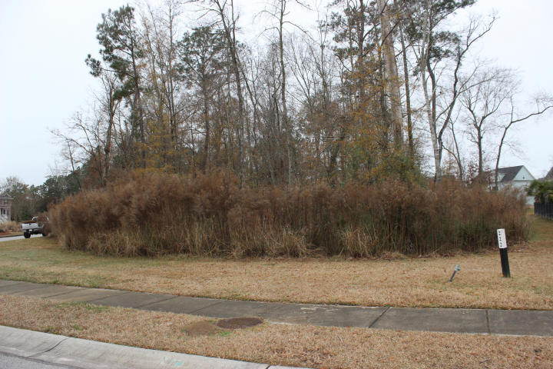
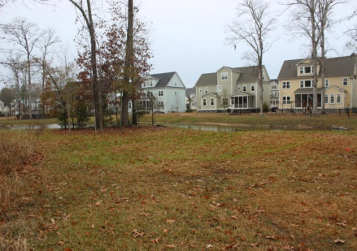
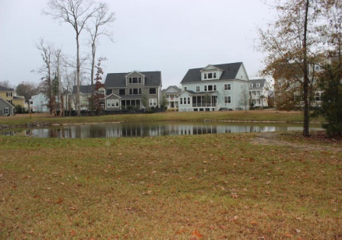
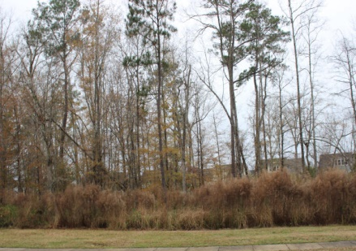
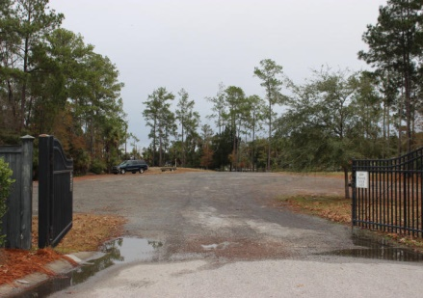


3043 Yachtsman Drive
Dunes West ~ Mount Pleasant ~ MLS# 15000769 ~ $159,000
Come see how life is lived in the exclusive neighborhood behind the community gates at Dunes West in The Harbour. The neighborhood is beautiful with gorgeous homes. Lot 222 is over 1/2 acre and seems larger with the pond and its buffer at the rear of the lot. Creating a spectacular streetscape are the million+ dollar homes across the street that are on Wagner Creek. The community boat ramp is close by offering convenience for those participating in water sports. Dunes West has a wide array of amenities. Life is finer in Dunes West!
Kay Kennerty
MBA, ABR, CRS, GRI
843-345-5011
Kay@agentownedrealty.com
www.KayKennertyHomes.com
The AgentOwned Realty Company
824 Johnnie Dodds Blvd
Mt. Pleasant, SC 29464

