Slide 1
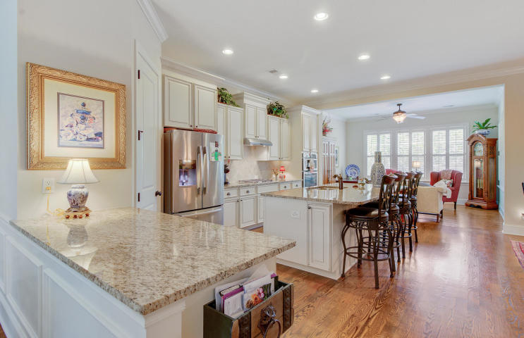
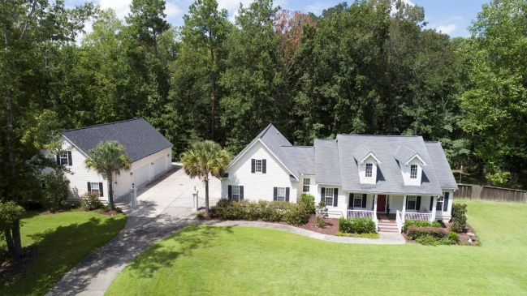
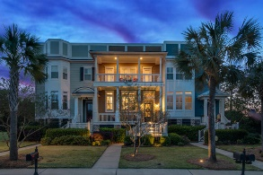
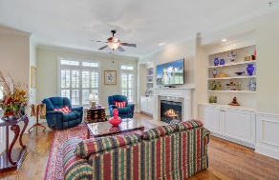
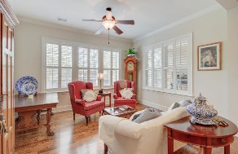
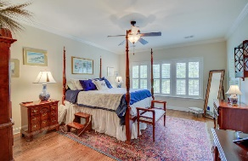
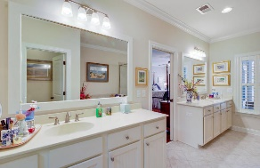
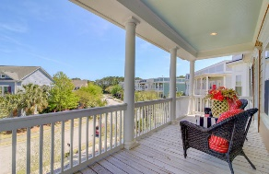
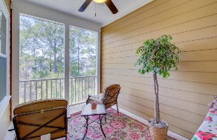
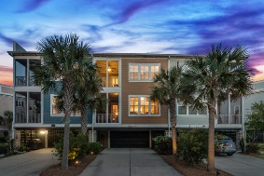



3045 Monhegan Way Hamlin Plantation| Mt Pleasant | MLS# 19003734 | $567,000
Custom home on beautiful lake!
Luxury Maintenance Free Living!
This stunning Charleston style luxury townhouse nestled within Hamlin Plantation in Mount Pleasant S.C. has been immaculately kept. Open concept includes: the formal dining room with medallion lighting, a kitchen with large pantry, upgraded cabinetry, eight foot center granite island with over sized sink and seating for four bar stools, refrigerator, gas stove top above granite countertops, microwave, oven and new 39 decimal quiet Bosch dishwasher with third rack, an enclosed half bath, a second formal dining area with medallion lighting, a keeping room with two walls of windows and Charleston shutters with natural light. The master bedroom hosts two master closets, windows with Charleston shutters along the back and windows overlooking the screened-in porch for viewing the western sky and approaching storms. The master bath includes an enclosed toilet, soaker tub, large shower, two sinks with vanities and extra electrical outlets for personal necessities. Behind the unit is a private drive enabling parking in the three car garage. The three car garage has additional storage areas and an elevator shaft from the ground level to the top floor. Professional lighting wired into the front stairs and yard adds an enriched and enchanted beauty at night to this 3045 Monhegan Way "GEM", as well as an added sense of security.
Amenities include: recently resurfaced nature trails, Olympic sized pool with recreational slides, mushroom water area for the kiddies, clubhouse, fitness center, tennis courts and don't forget to take advantage of our "little library trade" at the pool entrance!
Laurel Cockfield
M (843) 817-2021 | O (843) 284-1800
livelowcountry@gmail.com | www.LiveLowcountry.net
Carolina One Real Estate | 2713 Highway 17 North | Mt. Pleasant, SC 29466

