Slide 1
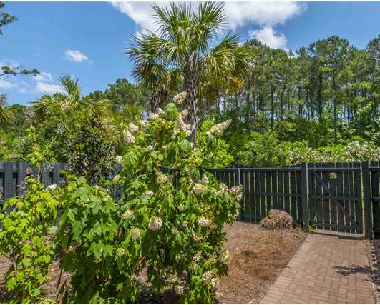
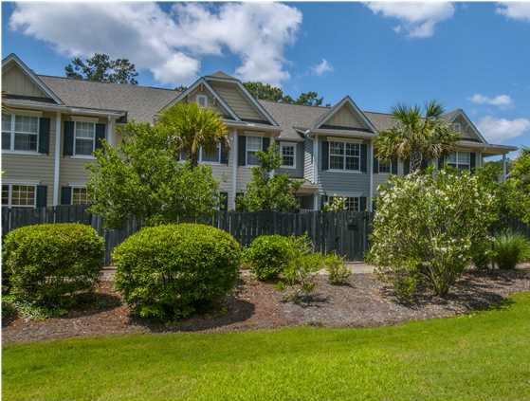
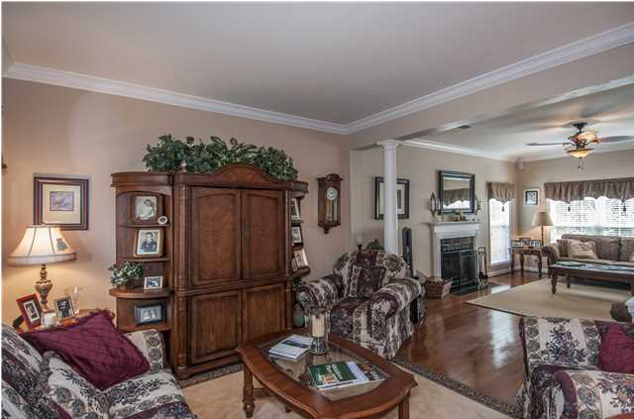
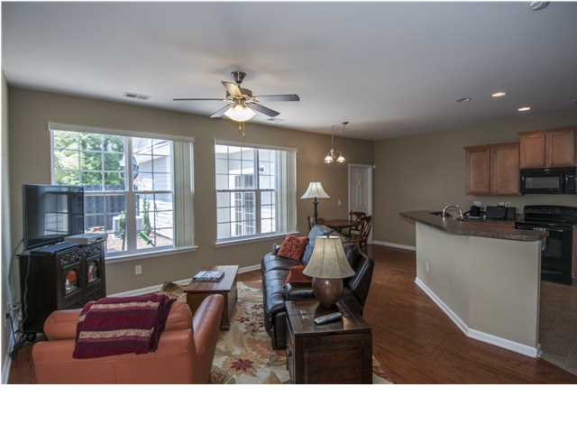
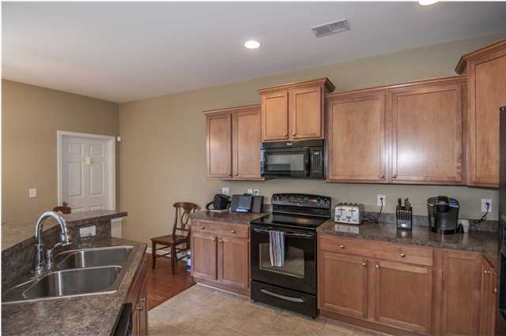
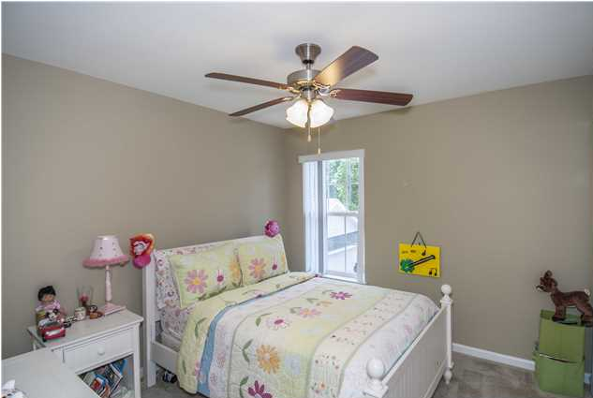
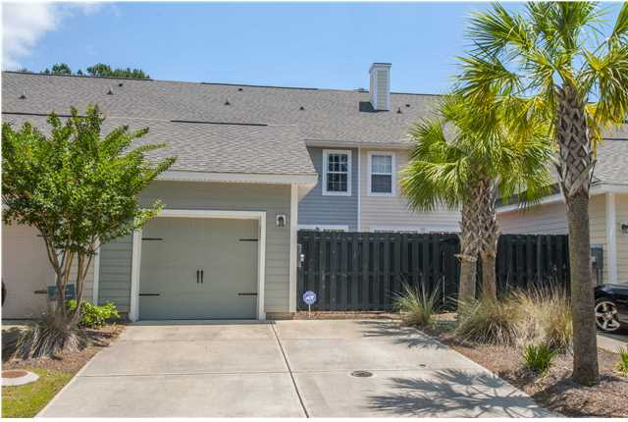

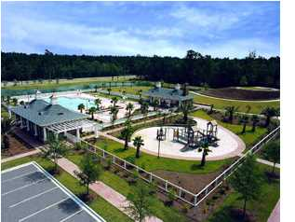

3049 Park West Blvd Mansfield @ Park West ~ Mt Pleasant MLS# 1413149 ~ $250,000
Seller Says “SELL!”
Vacant & Easy to Show
Fabulous Floor plan in the popular neighborhood of Park West! This townhome features 9 foot ceilings, attached garage, open kitchen to the family room, true dual masters -one large master suite on the main floor & one on the second floor, dual laundry, 3.5 baths, 2 additional secondary bedrooms, plus a 10x12 patio courtyard. This floor plan offers endless possibilities to suit your lifestyle. Nice green space to side and rear of property. Park West has great amenities including two pools, tennis courts, walking trails, schools, shopping and dining as well as Mt. Pleasant recreational complex in the community.
Catherine Parker
Realtor
843-814-0551 M
843-202-3678 F
cparker@carolinaone.com
catherineparkersellscharleston.com

