Slide 1
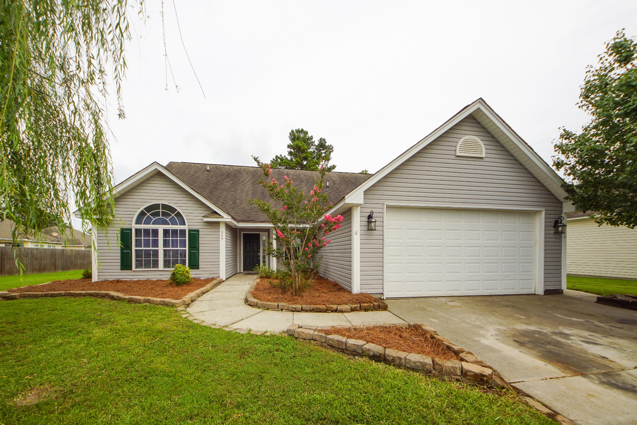
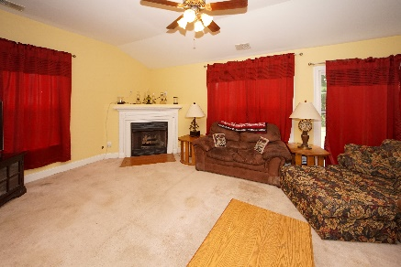
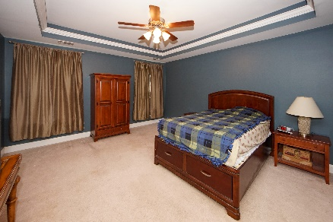
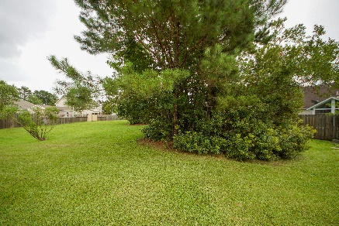


304 Carriage Wheel Road Moncks Corner, SC 29461 MLS# 19020289 :: $212,000 3 Bed / 2 Bath
Best Priced Home In Spring Grove!
New Price!
This 3 bedroom 2 bath is a great starter home with stainless appliances, granite counter tops, eat in kitchen and gas fire place.
Separate dining could be used as an office or additional living space.
NEW AC was in stalled April 2019.
Over sized yard and 2 car garage add to the charm of this one story home.
Connie White, Broker
843-532-3356
connie@chrepros.com · conniewhiterealestate.com
Charleston Homes · 597 Old Mt. Holly Road · Suite 301 · Goose Creek, SC 29445

