Slide 1
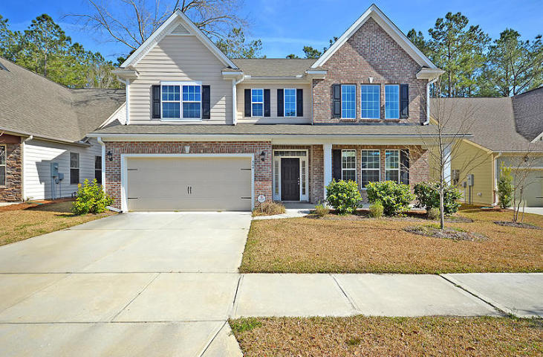
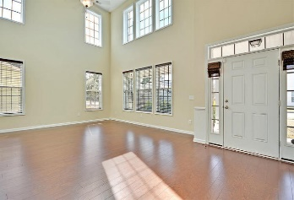
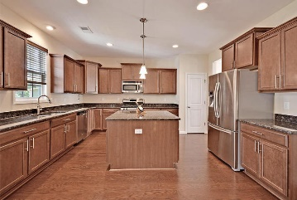
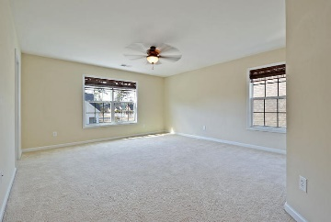
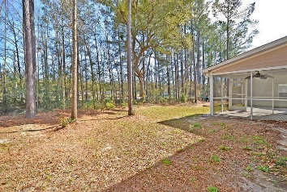
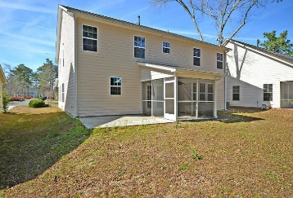


INCREDIBLE INSTANT EQUITY This Beautiful home is priced $22,000.00 below recent Appraisal!
304 Comiskey Park Cir
Fieldview
Summerville, SC 29485
MLS# 16006449
$319,900
This Sensational fully detached 2 story home is situated on a quiet tree-lined street and is surrounded by a large, private, landscaped yard. This Exclusive freshly painted home has four large bedrooms upstairs including the Incredible and Spacious master bedroom suite that offers his and her walk-in closets, a private master bathroom with a separate glass enclosed shower, an oversized soaking tub, and a stylish double vanity. There are several large rooms with crafted wood moldings on the main floor including the Amazing sun-lit Great room with 18ft ceilings and selected wood flooring, the Glamorous Formal Dining room with classic wains coating and the beautiful wood flooring, a family sized eat-in kitchen that boast rich crafted wood cabinets, priceless granite counter tops, upgraded stainless appliances including a 5 burner gas range and, of course, the beautiful wood floorings.
The family room is perfect for family gatherings and offers a useful gas fireplace. Don't forget the downstairs guest bedroom (5th bedroom or office). There is a French door walk-out to an authentic screened-in porch and a separate patio that is perfect for outside entertaining, cook-outs or just spending time with the kids. This Magnificent home is located in a wonderful family oriented neighborhood that offers sidewalks, play parks, walking trails and the popular Dorchester District 2 schools. The owners have completed a pre-listing home inspection and a pre-listing appraisal. Available upon request. The home is priced thousands of dollars less than the appraisal value. BRING YOUR CHECKBOOK! Age, sqft, schools. acreage, HOA fees, and taxes are approx. buyer to verify.
Bill Everett, Jr
Broker
843-693-8539
Bill@TheEverettGroup.net
RE/MAX Pro Realty, 9209 University Blvd, Charleston, SC 29406

