Slide 1
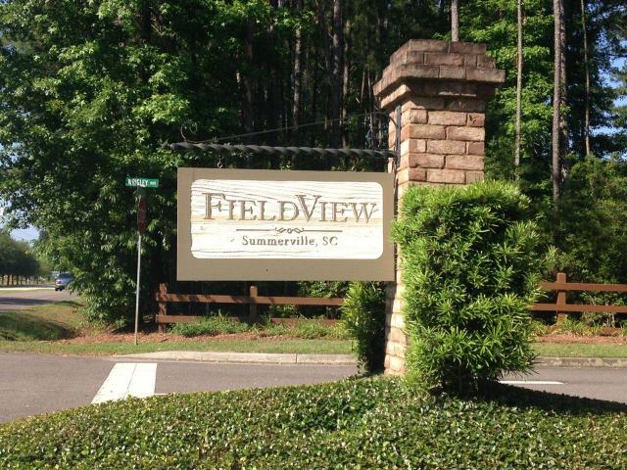
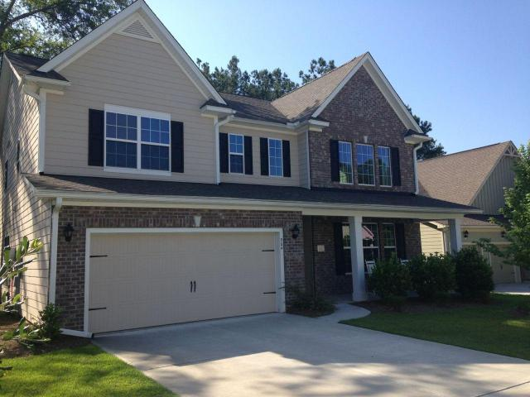
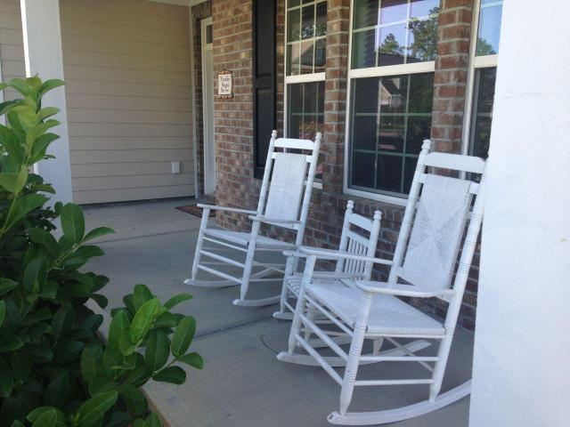
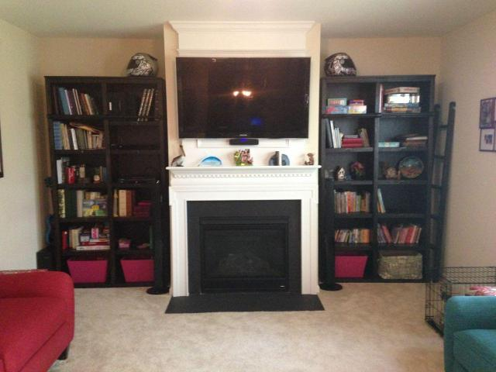
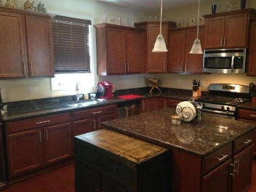
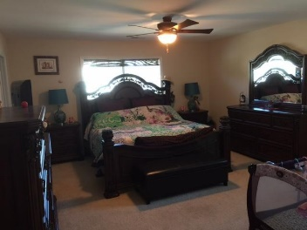
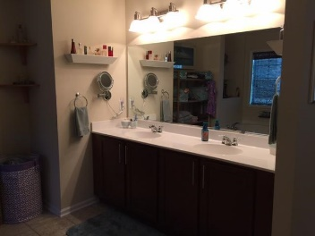
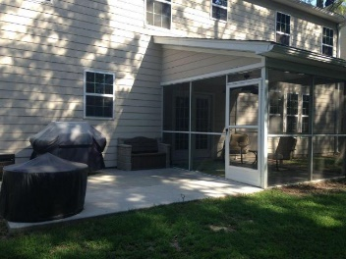
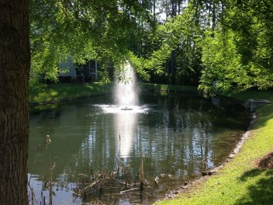


Ready to Sell!!
304 Comiskey Park Circle
Fieldview | Summerville | MLS# 15013216| Reduced to $319,000
House is only 2 years old and looks brand new! Downstairs bedroom and full bath! Living room features cathedral ceilings, hardwood flooring. Kitchen is a chef's dream with 36'' staggered cabinets, all stainless appliances, gas range, granite counters! Formal Living room, dining room and kitchen have hardwood floors. Master bedroom features double walk-in closets and a huge master bathroom with tile, his and her vanities, garden tub and separate shower. Desireable Dorchester II Schools. Walking distance from Gahagan Park and less than 10 minutes from downtown Summerville.
Erik Fender
C 843-830-7346
O 843-875-5525
Erik.Fender@cbunited.com
Coldwell Banker United, REALTORS
4969 Centre Pointe Dr., Ste 203
Charleston, SC 29418

