Slide 1
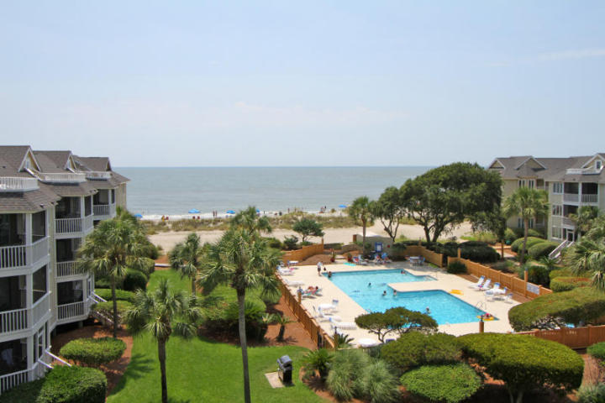
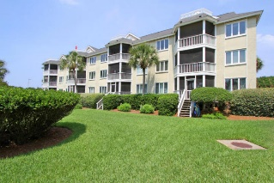
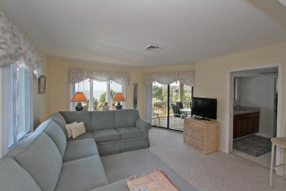
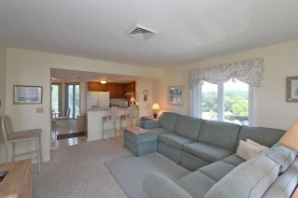
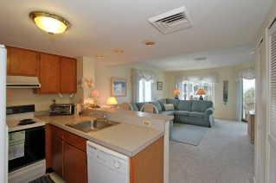
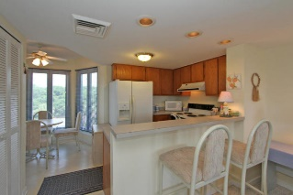
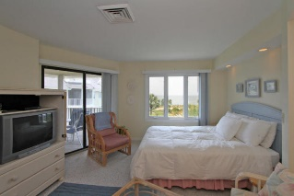
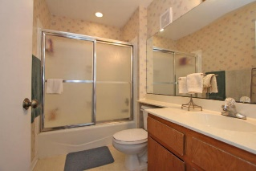
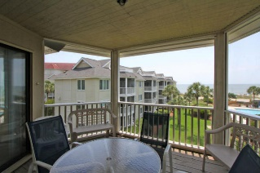
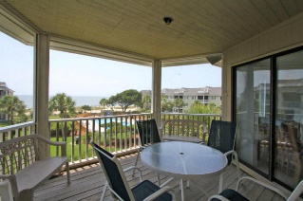
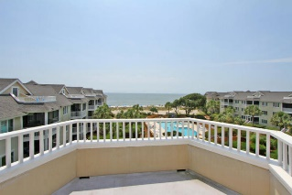


304-D Port O'Call Drive
Wild Dunes
Isle of Palms
MLS# 15019040
Reduced to $389,000
Views of the Atlantic...
...Great Rental Potential
This beautifully maintained 3rd floor condo shows pride of ownership throughout. Enjoy the extraordinary views overlooking the Atlantic Ocean and the pool. A spiral staircase leads up to a loft area and outdoor deck showing off even more views of the ocean. Currently lived in by the owner, the condo would also make an excellent rental with estimated rental income of $30-$35,000. Being sold furnished with exception of some personal property.
Darlene Smith
Office - (843) 886-8110
Mobile - (843) 696-7824
darlenesmith@carolinaone.com
DarleneSmithTeam.com
Carolina One Real Estate
1503 Palm Blvd Ste
Isle of Palms, SC 29451

