Slide 1
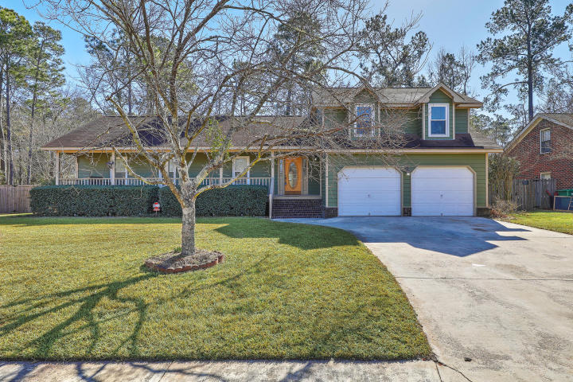
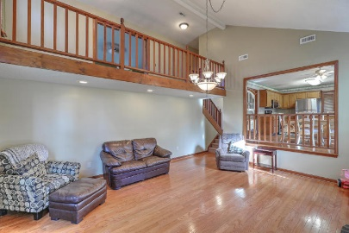
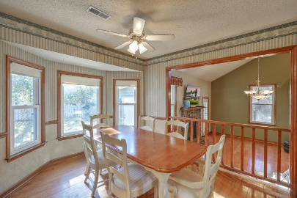
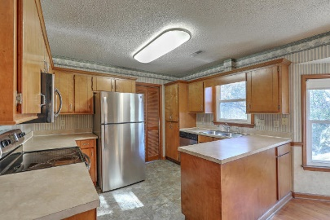
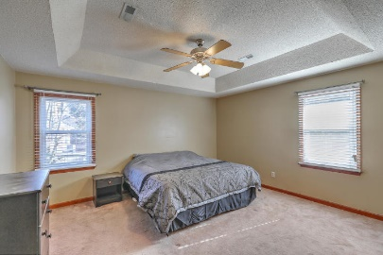
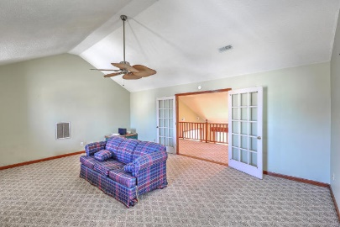
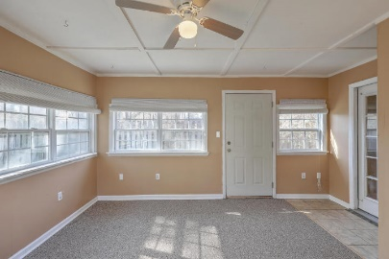
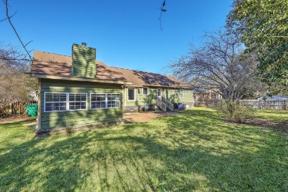


304 Eastover Circle
South Pointe | Summerville, SC 29483 | MLS# 18002519 | $224,900
New Price, Reduced $5,000!
Highly desirable South Pointe neighborhood in the DD2 school district. This 4 bedroom, 2 bath home has so much to offer. Step inside the foyer to hardwoods that continue to the eat-in area, great room and then down the hall to the 3 bedrooms. Kitchen has stainless steel appliances, tile floors and a large eat-in area. Laundry room is off of the kitchen. From the great room is a large sunroom overlooking the spacious fenced backyard. Upstairs is a small loft which is off of the huge FROG(4th bedroom, no closet). Double French doors help to provide privacy. Garage has built-in storage. Termite bond and AHS home warranty are included. Seller is also selling all furniture and large screen tv and mount over fireplace. HOA is voluntary at $10 a month.
Beth Mandell
M 843-900-1296 | O 843-871-2121
bmandell@century21properties.com
www.bestcarolinahomedeals.com
Century 21 Properties Plus of Summerville | 118 W Richardson Ave | Summerville, SC 29483

