Slide 1
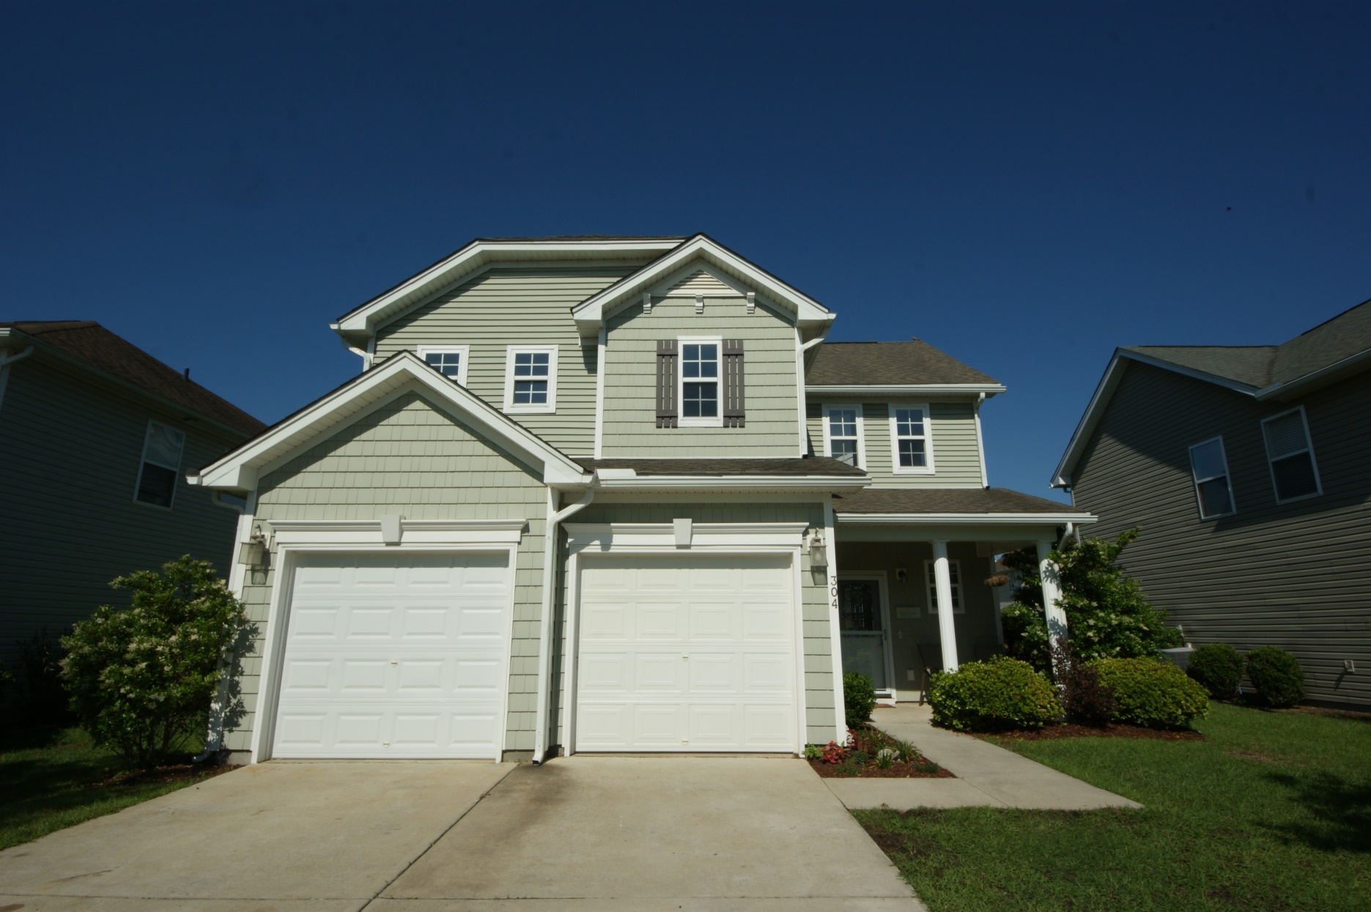
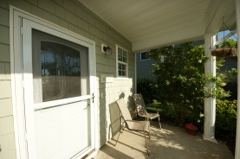
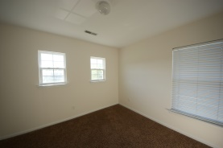
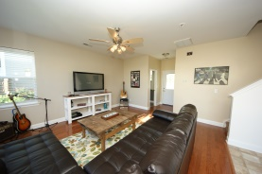
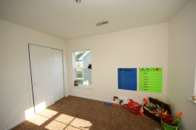
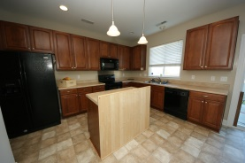
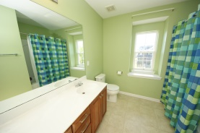
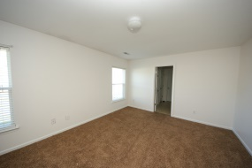
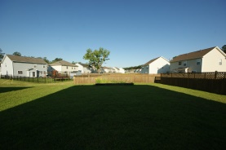
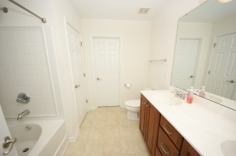
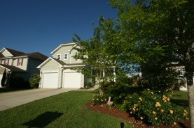
A Great Place to Call Home…
304 Evesham Avenue
Foxbank Plantation
Moncks Corner
MLS# 15000782
$177,900
304 Evesham is everything you need.
Walk into your open floor plan featuring a spacious living area with a gleaming hardwood floor connected to your eat in kitchen. Cabinets galore with a moveable island Pendant and recessed lighting. Whirlpool appliances for all your needs.
The garage is off the kitchen so carrying in groceries is a breeze. Full pantry, sliding glass doors that lead to your patio and backyard. ½ bath off the living area.
Upstairs is your master bedroom with an orversized garden tub, shower, linen closet and walk in clothes closet. The other 2 bedrooms are spacious with nice size closets.
This home is still under a ten year structural warranty & is move-in ready
Suzy Hylton
843-813-3545 | suzyhylton@att.net
Brand Name Real Estate | 207 East Bay Street Ste 311 | Charleston, SC 29401

