Slide 1
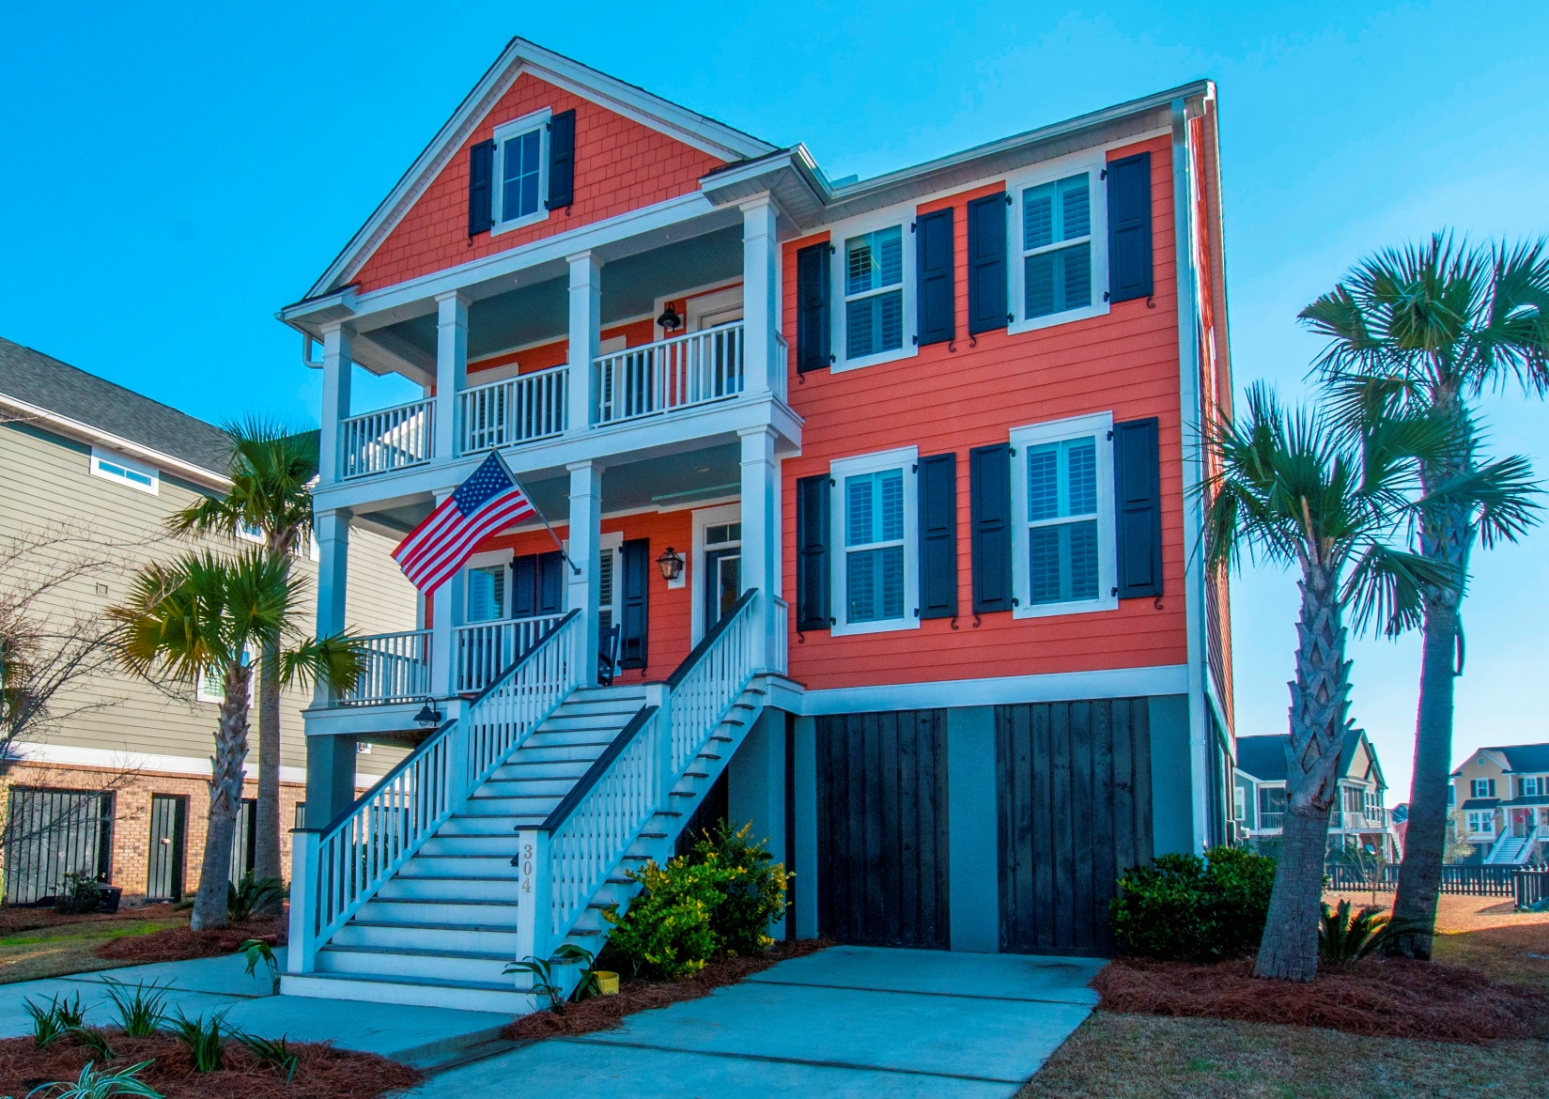
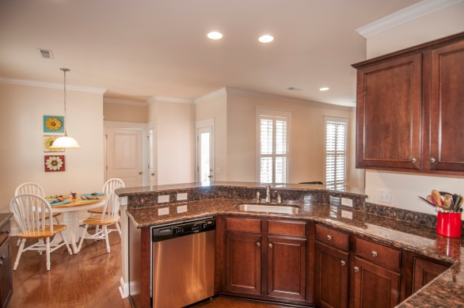
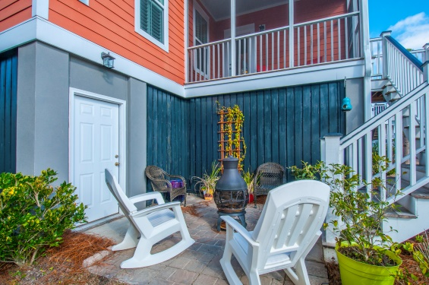
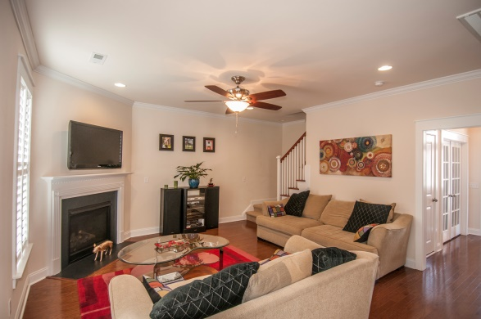


“Edge of Daniel Island, Unbeatable Location & Price…”
304 Megans Bay Ln
Charleston, SC 29492
Low $400s
Wonderful neighborhood, better-than-new
upgraded home, excellent custom touches…
Shellring, the “secret” Daniel Island vicinity
Good flow, efficient floor plan
Expanded Santee design – more powder room , utility, pantry space
Amenities in idyllic setting
Plantation shutters throughout
Custom built-in wall unit in French-door office
Walk/ride to Daniel Island shops
Innovative bar, recreation, storage space down
STEVE ROWE
,Realtor®
Retired Military. Active Agent.
(843) 303-7438
srowe@carolinaone.com
www.SteveRoweHomes.com

