Slide 1
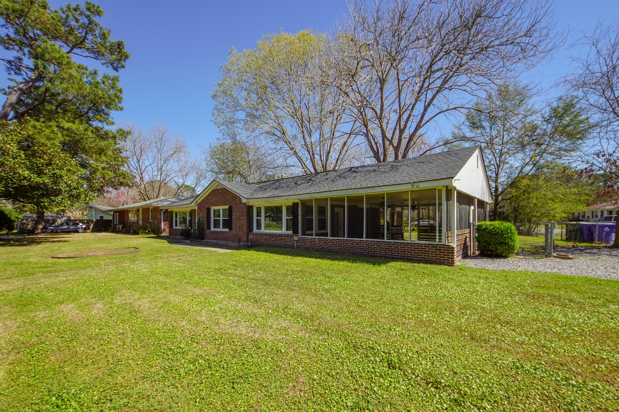
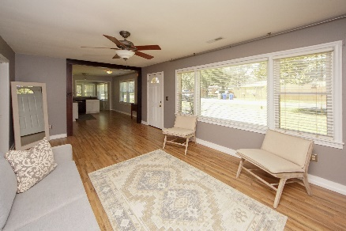
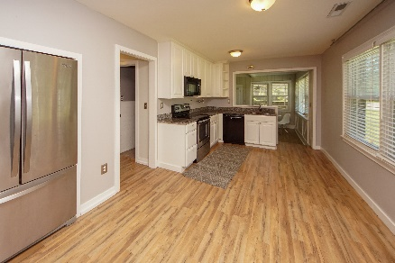
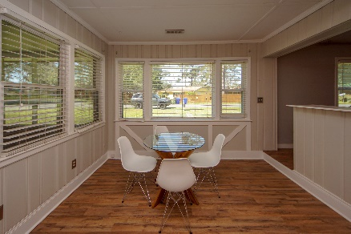
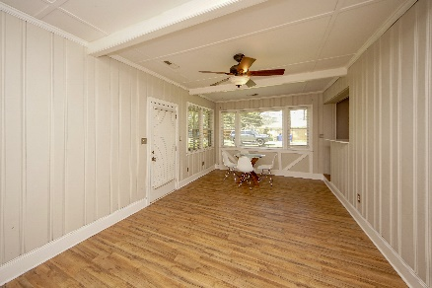
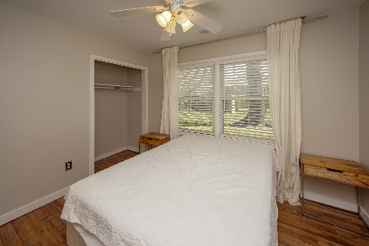
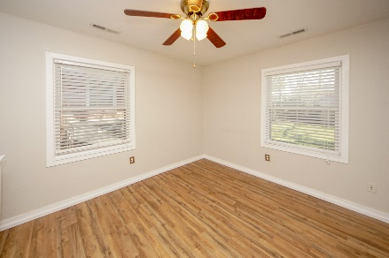
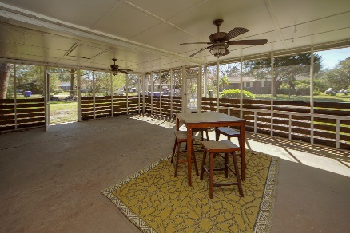
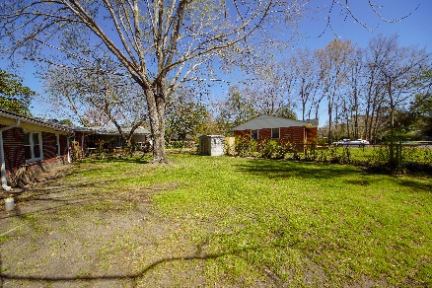

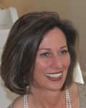
This Adorable Home Is Waiting For You! $1000 BUYER'S AGENT BONUS!
304 Stinson Drive Air Harbor | Charleston, SC 29407 | MLS# 18032847 | $259,000
Sweet brick 1-story ranch home just 10 minutes from Downtown Charleston! Large corner (fenced lot) in an established neighborhood. Close to the beach, interstate, shopping and dining. Location is perfect! NEW Wood laminate floors throughout!!! - Updated kitchen - newly painted - side additional room used as a Great Room with Laundry Area off of it. Large Carport that can be used for an extra entertaining space. NEW Roof (2016), NEW HVAC (2015). NO HOA!!
Susan Weeks
(843) 813-0495
susanweeksdesign@gmail.com
www.agentownedrealty.com
AgentOwned Charleston Group
902 Savannah Hwy
Charleston, SC 29407-7802

