Slide 1
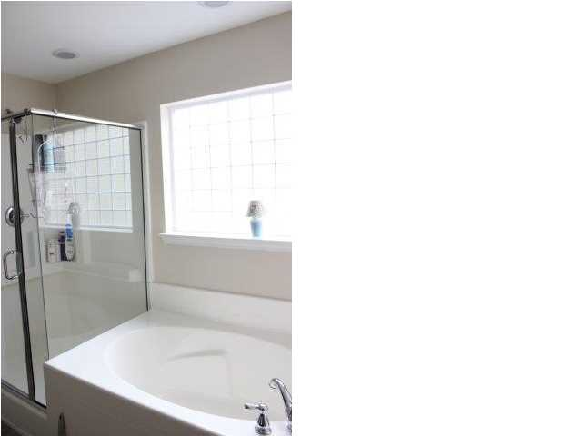
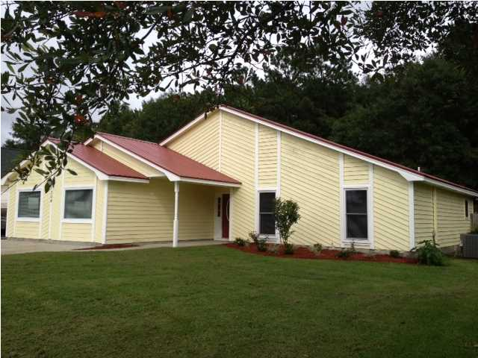
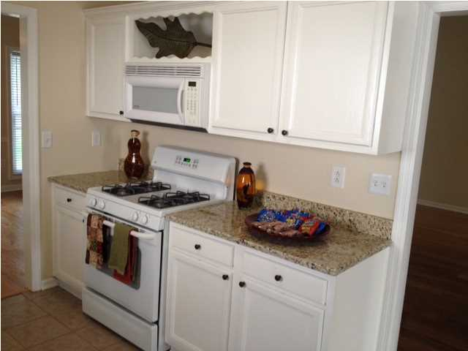
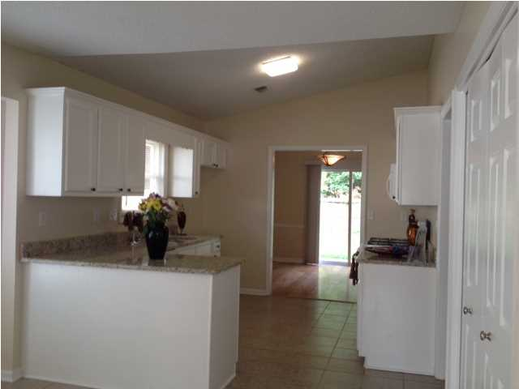
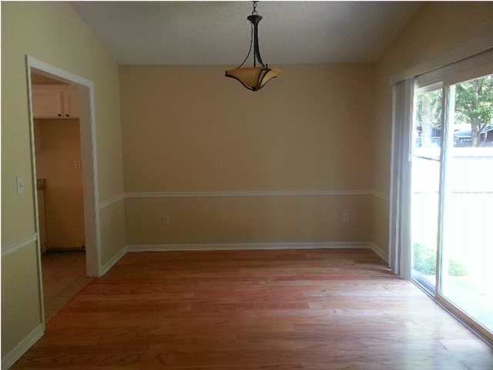
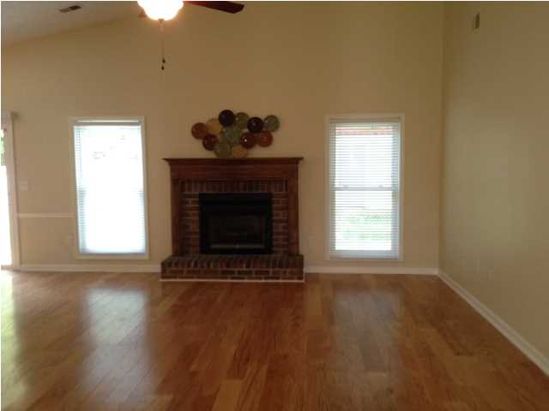
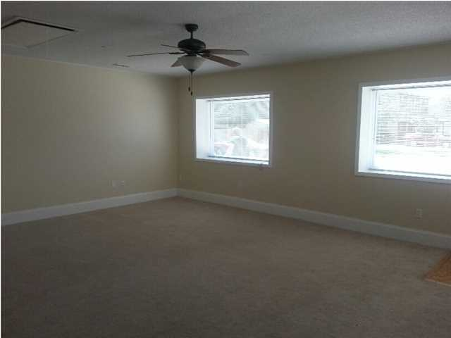
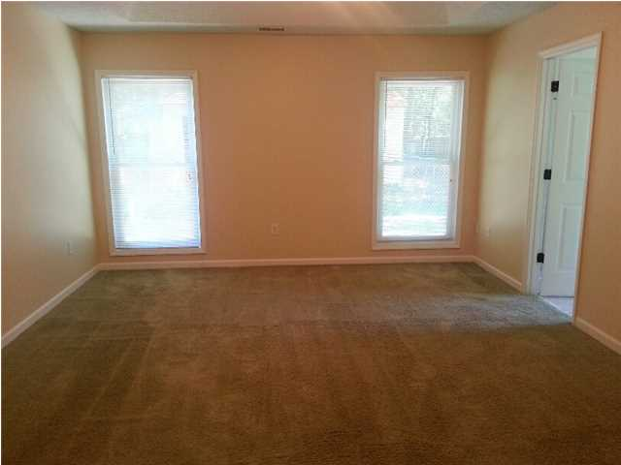
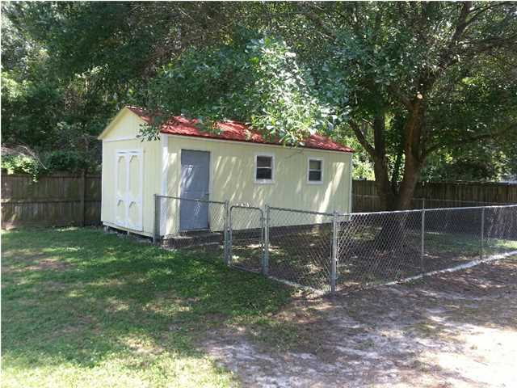
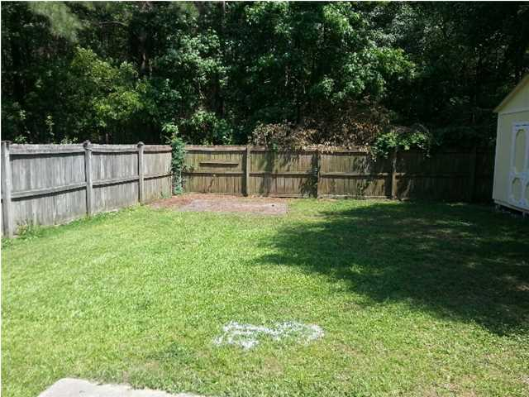


Great Living For The Entire Family
304 Trailway Dr
Tramway ~ Summerville ~ MLS# 1414087 ~ $174,900
Great family home must see!! Beautiful 3 bedroom 2 bath ranch located near the new Nexton development in Tramway subdivision! This house has new metal roof, new hardwood floors, kitchen with nook and new granite adorned counters, separate dining room which over looks back lawn, huge 20x22 great room with additional entrance, would make a great mother-in-law private nest, or family game room! New carpet thru out. Master suite has single tray to give a touch of elegance with a garden tub & glass shower in master bath with new tile floors. Huge family room with cathedral ceiling laced with beams giving a unique look, adjoined is a wet bar & serving area to caterer all of the family holiday events, with a wood encased gas fire place over looking entire family room! Additional 12x24 storage unit with pet run/play yard.
Joanie Rhoten
Office: 843-261-7166
Mobile: 513-518-7475
joanie.rhoten@agentownedrealty.com
www.agentownedmainst.com
AgentOwned Realty Co. Premier Group | 141 A N. Main Street | Summerville, SC 29483

