Slide 1
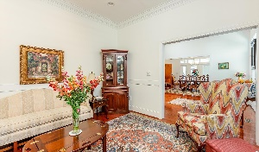
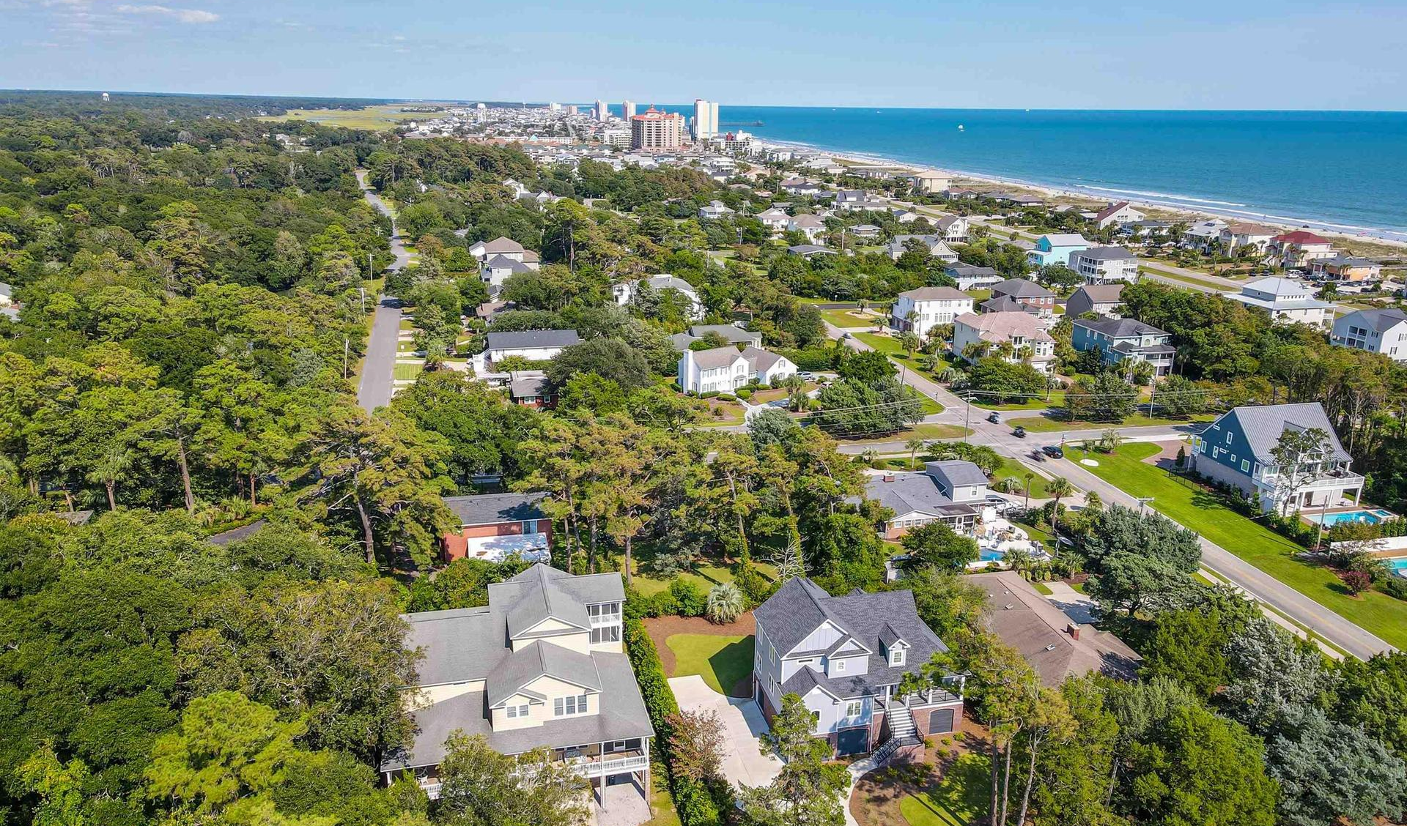
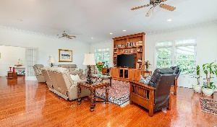
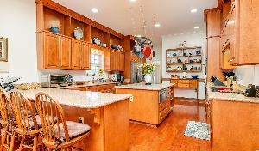
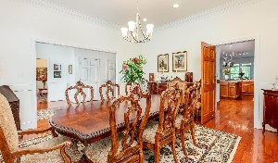
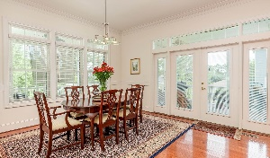
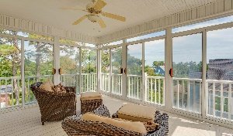
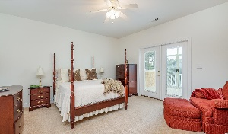
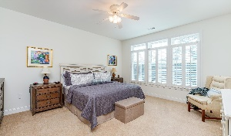
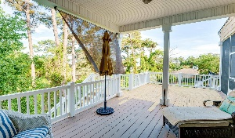
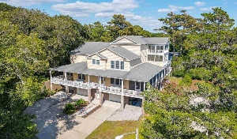
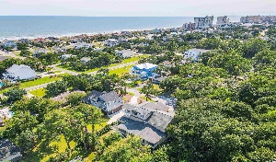



COLOSSAL LUXURY HOME STEPS FROM THE OCEAN
304 10th Ave N
Tilghman Estates
North Myrtle Beach, SC 29582
MLS#2123636 ~ $1,659,000
Steps from the ocean, this colossal, luxury home is being sold with upscale furnishings (does not convey list provided). It boasts an internal private elevator convenient to all four home levels and with multiple choices for master suites. The formal dining room easily accommodates 12, and there are both a great & bonus rooms for entertaining families or multiple foursomes, along with some smaller intimate rooms to gather, such as a parlor and small informal Carolina room on the main-living level. Plus, the owner is in the process of adding exterior front stairs for even greater ease of access. There is a roof allowance, too. Other items of interest include: Four geothermal Heat/AC pumps -- water comes from the well in the back garden (low electric bills provided upon request); three 80-gallon hot water heaters; all 5 bedrooms have an en suite with a sixth possible bedroom en suite on the fourth level which is currently used as an office; there are 7 full and 2 half-baths, 5 with walk-in showers; work island & luxury bull-nose granite in the kitchen highlight 42" appealing hardwood cabinets with generous display space; all major kitchen appliances are stainless steel GE Profile, and there is even a warming drawer; 2 laundry rooms on second and third floors, utility area with storage and sink and workshop on the ground level; stunning hardwood floors on the main living level; breathtaking porches with views on three sides to relax and refresh there, hear the waves and to enjoy the ocean breezes, even on the warmest day; parking for up to 10 vehicles; windows are hurricane-rated up to 120 mph; Old Republic top-of-the-line Platinum Home Warranty; all the room you could ever want and huge, numerous closets and lots of storage and a variety of fun places to dine, from porches to big dining space in the kitchen, including a breakfast bar! Easy stroll across N. Ocean Blvd. oceanfront to dedicated public beach access with parking. This custom-built home is nothing less than magnificent, in coveted historic Tilghman Estates and near everything that makes the OD neighborhood of North Myrtle Beach highly desirable -- for a primary, vacation home or for an investment. Area history is rich. By the 1940s communities were evolving along the North Strand. Simple frame houses, some built on stilts, an inspiration for this raised-beach-style landmark home, rose along the oceanfront. A large tract was developed in 1948 by Charles T. Tilghman, Jr. Tilghman Beach benefited from protective covenants and sound planning, becoming an upscale residential enclave known as Tilghman Estates, where this signature home is situated in a private cul-de-sac which backs up to secluded woods. Nearby to the south, Ocean Drive Beach and Crescent Beach were also developed. A pavilion and amusement park drew crowds to play and to dance the state dance, The Shag. Windy Hill Beach was developed after World War II. The beach boomed in the 1960s, and new golf courses also expanded “beach season” to year round. Neighboring Cherry Grove has always been a home away from home for visitors. The small beach community received its name from Cherry Grove Plantation, which occupied the area in the early 1700s and is home to architectural treasures, the Cherry Grove Pier and Swing Bridge. In 1968 Cherry Grove, Ocean Drive Beach, Crescent Beach, and Windy Hill consolidated into North Myrtle Beach. North Myrtle Beach is now a Top 5 beach town in the U.S. and the number-one family beach. It is the safest city in the Carolinas and has the lowest millage of any such full-service city. It is literally minutes to the beach, shopping, dining, entertainment, medical services, outstanding schools & parks and access to highways and airports. It represents a lifestyle, to do as much as you desire or to just appreciate the quiet of the location in its pristine, historically important surroundings. There may be no place left in the world quite like this wonderful home for the generations.
3D Virtual Tour: https://my.matterport.com/show/?m=X8ADizrwmse
Video Tour: https://youtu.be/M1NFec2JCrw
Connie Ross-Karl
702-306-2643
conniesross@aol.com
Ronnie Nichols
Realtor
Broker in Charge
NEW WAY PROPERTIES MYRTLE BEACH

