Slide 1
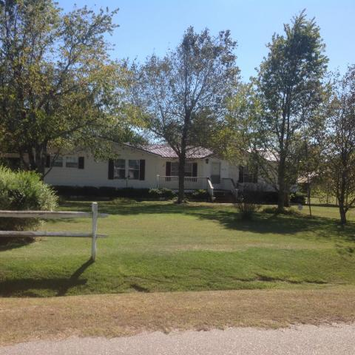
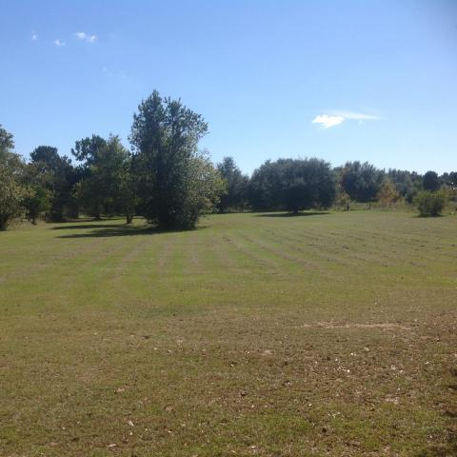
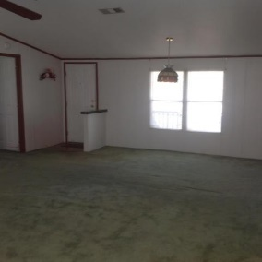
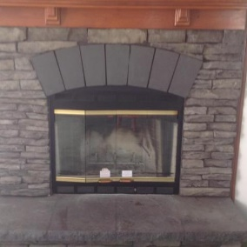
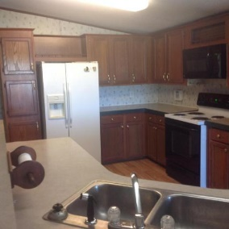
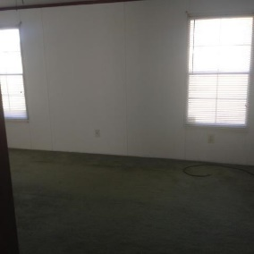
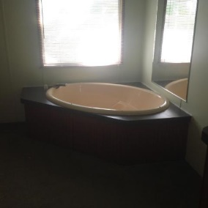
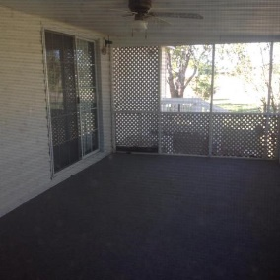
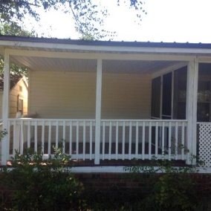
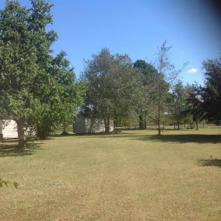
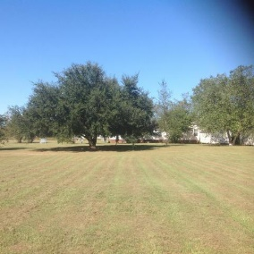
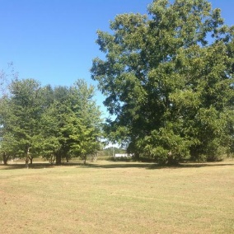

Great Property For Multiple Homesites!
304-308 Michelle Street
Eutawville, SC 29048 | MLS# 17026801 | $149,900
BEAUTIFUL 5 ACRES SITE WITH MATURE TREES. THIS WELL MAINTAINED 4 BEDROOM AND 2 BATH HOME JUST GOT NEW METAL ROOF WITH LIFETIME WARRANTY (JUNE 2017). PROPERTY WAS ORIGINALLY (2) 2.5 ACRES TRACTS. ONE TRACT HAS WELL AND SEPTIC FROM PREVIOUS DWELLING. THIS PROPERTY WOULD BE GREAT FOR A FAMILY MEMBER TO BUILD NEXT DOOR OR OPPORTUNITY FOR INVESTMENT POTENTIAL. BUYER AND BUYERS AGENT PLEASE VERIFY INFORMATION OF IMPORTANCE.
Carla C Davis
Mobile - (843) 437-4873
gaweber@tds.net
AgentOwned Premiere Group
141 A N. Main Street
Summerville, SC 29483

