Slide 1
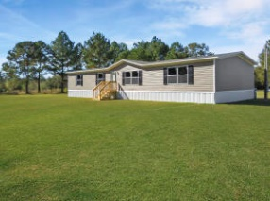
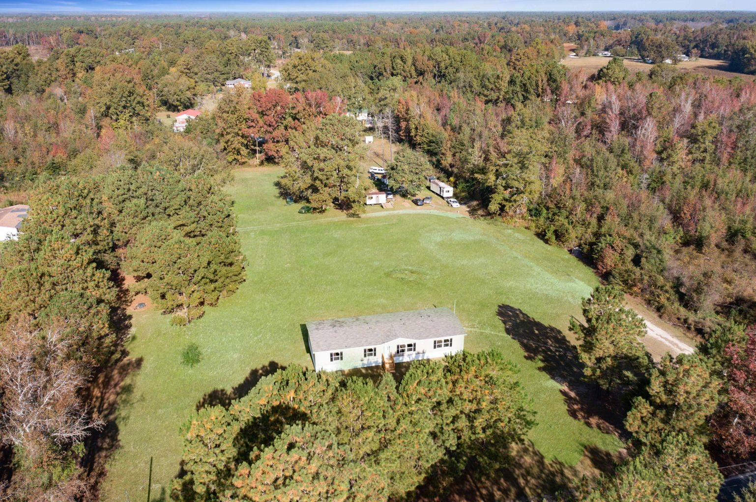
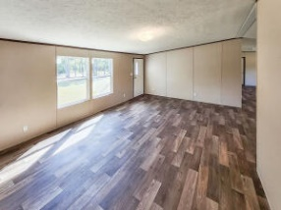
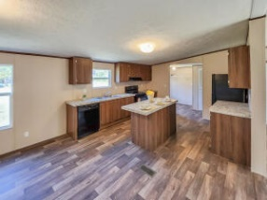
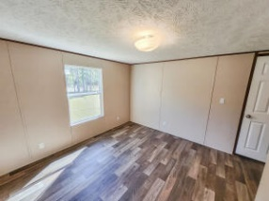
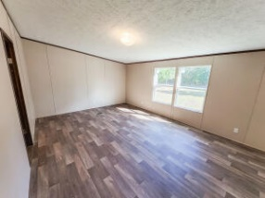
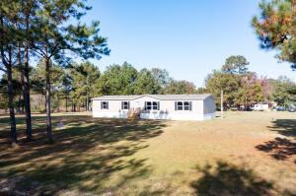
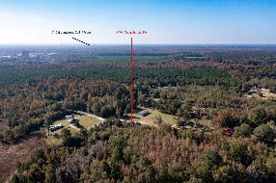
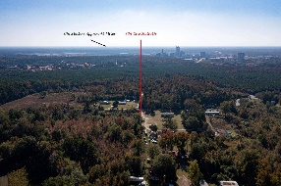
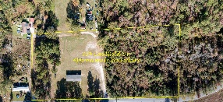


304 Caufield Court Holly Hill, SC 29059 | MLS# 22027341 | $375,000
Price Improvement!
2022 Manufactured Home on 5.4 Acres!
Open House
Wednesday, 7/20
3-5PM
Enjoy the peace and tranquility of the country life in your brand new 2022 Tru Home double wide manufactured home on 5.54 acres!
Located only 33 minutes from Summerville, 20 minutes to Lake Marion, and just an hour's drive to Charleston! This home offers 4 bedrooms, 2 full baths, 1904 Sq. Ft, brand new 2022 HVAC unit, spacious interior, vinyl flooring, and full appliance package!
Do you have horses? This is an ideal location! Schedule your exclusive showing today before this great opportunity is gone!
Brandon Ray
(843) 499-1928
brandon.ray@carolinaone.com
www.therightrayhome.com
Carolina One Real Estate
900 N Main St
Summerville, SC 29483

