Slide 1
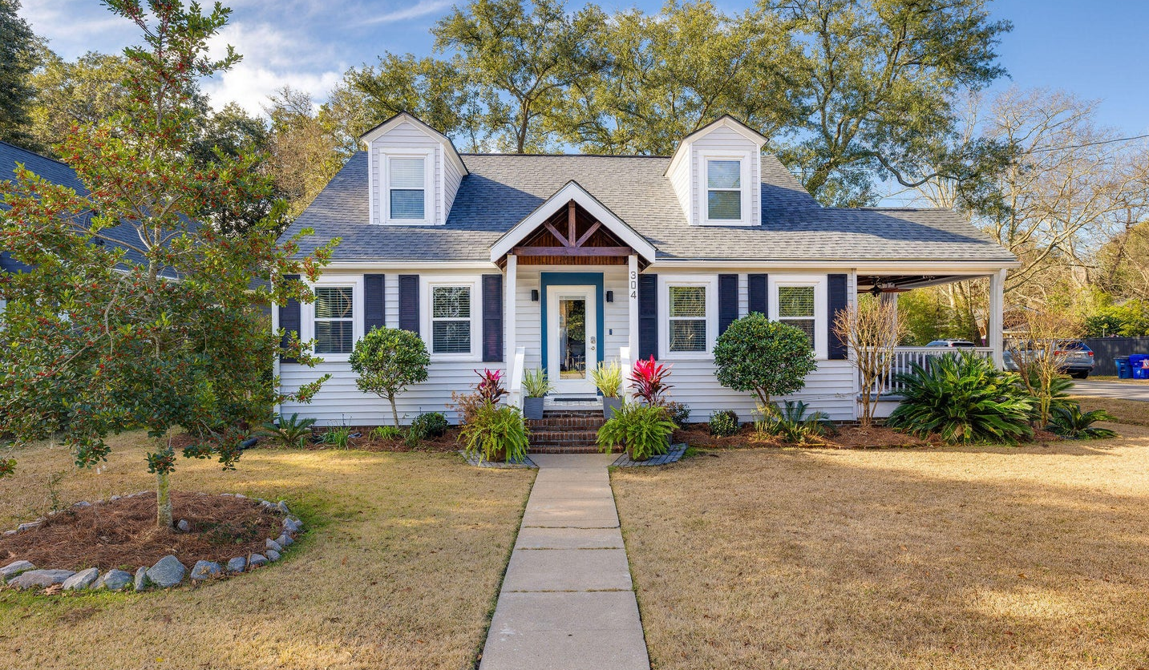
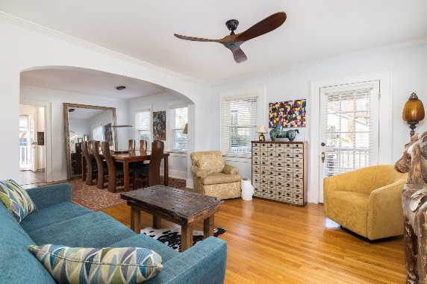
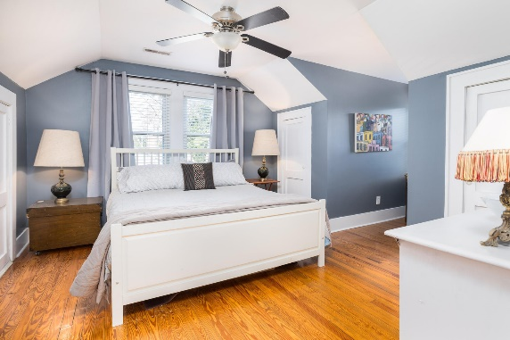
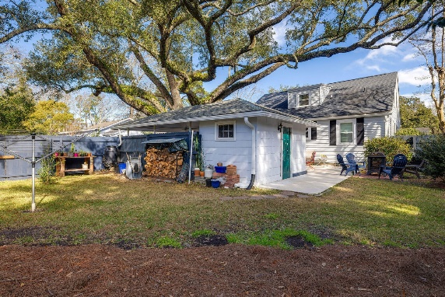

UPDATED 4 BEDROOM
HOUSE IN AVONDALE
304 Magnolia Road
Carolina Terrace | Charleston, SC 29407 | MLS# 24003112 | $899,000
Welcome to 304 Magnolia Rd, a stunning craftsman-style home nestled in the heart of Charleston, SC. This residence combines modern luxury with classic charm, offering a lifestyle of convenience and elegance, located just a short walk to Avondale, five minutes to downtown Charleston, and fifteen minutes to the sandy shores of Folly Beach. Nestled on a large corner lot, this 1810 sq ft residence features 4 bedrooms and 3 bathrooms, providing ample space for comfortable living. Step inside and discover a renovated kitchen that reflects an unwavering commitment to detail. Slow close drawers, discrete power outlets, and a high-end below-counter beverage fridge create a culinary haven that's both stylish and functional.
Indulge in quiet moments of relaxation on the side porch, offering the perfect setting to relax and to connect with new neighbors. The fenced-in backyard, shaded by a grand oak tree, provides a tranquil oasis, while the detached carport with an attached outdoor storage shed adds convenience to your daily life. Entertain effortlessly on the large back patio, or host more formal gatherings in the distinguished formal dining and living rooms adorned with a beautiful arched doorway. Every corner of this home exudes classic charm and timeless elegance.
The primary suite becomes a luxurious retreat complete with a steam shower and dual vanities. Don't miss the second full bathroom downstairs which is cleverly situated under the stairs. Not just a feast for the eyes, this home also ensures peace of mind with a fully encapsulated crawlspace, enhancing the property's durability and energy efficiency. Discover the epitome of Southern living at 304 Magnolia Rd. Schedule your tour today to experience the perfect harmony of style, comfort, and practicality that this residence has to offer.
Kelly Snyder
843-457-5951
kelly.snyder@agentownedrealty.com
Greg Gelber
843-494-2354
greg.gelber@agentownedrealty.com
AgentOwned Charleston Group | 902 Savannah Hwy | Charleston, SC 29407-7802

