Slide 1
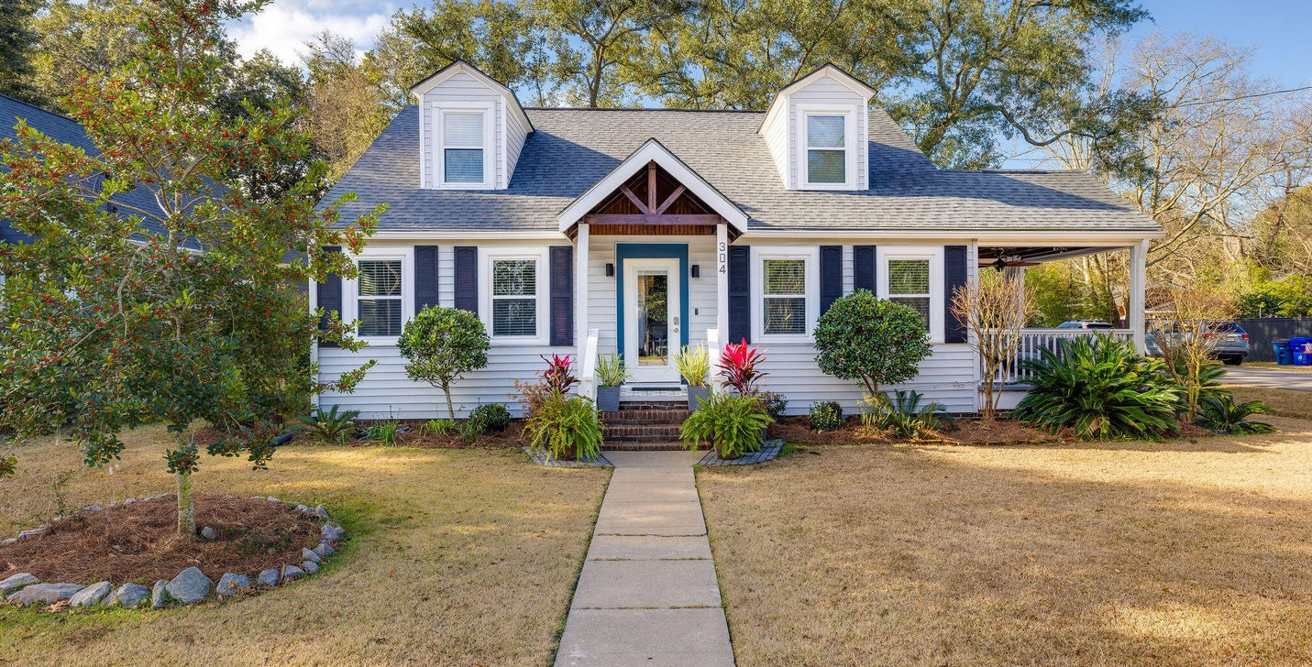
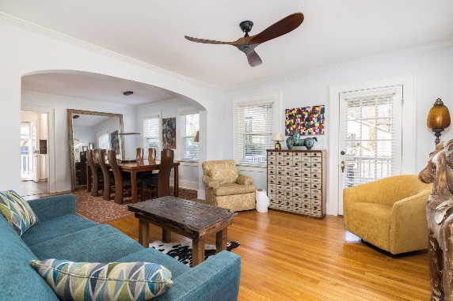
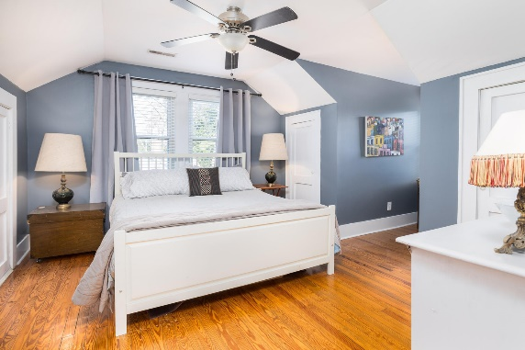
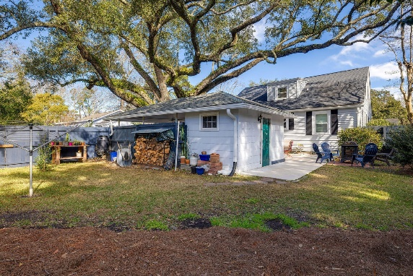

Avondale Home - Schedule Your Showing Today!
304 Magnolia Road
Carolina Terrace | Charleston, SC 29407 | MLS# 24010773 | $835,000
This stunning home is conveniently located just a short walk to Avondale, five minutes to downtown Charleston, and fifteen minutes to the sandy shores of Folly Beach. Nestled on a large corner lot, this 1810 sq ft residence features 4 bedrooms and 3 bathrooms, providing ample space for comfortable living. Recent updates include: full kitchen renovation (2021), updated bathrooms (2021), roof (2017), new windows, new HVAC units (2022), new duct work, and encapsulated crawl space w/ dehumidifier. The fully renovated kitchen has slow close drawers, high-end appliances, a built-in wine fridge, and a pot filler above the gas range. Indulge in quiet moments of relaxation on the side porch, offering the perfect setting to relax and to connect with new neighbors.
The fenced-in backyard, shaded by a grand oak tree, provides a tranquil oasis, while the detached carport with an attached outdoor storage shed adds convenience to your daily life.
Entertain effortlessly on the large back patio, or host more formal gatherings in the dining and living rooms adorned with a beautiful arched doorway. Every corner of this home exudes classic charm and timeless elegance.
The primary suite becomes a luxurious retreat complete with a steam shower and dual vanities. Don't miss the second full bathroom downstairs which is cleverly situated under the stairs.
Discover the epitome of Southern living at 304 Magnolia Rd. Schedule your tour today to experience the perfect harmony of style, comfort, and practicality that this residence has to offer.
Kelly Snyder
843-457-5951
kelly.snyder@agentownedrealty.com
Greg Gelber
843-494-2354
greg.gelber@agentownedrealty.com
AgentOwned Charleston Group | 902 Savannah Hwy | Charleston, SC 29407-7802

