Slide 1
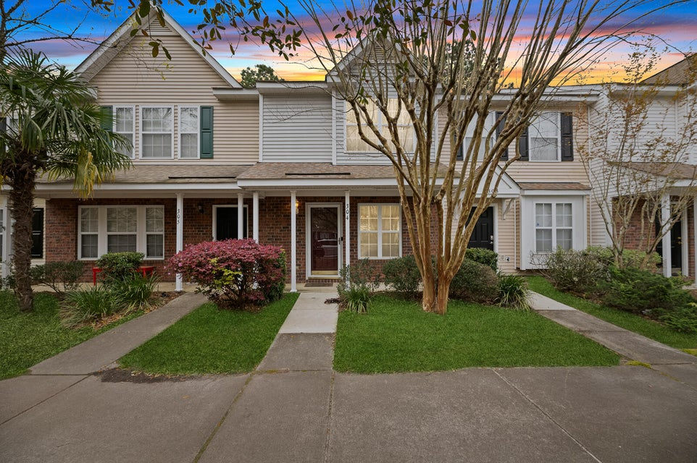
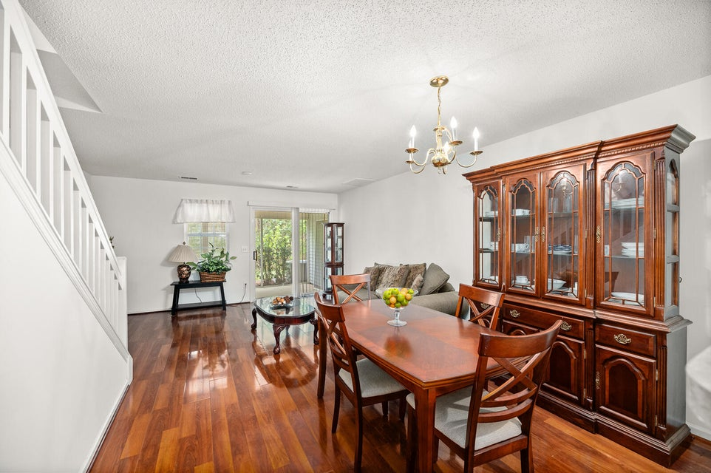
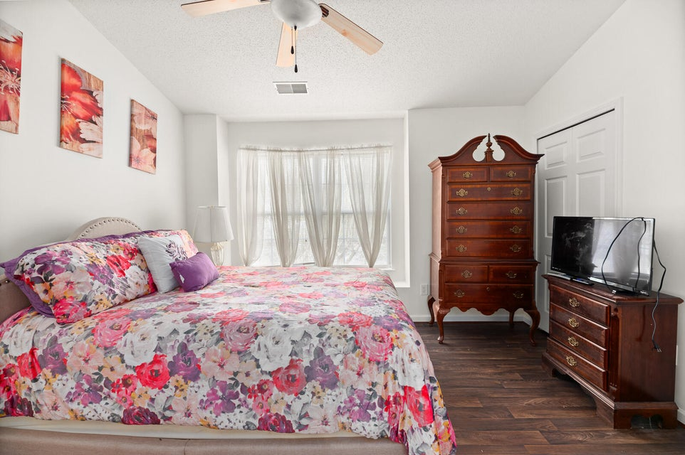
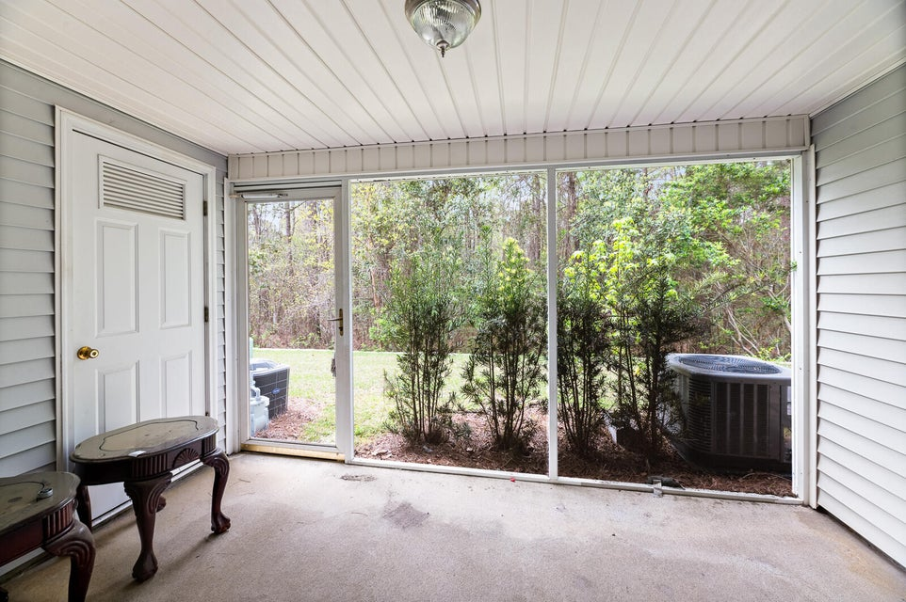


Charming 2 Bed, 2.5 Bath Home with Seller Concessions
304 Tree Branch Circle
Summer Wood | Summerville, SC 29483 | MLS# 24023097 | $235,000
Welcome to your new home sweet home! This charming 2-bedroom, 2.5-bathroom townhouse offers the perfect blend of comfort, convenience, and relaxation. Step inside and be greeted by a spacious open floor plan, featuring a cozy living area bathed in natural light. The kitchen offers ample counter and cabinet space, along with a pantry. The main level has a half bath, closet with storage under the stairs, bar seating at the kitchen/dining area, living room Upstairs, you'll find two generously sized bedrooms, each offering plenty of closet space with a laundry room closet in the hallway. . Both rooms offer its own private ensuite bathroom, providing a tranquil retreat at the end of a long day.
But that's not all - this townhouse also features a delightful screened-in patio porch, where you can savor your morning coffee or unwind with a good book while enjoying the fresh air and serene surroundings. Two assigned parking spots are designated for this home. Never worry about maintenance since the HOA covers all of your lawn work...(inside any fence is the owner's responsibility), external hazardous insurance (owner only needs to hold an H06 policy), two neighborhood pools, termite bond, pressure washing and fresh pine straw once a year for all of the homes.
Located in a desirable neighborhood with less than a 10 minute commute to Historic Downtown Summerville where the Town of Summerville hosts plenty of events with easy access and short distance to plenty of shopping, restaurants, walking & bike trails, I-26, Nexton and a short commute to the Walmart warehouse, Volvo plant, and still easy access to Boeing, Airport, Bosch, Hospitals and less than a 25 minute commute to Historic Downtown Charleston. Don't miss the opportunity to make this house your place to call home! If schools and square footage are important, please verify.
Don't miss out on the opportunity to make this wonderful townhouse your own. Schedule your showing today and start envisioning the vibrant lifestyle that awaits you!
Nyashia Gilliard
843-695-7221
screalestatediva@gmail.com
Changing Lives Forever Home Solutions | 2060 Northbrook Blvd, STE 103 | North Charleston, SC 29406

