Slide 1
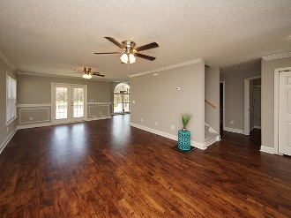
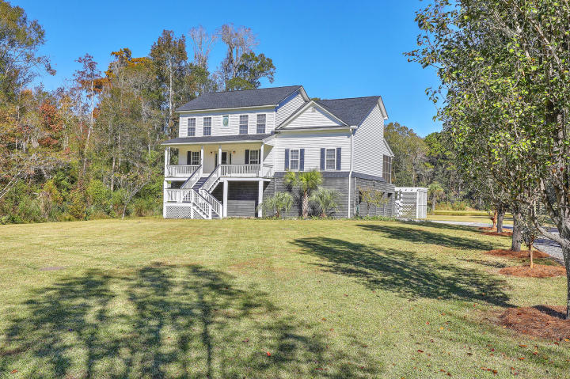
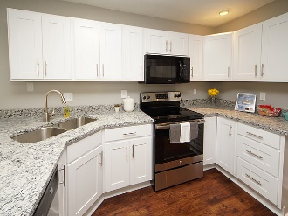
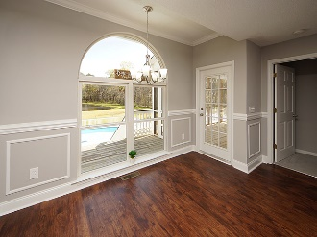
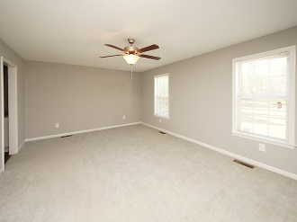
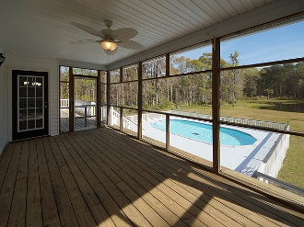
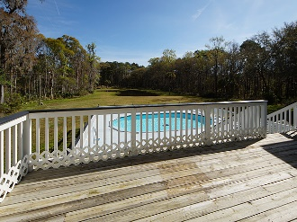
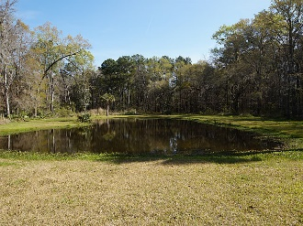
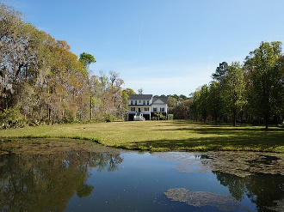
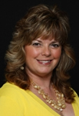


Open House Saturday July 21st from 2-6 pm
3050 Murraywood Road
Johns Island | MLS# 17031186 | $625,000
Gift Card Giveaways
Bring your buyers and business cards and WIN!
Light refreshments, Wine & Cheese will be served.
Gina Brammer, Realtor
(843) 437-7828
ginabrammer1@gmail.com
AgentOwned Premiere Group | 1800 Trolley Rd | Summerville, SC 29485

