Slide 1
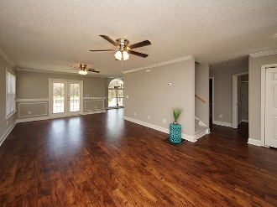
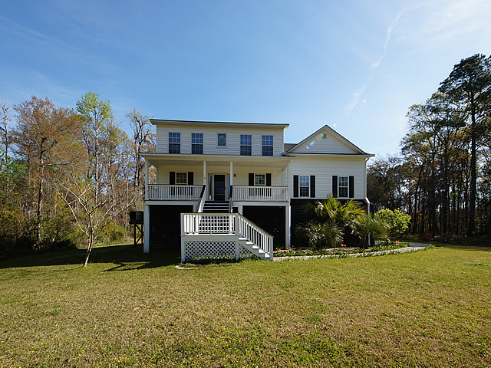
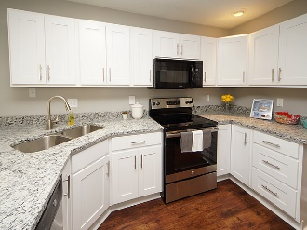
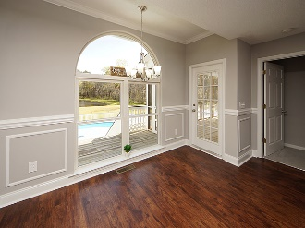
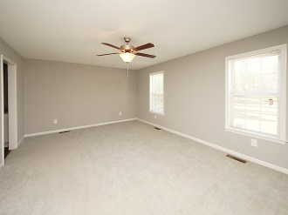
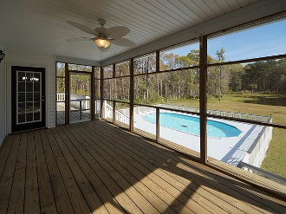
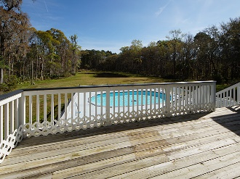
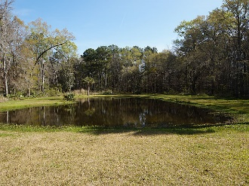
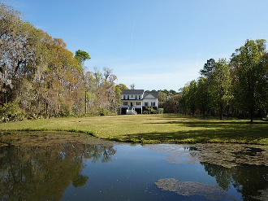



COME SEE!! PRICED TO SELL ON JOHNS ISLAND WITH 5 ACRES!
3050 Murraywood Road
Johns Island | MLS# 17031186 | $680,000
Johns Island Beauty! This Luxurious property offers several immaculate acres that boast serenity with private pool, ponds and nature! Are you looking for your own paradise secluded by beautiful trees and yet close to dining and shopping? Get ready to be wowed once you enter the NEWLY RENOVATED CUSTOM BUILT HOME that has mostly glass on back of home with stunning views! Tranquil outdoor living space is always available. You will especially enjoy relaxing while floating in your sparkling pool that overlooks the pond and lush landscaping. New Roof! New flooring throughout home including both Master Suites on main and upstairs levels. New renovated kitchen with cutting edge design and high-end granite countertops, white cabinets with easy close drawers, refrigerator, dishwasher, stove, sink and faucet. Screen porch is only a few steps away that brings additional value to home which allows more of the outdoor living space and majestic views. Main level Master Suite is more like a private retreat offering brand New Renovated Bathroom with granite countertops, white cabinets with easy close drawers, two sinks with new faucets, mirrors, light fixtures and new flooring. Huge walk in tile shower, his and her walk in closets with plenty of storage space. The second floor Master Suite has new flooring, massive walk through closet that leads into another room perfect for your office, sitting room or work out area. The second floor Master Bathroom has new flooring and nice size tub/shower combo. All new light fixtures and ceiling fans throughout home. Pool deck and front porch steps newly painted. New Smoke Detectors and Electrical Outlets with covers. All new door locks on every door. 5 Ton Compact HVAC System was installed in 2013 and warranty is transferable to buyers per homeowners. Additional approximate 1,100 sq.ft. is available underneath the home for parking your boat, golf cart or favorite vehicles. This spectacular home has been freshly painted with the magnificent color of Light French Gray. Too many upgrades to list them all. This Executive home is a hidden GEM on Johns Island that has everything you are looking for and won't last long. Very "UNIQUE OPPORTUNITY" to own 5 acres with a private setting, two ponds and a pool on Johns Island with nature that surrounds you. This home is truly a must see to appreciate -schedule to see this one today!
Gina Brammer, Realtor
(843) 437-7828
ginabrammer1@gmail.com
AgentOwned Premiere Group | 1800 Trolley Rd | Summerville, SC 29485

