Slide 1
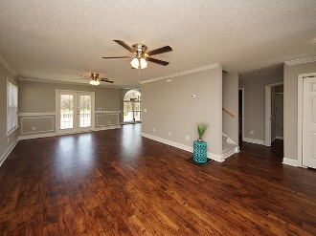
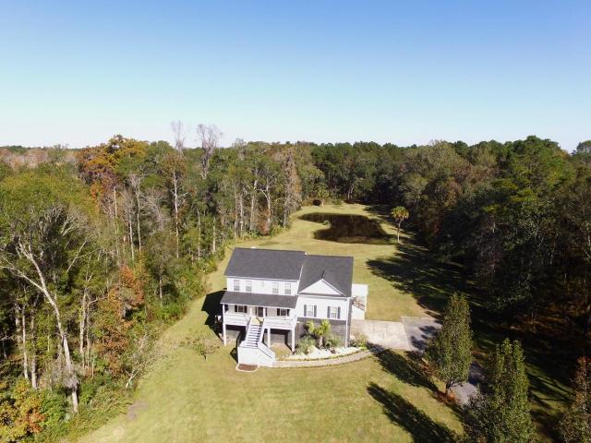
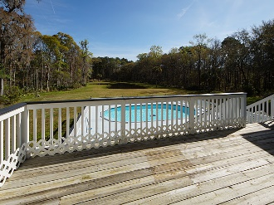
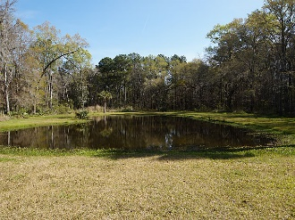
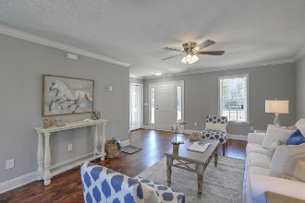
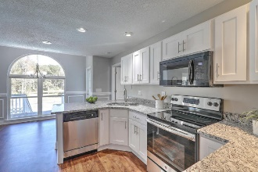
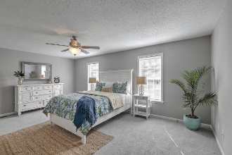
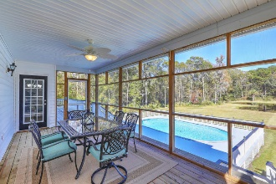
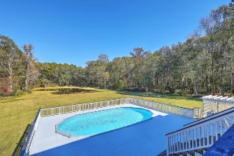
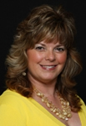


Reduced to $560,000!
Highly Motivated Sellers ~ Ready to Make a Deal
3050 Murraywood Road
Johns Island | MLS# 17031186 | $590,000
Tired of the Hustle and Bustle?
It's time to be free from commotion and enjoy your own tranquil paradise where it is peaceful, quiet, calm, secluded by beautiful trees and yet CLOSE to Downtown Charleston, beach, shopping and dining?
Very "UNIQUE OPPORTUNITY" to own 5 acres with a private setting, two ponds and a pool on Johns Island with nature that surrounds you. It also would make a great investment for an Air B&B or second home because there is no other property like this one on Johns Island! This home is truly a must see to appreciate -schedule to see this one today!
Gina Brammer, Realtor
(843) 437-7828
ginabrammer1@gmail.com
AgentOwned Premiere Group | 1800 Trolley Rd | Summerville, SC 29485

