Slide 1
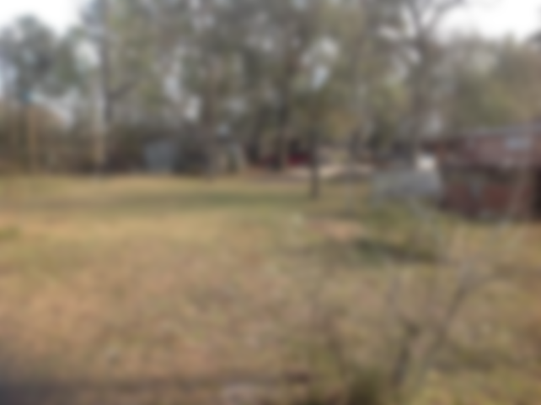
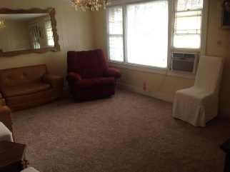
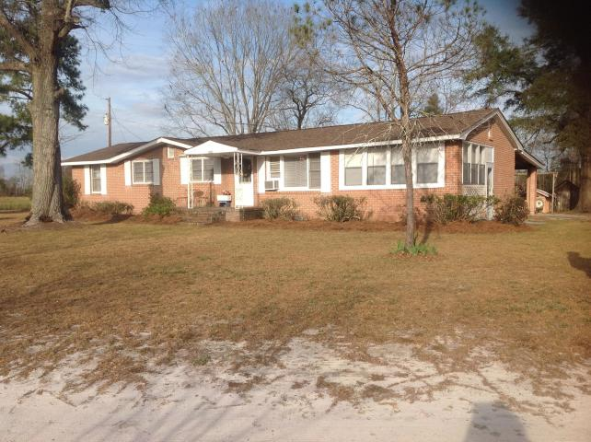
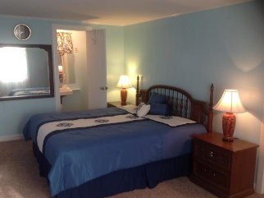
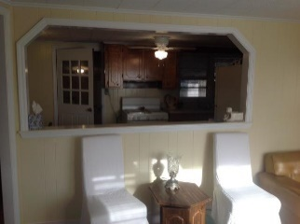
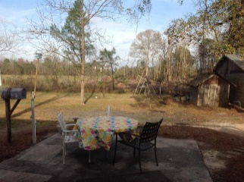
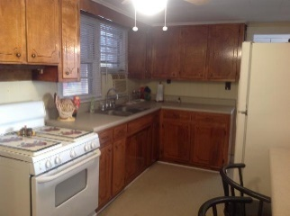
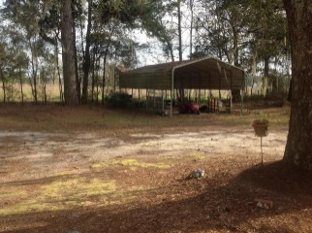

All The Space Your Family Needs!
3 Acres of Peace & Quiet ~ Easy to Show!!
3051 Cattle Creek Road
Branchville, SC 29432 | MLS# 19005764 | $124,900
This 3 bedroom 2 bath home sits off the road on 3 acres with plenty of storage. The roof has been replaced within the last two years. New flooring water pump and tank within the last year. The hall bath has been completely remodeled within the last two years. This is a wonderful starter or home if downsizing. If you are looking for peace and quiet you need to come see this property. Buyer and Buyer agent please verify all information of importance. Please verify schools if important.
Karen Brown
(843) 709-4029
karenbrown22@gmail.com
AgentOwned Premiere Group
141 A N. Main Street
Summerville, SC 29483

