Slide 1
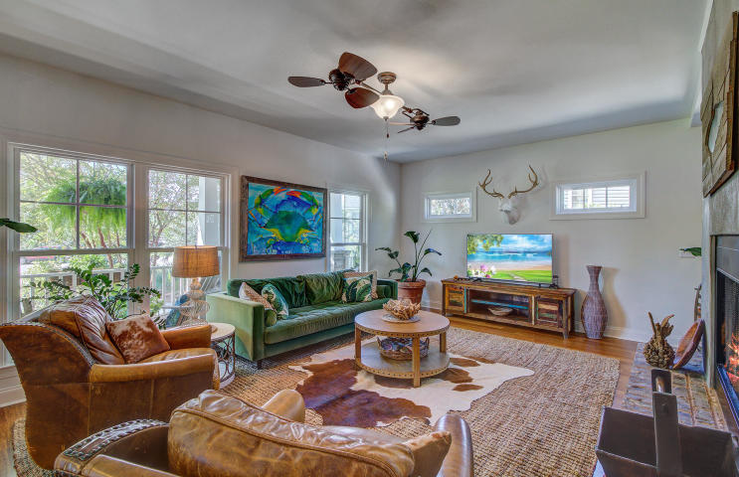
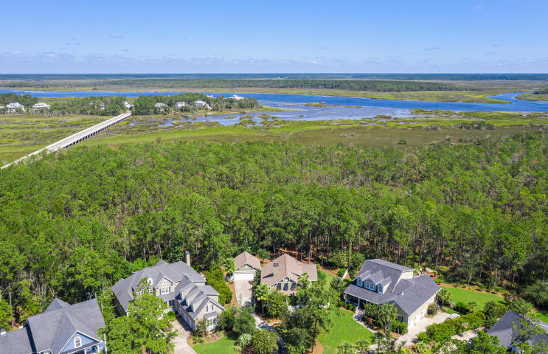
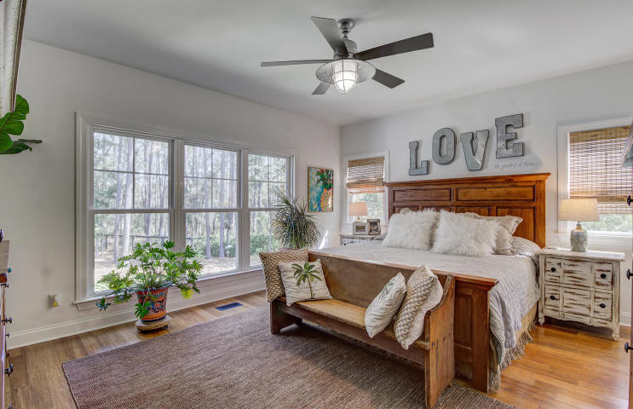
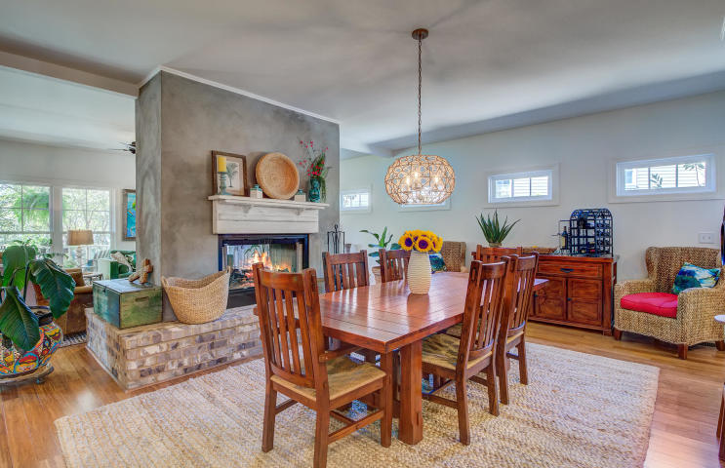
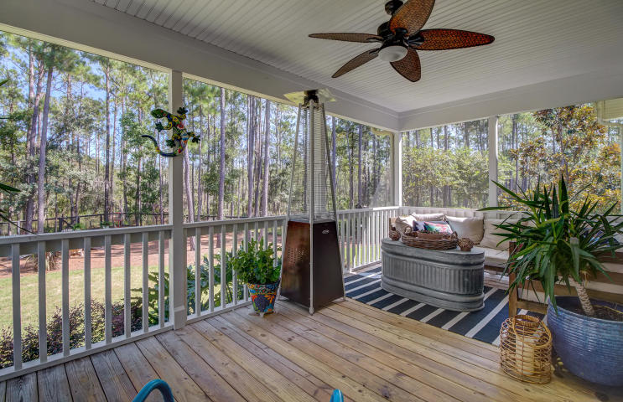
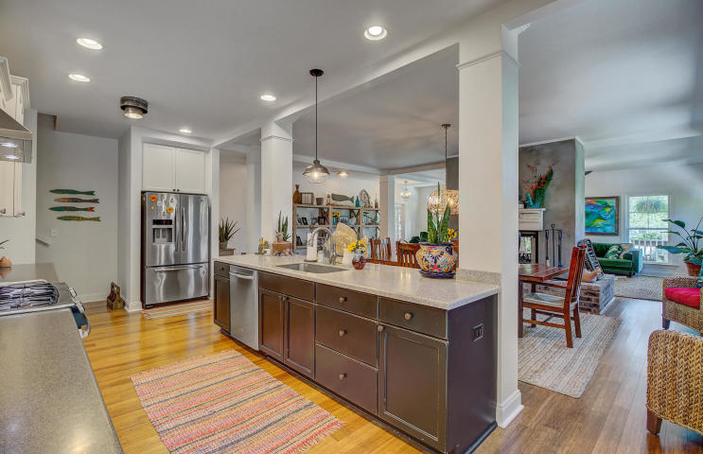
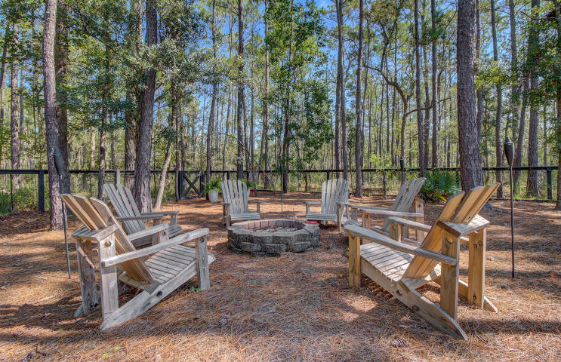


JUST LISTED Stunning Park West Andover Community Retreat
3052 Ashburton Way
Park West
Mount Pleasant, SC 29466
MLS# 20025620 | $649,900
The WHOLE PACKAGE- This is what you have found at 3052 Ashburton Way. As you approach the home you are immediately struck with the magnificent landscape design. This yard is a gardener or landscape enthusiast's dream come true. (See details in the documents section of listing.) The full front porch beckons you to sit and admire the beautiful grounds as you enjoy the peace and quiet at the end of the cul-de-sac. Open the front door and the next thrill awaits- you have found the unique home you have been searching for! Every bit as much care went into the design and finishes inside the home as outside! The architectural design strikes you as you admire the double sided free standing fireplace to be enjoyed while in the family room or kitchen. Stunning bamboo wood floors are found through-out the main level. A large family room on the front of the home is perfect for gathering with friends and family. The kitchen has a huge island and room to seat a large group in the dining area. Bright white cabinets and stainless steel appliances make for an aesthetically pleasing kitchen, and the cook in the house will love that this home is equipped with a GAS range and DOUBLE WALL OVENS! The master bedroom is on the main level, located on the rear of the home ideally situated to take in the views of the expansive wooded back yard. Double sinks and a huge walk in shower make this spacious master bath ideal. A huge walk in closet with a California Closet system will be enjoyed by the owners. An additional bedroom for guests is located on the main level. This room is currently being used as an office, providing a light and bright work space with french doors to provide seclusion when needed. As you head out the back door to the screened porch, you will pass the massive walk in pantry that doubles as a laundry room. This home has amazing storage throughout! The large screened porch will be a favorite spot in the house. Ultra private describes this yard, with a large wooded buffer behind the home that leads to the marsh. The entire yard is fenced in, with natural fence to preserve the views in all the right places. The spectacular landscape design continues in the rear of the home to enhance the natural beauty that already exists on this prime lot. A two car detached garage is at the end of a long driveway that provides plenty of space to park multiple cars. There is room to finish the upper level of the garage if desired, whether for additional storage or living space- a studio, hobby room, or whatever else you desire. Back inside the home travel upstairs to find the next two guest bedrooms, each with their own full bath! This is a fantastic layout, with a bonus room between the bedrooms providing an additional living space, a perfect retreat for guests or play area for children. Don't forget to check out the huge attic space accessed from the bonus room. You will be pleasantly surprised with the amount of storage not only in this space, but throughout the home! 3052 Ashburton Way is located in the sought after Andover community in Park West. Award winning schools are located within Park West, a master planned community with a junior olympic sized pool, additional pool with zero entry and splash features popular with the little ones, tennis courts, a playground, volleyball courts and miles of walking and biking trails. The Mt. Pleasant Recreation Department Park West Complex is the site of numerous football, soccer, lacrosse and basketball games for residents all around town. Shopping, restaurants, local businesses and professional services are all located within this community and young drivers will not have to navigate Rt. 17 in order to get to Wando High School. Additional shopping, including the new Costco, are a short ride from Park West. The beaches at Isle of Palms are a mere twenty minute ride from the Park West community and Historic Downtown Charleston is just a few more minutes away. If you have been looking for a truly special home with a masterfully designed, private yard then your search is officially over!
Check out the virtual tour here: https://my.matterport.com/show/?m=civWTkqGoUM
Ellen O'Neil
Broker/Owner, ABR, e-PRO, CNE
Charleston Realtor of Distinction
(843) 300-8530
www.EllenONeilProperties.com

