Slide 1
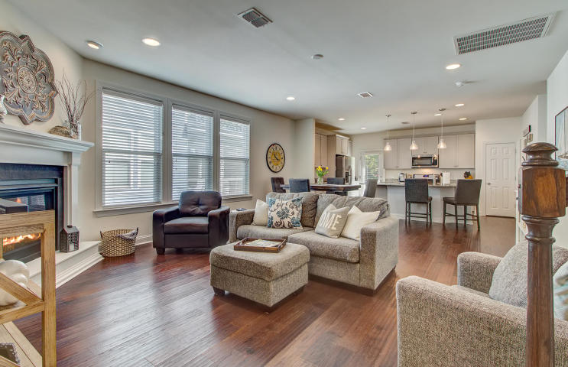
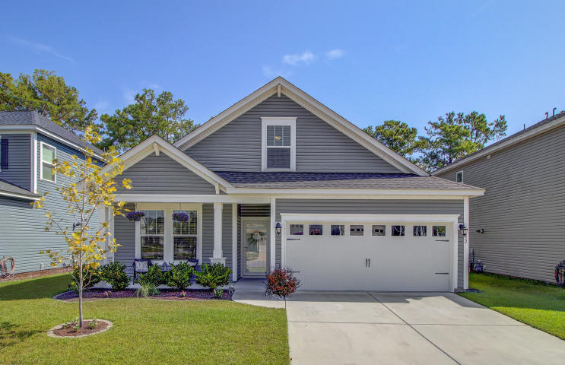
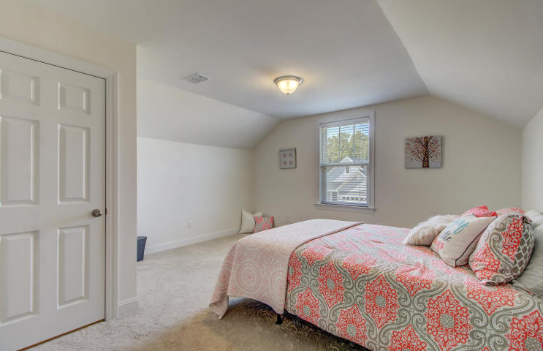
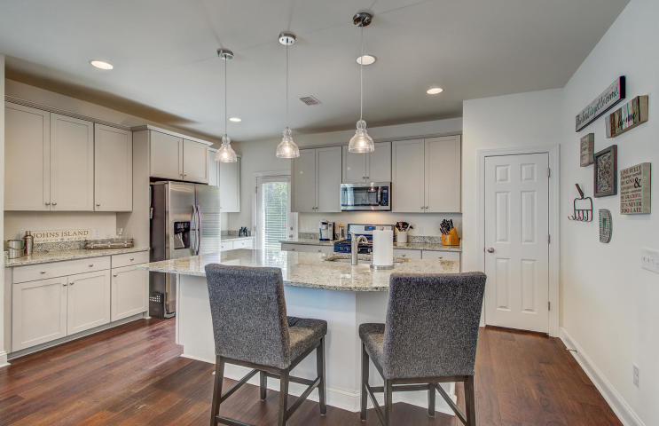
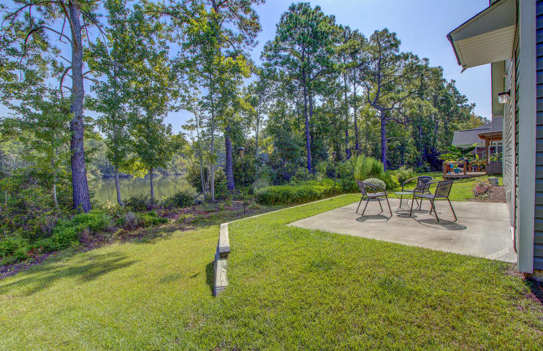
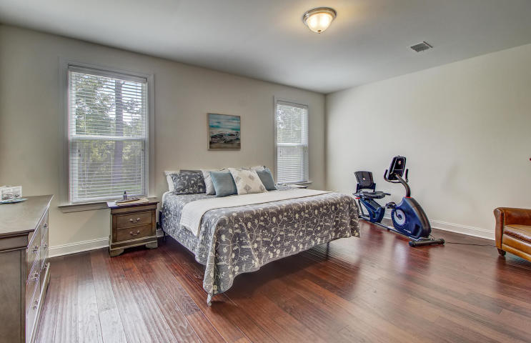
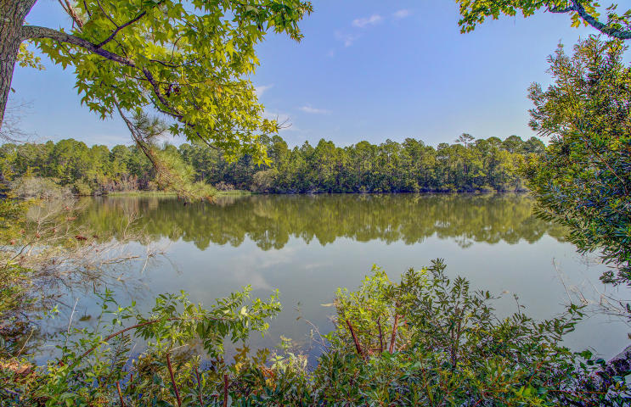


JUST LISTED
Johns Island in Popular Maybank Village
3052 Grand Bay Lane
Maybank Village
Johns Island, SC 29455
MLS# 20024714 | $345,000
A truly special opportunity awaits you at 3052 Grand Bay Lane in popular Maybank Village on Johns Island! This PRISTINE home has been a second home for its current owners and you will be hard pressed to tell that it is not brand new construction. Upon entry you will be thrilled to see the open concept floor plan and there are beautiful wood floors throughout the entire first level! This is a 4 bedroom ranch where the master and two guest bedrooms are on the main level while the fourth bedroom was added to the upstairs. As you walk through the home many beautiful features will stand out: the hardwood floors, gorgeous granite in the kitchen and baths, huge island, natural light flooding the home, and gas fireplace. But do not overlook the details such as pull-out drawers in the kitchen, abundant storage throughout the home (check out the utility closet upstairs- it is like a storage attic, too) and neutral colors throughout. Even the walls in the garage are drywalled and painted! The furnishings throughout the home are available as well. This home was built on a premium lot offering privacy backing up to a huge natural pond. Maybank Village is a prime location in that you are close to Folly Beach, Kiawah, minutes to James Island and a short ride to Historic Downtown Charleston. The restaurants, brewery, shops and businesses lining Maybank Highway are just outside your door! Come see this beautiful home today - it will not last long!
Check out the virtual tour here: https://my.matterport.com/show/?m=4odwBf2DxtQ
Ellen O'Neil
Broker/Owner, ABR, e-PRO, CNE
Charleston Realtor of Distinction
(843) 300-8530
www.EllenONeilProperties.com

