Slide 1
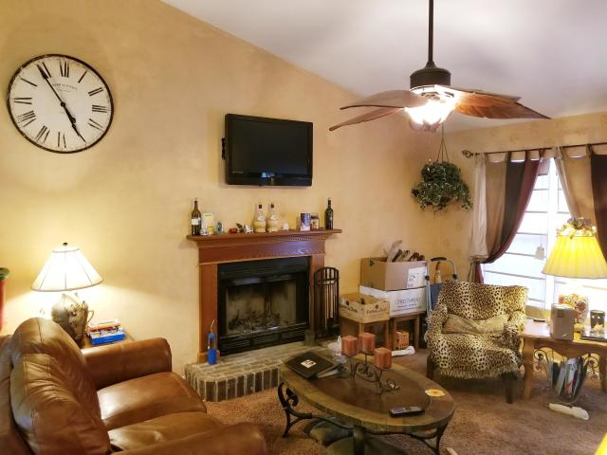
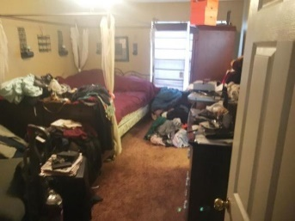
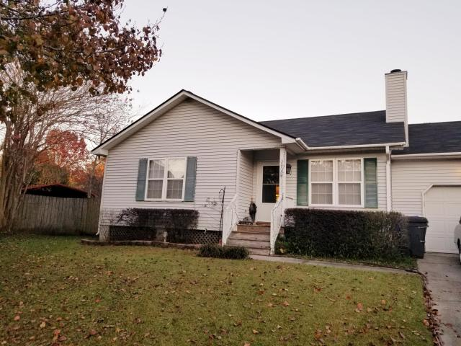
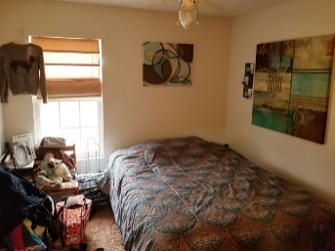
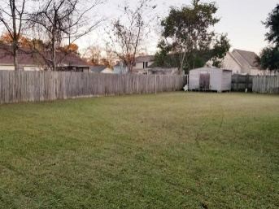

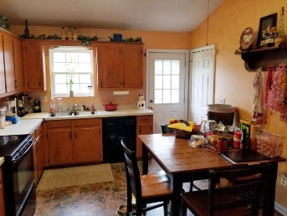

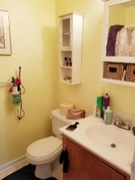
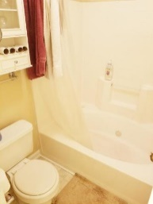
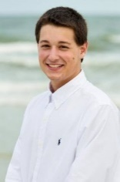

NO HOA + HUGE BACKYARD
Open House Saturday, January 5th - 11am-4pm
3056 Brigham Court
Northwoods Estates ~ North Charleston, SC 29406 ~ MLS# 18032424 ~ $180,000
Now's your chance to own this fantastic home in the desirable Northwoods Estates! This 3 bedroom, 2 bathroom home with a BRAND NEW ROOF is the perfect starter home! As you walk in, you are welcomed by the wood-burning brick fireplace in the comfy living room with vaulted ceilings. The kitchen has plenty of counterspace to accompany cooking for friends and family during the holidays. The kitchen comes with appliances including the refrigerator, electric range, and dishwasher - so no need for purchasing! Great size master with garden tub in the master bathroom. The private and fenced backyard is huge - perfect for playing with the kids, pets, or hosting Summer get-togethers. There's also an insulated shed - great for storing tools, outdoor equipment, decorations and more.
There's NO HOA FEES in Northwoods, but comes with full service trash removal and newly repaved roads throughout the subdivision. Minutes away from restaurants, shopping, gas stations, and other retailers AND right around the corner from A.C. Corcoran Elementary School! Come see this gorgeous home today!
Nick Mazzilli
(843) 640-5575
nick@nickmcharleston.com
www.nickmcharleston.com
Reside Real Estate LLC
155 Wingo Way Unit 421
Mt. Pleasant, SC 29464

