Slide 1
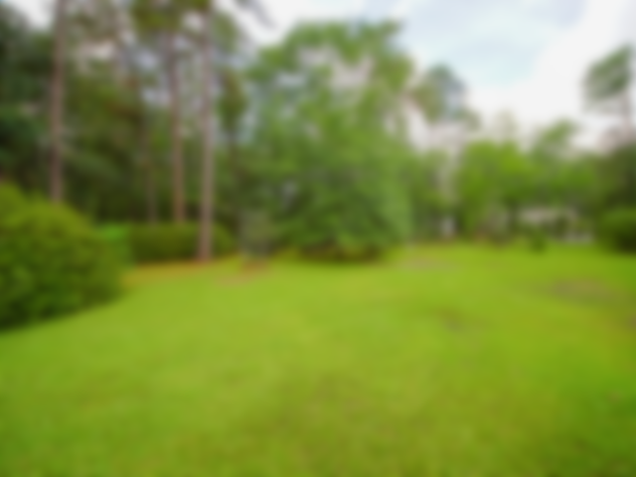
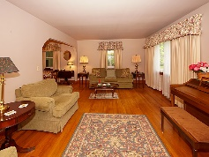
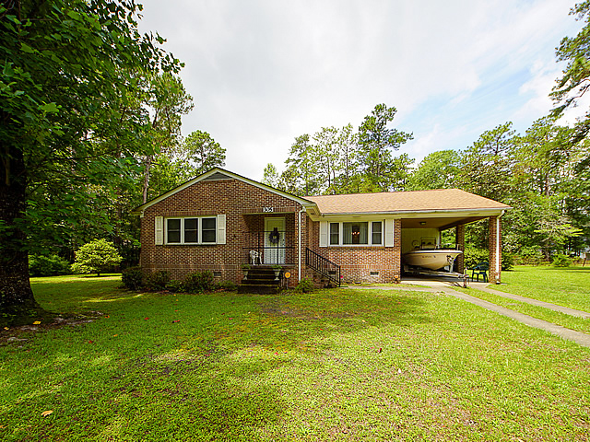
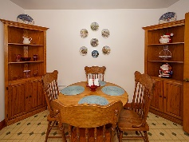
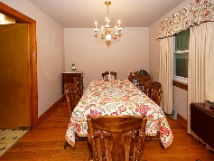
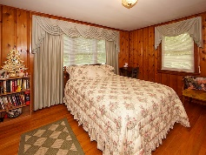
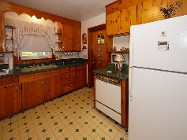
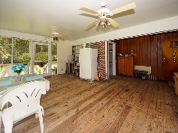
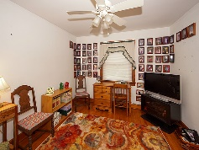
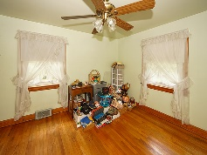
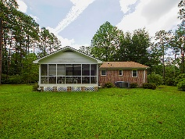
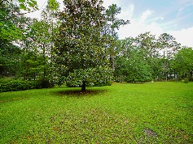
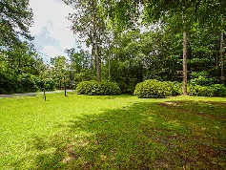


305 Parkwood Drive
Shepard Park | Summerville, SC 29483 | MLS# 19020585 | $650,000
Custom home on beautiful lake!
One-Owner Home with 2.5 Acre Lot
Wonderful opportunity to acquire this one-owner home with large beautiful lot. This 3-bedroom brick home has nice curb appeal and quaint interior features. There are hardwood floors throughout the main living areas of the home and large windows providing lots of natural light. The living room/dining room combination provides a pleasant spot to entertain family and friends. There are attractive built-in bookcases with cabinetry underneath perfect for displaying books and storing household goods. The eat-in kitchen provides a nice area for dining, and the original cabinets provide lots of room for storage of kitchen items. This home has three bedrooms and a hall bathroom with original tile features. There is a large screened porch on the back of the home overlooking the 2.56 acre lot. To the right of the home is a 2-car detached garage with extra space for a workshop. This building would be ideal for additional car storage, a handyman's work area, or just household storage. The owners have thoroughly enjoyed their yard...many azaleas are on the property, and they provide lovely blooms and color to the property in the spring. A small blueberry patch has been lovingly maintained through the years for the enjoyment of family and friends. This house is close to town and is in a lovely area of Summerville. This would be a great place to call home!
Gay Hartmann
M (843) 607-3400 | O (843) 871-9000 | F (843) 202-2958
ghartmann@carolinaone.com
Carolina One Real Estate | Summerville, Trolley Road Office | 1530 Old Trolley Rd | Summerville, SC 29485-8225

