Slide 1
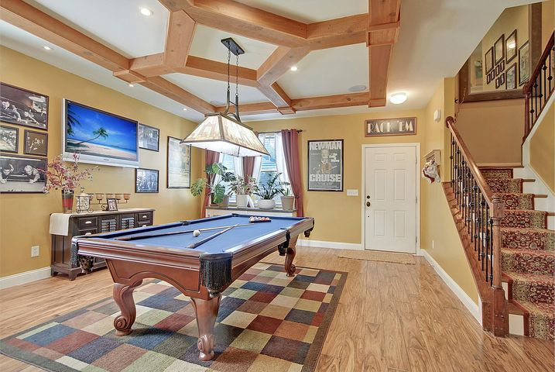
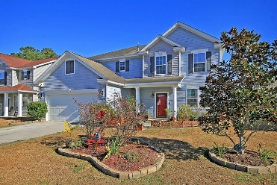
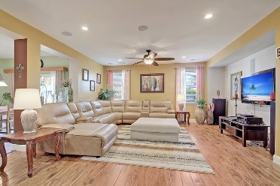
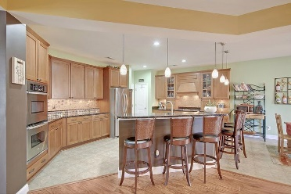
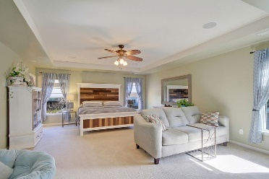
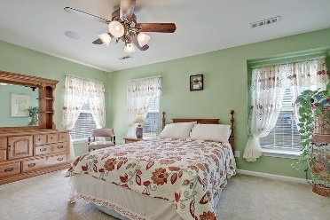
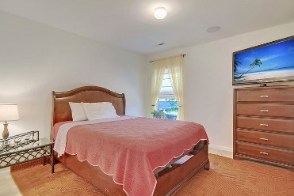
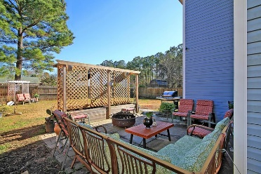
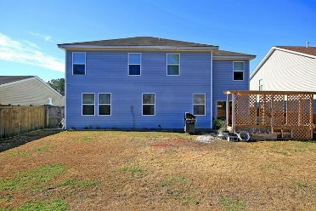

305 Duck Pond Lane
Blackberry Creek · Summerville, SC 29483
MLS# 21000059 · $335,000
Gorgeous Listing
New Low Price ~ Huge House!
Beautiful 4-5 bedroom, 2.5 bath home with wonderful curb appeal featuring a tranquil koi pond, covered front porch perfect for rocking chairs and established landscaping! Upon entering the home you are greeted with gorgeous porcelain tile flooring through out the first level that looks like Acacia wood, this continues on the stairs and upstairs hallway, open floor plan, custom woodwork detailing, and an abundance of natural light. The game room/flex room is to the right and is spacious enough to hold a regulation sized pool table. Continuing in is the huge family room that is large enough for an oversize sectional sofa and super-sized TV. The chef inspired gourmet kitchen is every cooks dream: double ovens, gas cook top, custom vent hood, stainless steel appliances, custom 42" cabinets, granite, island with room for 6 stools, single bowl sink, pantry and eat-in area. Off the family room is also an office/workout/5th bedroom with stunning barn door with metal inlay-a must see! The impressive master bedroom suite is upstairs and features a sitting area with wine/coffee bar that is ideal for watching a movie at night with a chilled drink from the mini-fridge or enjoying a morning cup of coffee without needing to leave your private haven. The master also features a trey ceiling, walk-in closet, and relaxing ensuite bath with dual sink vanity, water closet, tub/shower and linen closet. There are 3 additional nicely sized bedrooms that share a full bath and laundry room upstairs. The backyard is large and fenced and has a private patio area perfect for the outdoor enthusiastic with room entertaining and grilling with friends and family. The house is also wired for sound in every room, including waterproof speakers in the the bathrooms. Also has sound outdoors in the front and back yard, as well as in the attached 2 car garage. Blackberry Creek in Summerville, SC is a wonderfully landscaped neighborhood with a community park. The neighborhood is close to local shopping and grocery stores and is a short drive to downtown Charleston with 5-star restaurants, world class shopping and iconic history as well as a short drive to the beaches, the airport, Boeing, Volvo and Mercedes. Come take a look because you will not find another home that offers as much as this one!
Take a video tour: https://vimeo.com/495653448
Stan Huff
843-670-2835
stan.huff@agentowned.com
Jill Marcacci
843-297-5590
jill@agentowned.com
www.agentownedrealty.com
AgentOwned Realty Co. Preferred Group, Inc. | 824 Johnnie Dodds Blvd | Mt Pleasant, SC 29464

