Slide 1
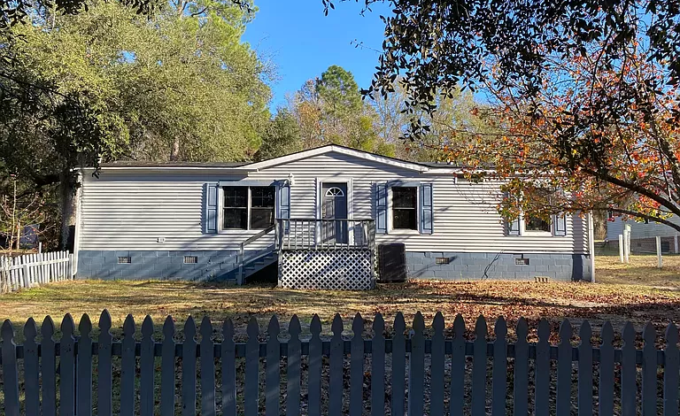
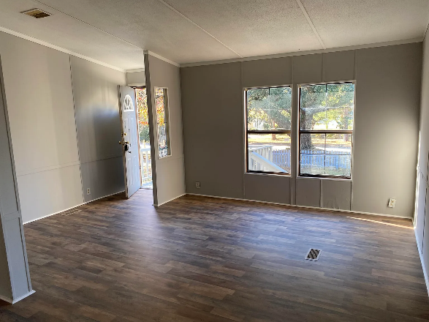
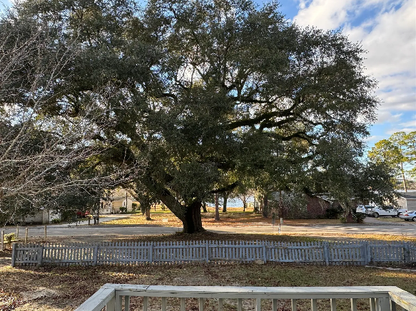
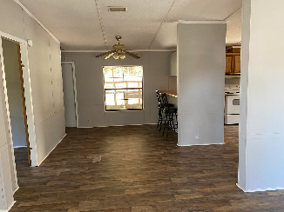
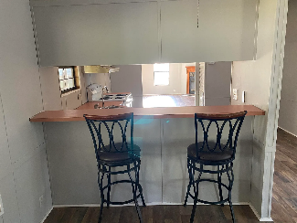
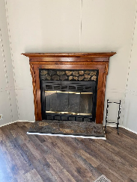
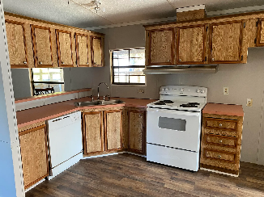
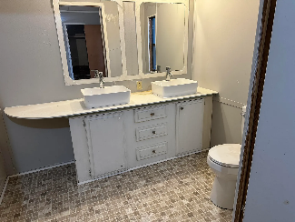


STEPS FROM LAKE MARION
305 Fountain Lake Drive
Eutawville, SC 29048
MLS# 24001222
REDUCED PRICE! $159,000
CHARLESTON SINGLE STYLE HOME
4 BEDS/2.5 BATHS/LOFT
MASTER BEDROOM DOWN
YARD W/PRIVACY FENCE
HARDIPLANK SIDING
HOME ONLY 2 YEARS OLD
QUARTZ COUNTERTOPS
STAINLESS APPLIANCES
REFRIGERATOR INCLUDED
COVERED PORCH
PERFECT JOHNS ISLAND LOCATION
1 MILE FROM SEVERAL RESTAURANTS/SHOPS
BLINDS AND WASHER/DRYER INCLUDED
LESS THAN 10 MILES TO DOWNTOWN CHARLESTON
12 MILES TO KIAWAH OR FOLLY BEACH
THIS 3 BEDROOM/2 BATH HOME IS LOCATED JUST A MINUTE AWAY FROM LAKE MARION (WITH PUBLIC BOAT LANDING), HAS VIEWS OF THE LARGE LAKE ACROSS THE STREET AND GORGEOUS OAK TREES IN THE YARD! SOME OF THE WONDERFUL IMPROVEMENTS MADE IN THE PAST 3 MONTHS INCLUDE NEW PAINT, NEW VINYL FLOORS IN MOST OF THE HOME, VAPOR BARRIER, NEW PUMP ON WELL, NEW BACK DOOR AND PRESSURE WASHING. NEW FLOOR COVERING IN MASTER AND SECOND BATHROOMS IN AUGUST 2024 ALSO SECOND AND THIRD BEDROOMS. THE HVAC WAS JUST SERVICED IN NOVEMBER 2022. AFFORDABLE PRICE AND GREAT LOCATION!
Carla Davis
843-437-4873
gaweber@tds.net
Adler Realty
518 Parrot Point Dr
Charleston, SC 29412
www.adlerrealtychs.com

