Slide 1
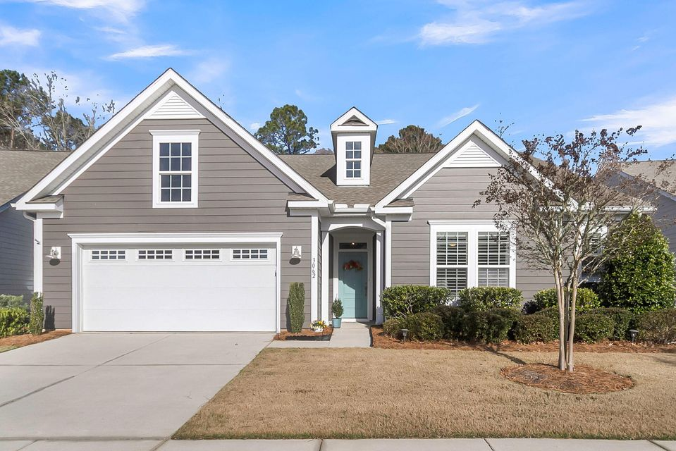
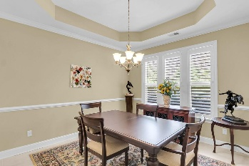
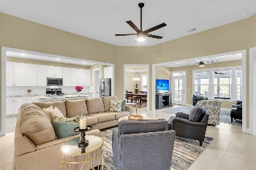
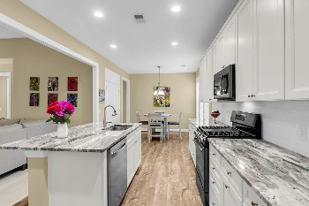
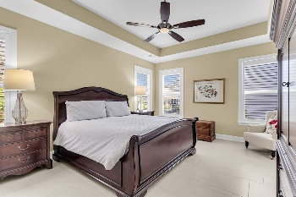
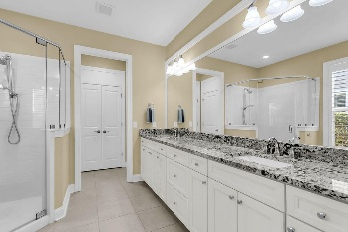

3062 Cross Vine Lane
The Ponds | Summerville, SC 29483 | MLS# 26001110 | $525,000
Just Listed-Lowest Price SQFT in Cresswind-Shows Beautifully
Exceptional value-lowest price per sqft in Cresswind! Absolutely breathtaking one-level home backing to serene, protected wooded wetlands with a stunning new (2024) 10' x 18' four-seasons room, freshly painted exterior (2024), and 3 bedrooms and 2.5 baths. This home truly shines from every angle. From the moment you step inside, you are welcomed by soaring ceilings, elegant tile flooring, 3' plantation shutters, and walls of natural light that create an open, airy, and luxurious atmosphere. Two beautifully appointed guest bedrooms sit just off the foyer, connected by a Jack-and-Jill bath with dual private vanities - ideal for hosting visitors in comfort and style. At the heart of the home is a dramatic vaulted family room that flows seamlessly into the chef-inspired gourmet kitchen and sunroom/flex room, creating the perfect space for both everyday living and entertaining. The kitchen is a showstopper with a massive granite island, upgraded white cabinetry, stainless steel appliances with a gas range, TWO spacious pantries, and a bright eat-in area. Just beyond is an elegant formal dining room with plenty of space for a large table and buffet, perfect for hosting holidays, dinner parties, and special occasions while staying connected to your guests. The luxurious primary suite is privately tucked away from the secondary bedrooms and offers tranquil wooded views for the ultimate retreat. The spa-inspired en-suite features a dual-sink vanity, a separate makeup vanity, a large walk-in shower, and a massive walk-in closet designed for both comfort and convenience. One of the most special features of this home is the incredible four-seasons room complete with its own mini-split system, allowing you to enjoy sweeping views of the protected wetlands year-round. Whether you're sipping morning coffee, reading a favorite book, or unwinding in the evening, this space delivers pure peace and privacy. Additional highlights include an oversized laundry room, new HVAC condenser (2024), whole-house surge protector, epoxied garage floor and refrigerator, washer, and dryer all convey, making this home truly move-in ready. Located in the highly desirable Cresswind at The Ponds, a gated 55+ community, residents enjoy low-maintenance living with lawn care included and exceptional resort-style amenities, including a zero-entry pool, hot tub, pickleball and tennis courts, bocce ball, fitness center, craft room, and a beautifully appointed clubhouse. This is a rare opportunity to own a perfectly designed, impeccably maintained home in one of the area's most sought-after communities-don't let it slip away!
Stan Huff
843-670-2835
stan.huff@agentowned.com
Jill Marcacci
843-297-5590
jill@agentowned.com
www.agentownedrealty.com
AgentOwned Realty Co. Preferred Group, Inc. | 824 Johnnie Dodds Blvd | Mt Pleasant, SC 29464

