Slide 1
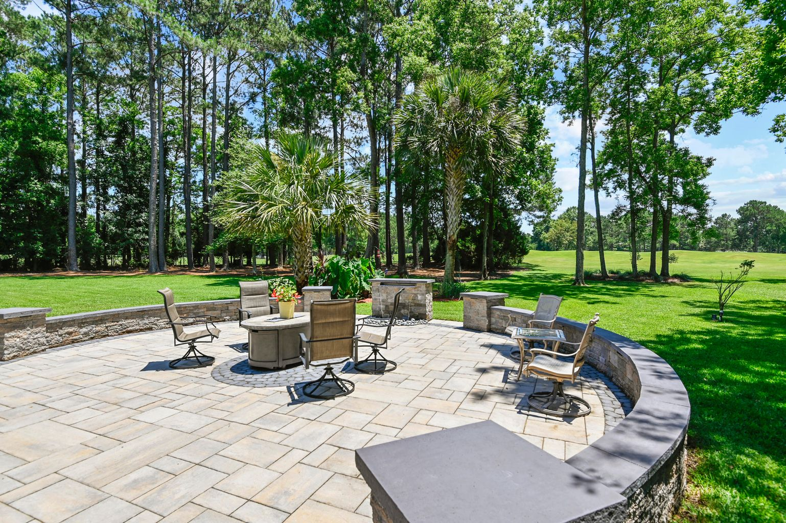
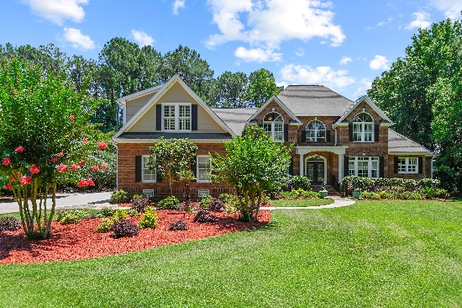
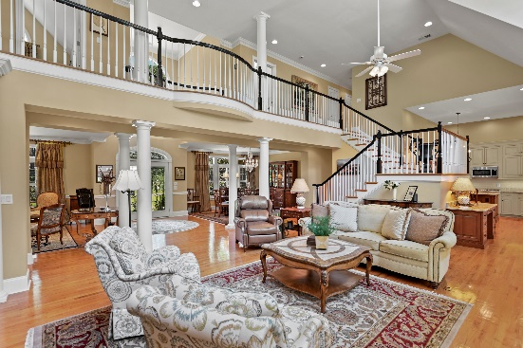


3065 Pignatelli Crescent
MLS# 21016630 ~ $1,385,000
Dunes West's Finest
New
Construction
5 Bedrooms, 4.5 Baths
Resort Style Pool and Patio Areas
Exceptional Rental History
Rare Double Lot
Block from Beach
2 Huge Great Rooms
Expansive Screened Porches
Separate Grilling and Observatory Decks
Multiple Fireplaces
Short walk to Restaurants & Shopping
Located in the prestigious gated community of Dunes West, this gorgeous Lowcountry home offers amazing Views, an open floor plan, a well appointed Kitchen with top of the line appliances, Dual Masters on the Main level, separate Living and Dining rooms, a Den with vaulted ceiling, and a large Sun Room overlooking a beautiful canvas of lush landscaping featuring a custom built patio with wall seating and a calming endless waterfall. This meticulously maintained home has custom crown molding, plantation shutters, red oak wood flooring throughout, and ample walk-in storage and closet spaces. Your family and guests will all love the first class Amenities that Dunes West has to offer. From Walking and Biking Trails, Playgrounds, Golf and Tennis, to Swimming and Workouts, you will have it all at your fingertips! What are you waiting for?
Wendy Arnsdorff
843-364-8619 – M :: 843-284-1800 – O
wendy.arnsdorff@carolinaone.com
www.wendyarnsdorff.com
Carolina One Real Estate :: Mt. Pleasant North Office :: 2713 N Highway 17 :: Mt. Pleasant, SC 29466

