Slide 1
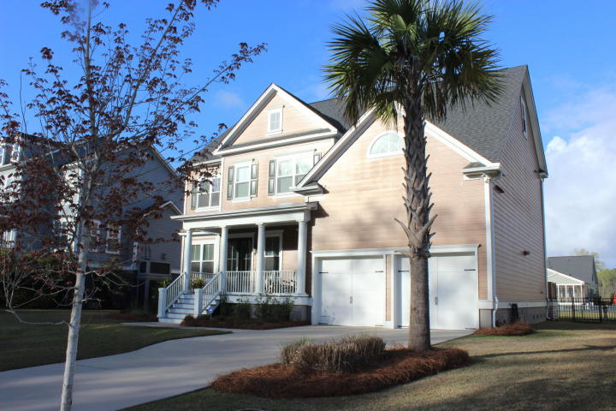
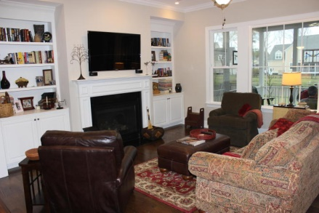
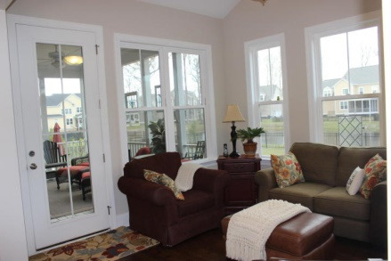
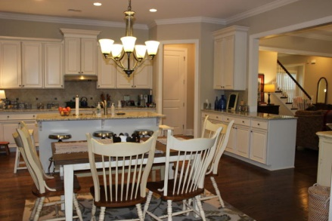
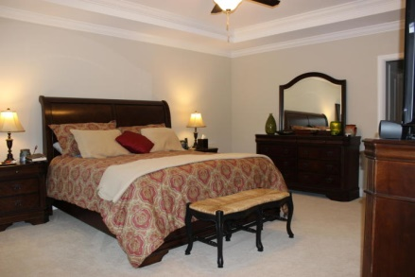
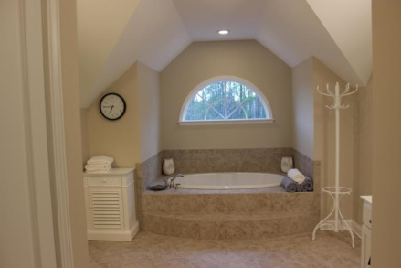
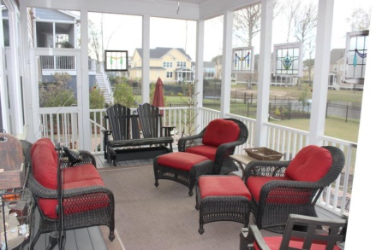
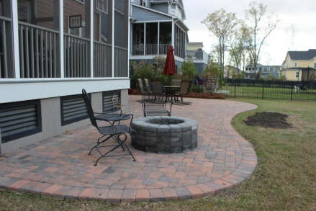


3066 Yachtmans Drive
Dunes West ~ Mount Pleasant ~ MLS# 15007712 ~ $599,900
Priced Below Market
3% Commission
Come see this two year old classic Harbour home on a pond in gated Dunes West that has been gently used and improved. It is ready for you to move in and have all of the necessities in place. A tasteful metal fence encloses the large back yard offering panoramic views of the pond. The recently laid patio with a fire pit is the perfect extension of the screen porch for entertaining, grilling and enjoying time with the family. The Mayer floor plan has flexibility galore. The use of rooms can be tailored to a family, empty nester or a young professional. Three examples of rooms that can be customized are the gathering room in the kitchen-family room, the third floor large bonus room and the guest bedroom on the first floor can be used for home office/study, exercise room, rec room, craft room, living room, media room or your choice. In addition there is the existing family room, living room, separate dining room and kitchen for all to enjoy. Storage is abundant in this home and the third floor has two large walk-in storage rooms. You too can enjoy the comfort and serenity of your view through the many windows while sitting in your family room or on the screen porch. Life is grand in Dunes West with its many amenities. The Health Club and Country Club membership are available. The boat ramp is conveniently located just down the street from the home as well is the crab dock. Walking and jog for miles within the gates. Enjoy the good life in Dunes West.
Kay Kennerty
MBA, ABR, CRS, GRI
843-345-5011
Kay@agentownedrealty.com
www.KayKennertyHomes.com
The AgentOwned Realty Company
824 Johnnie Dodds Blvd
Mt. Pleasant, SC 29464

