Slide 1
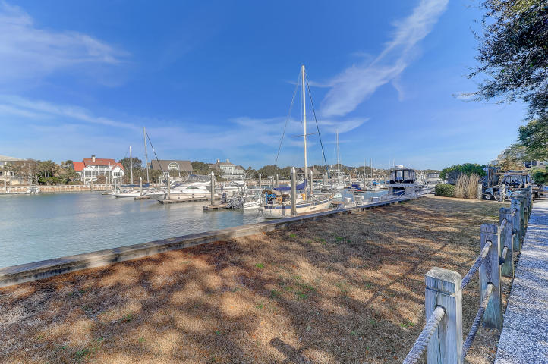
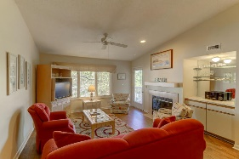
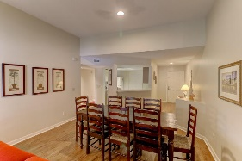
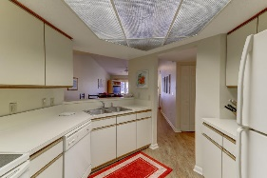
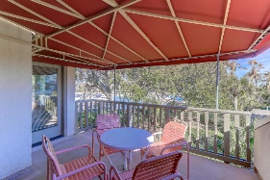
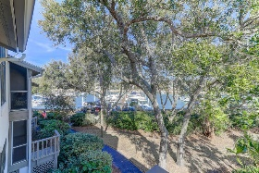
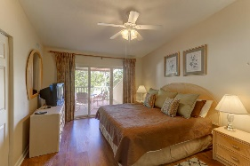
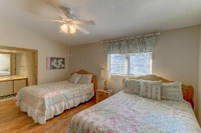
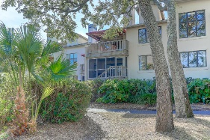
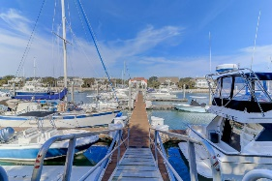
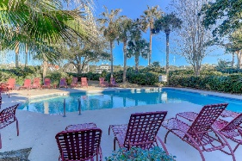


306-A Yacht Harbor Ct
Wild Dunes
Isle of Palms, SC 29451
MLS# 18002114
$110,000
Worry Free Quarter Ownership...
13 Weeks Annually
Enjoy 13 weeks a year (excluding Dec, Jan and Feb) of absolute relaxation in this lovely 2 bedroom, 2.5 bath villa. This fully furnished unit is a two week, Sunday to Sunday 1/4 share that rotates between 3 owners giving everyone the opportunity to enjoy various holidays. Regime is paid quarterly and covers Wild Dunes fees, gate passes, taxes, insurance, utilities, maid service, exterior common expenses, and the 306 Yacht Harbor owners have a reserve for replacing furniture and appliances as needed. Give yourself the vacation you deserve with the typical worries removed and enjoy the spacious living space, fireplace, and wet bar with your own covered balcony overlooking the beautiful landscaping, enjoy the private pool (heated seasonally) and hot tub and marina. Downstairs next to your private parking is a storage closet for additional beach gear, golf clubs and more! So whether you're a golfer, boater or beachcomber this well maintained villa is a perfect island destination spot for you! Experience a true vacation 13 weeks a year.
Darlene Smith
Office - (843) 886-8110
Mobile - (843) 696-7824
darlenesmith@carolinaone.com
DarleneSmithTeam.com
Carolina One Real Estate
1503 Palm Blvd Ste
Isle of Palms, SC 29451

