Slide 1
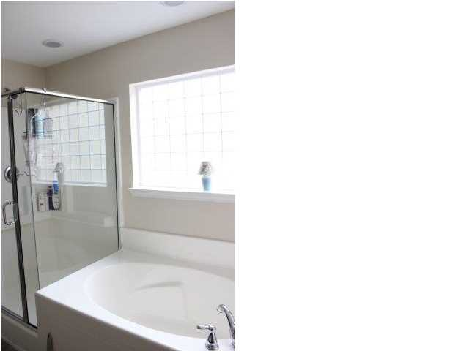
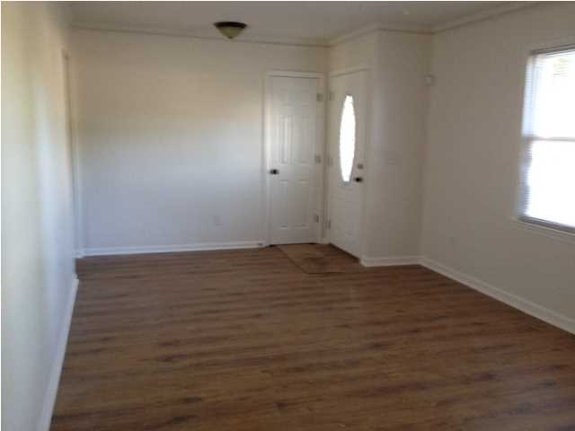
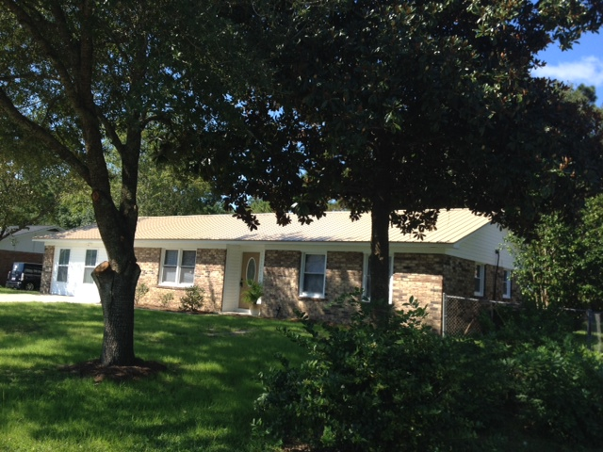
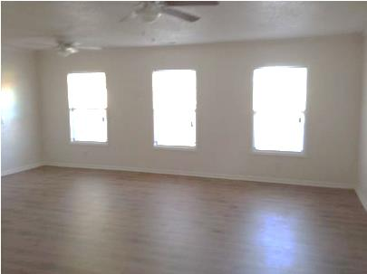
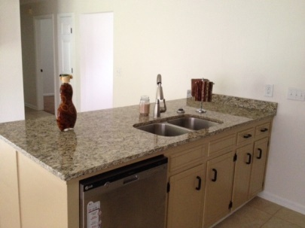
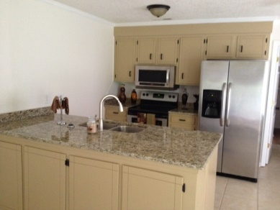
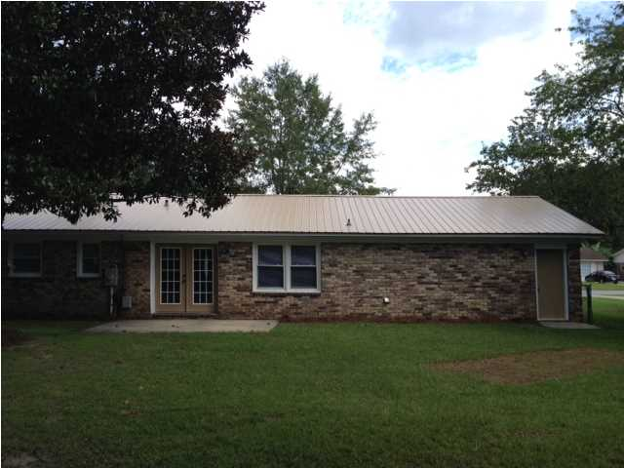
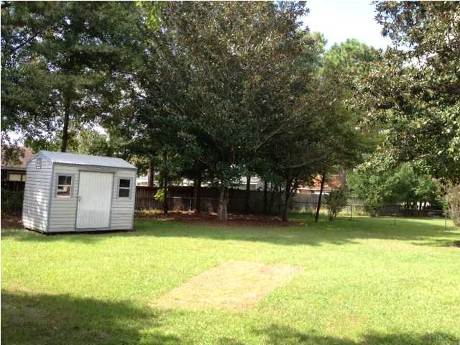
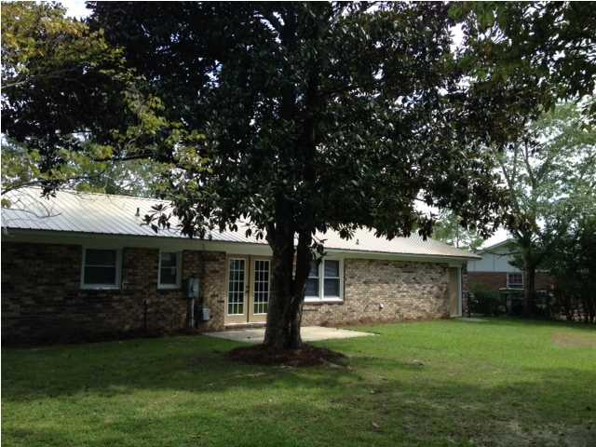

$1,000 Agent Bonus with ratified contract by 10/31/14
$1,000 Agent Bonus at Closing!
306 Beauregard Rd
Summerville ~ Sangaree ~ MLS# 1424330 ~ $159,500
Updated 3 bedroom 2 full bath brick ranch home. Home has large eat in kitchen with pantry and separate laundry room. Spacious family room and living room. Fenced backyard with large patio for entertaining. Home has new metal roof, facia and soffits, new water heater, all new flooring throughout, 6 panel doors, all new stainless appliances and most windows have been replaced. Kitchen has new granite countertops. A must see with easy access to I-26.
Joanie Rhoten
Office: 843-261-7166
Mobile: 513-518-7475
joanie.rhoten@agentownedrealty.com
www.agentownedmainst.com
AgentOwned Realty Co. Premier Group | 141 A N. Main Street | Summerville, SC 29483

