Slide 1
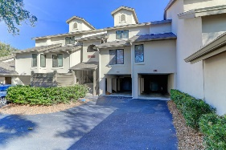
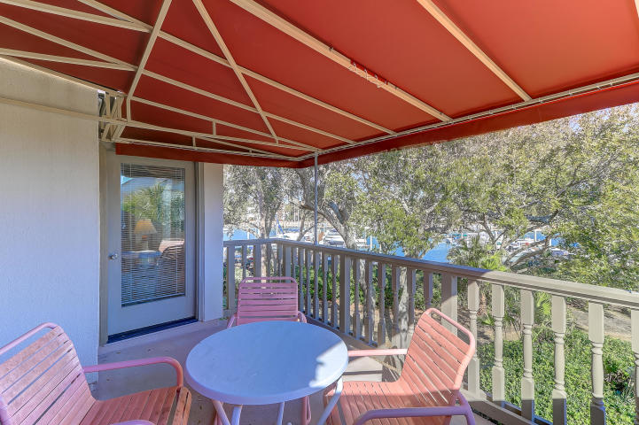
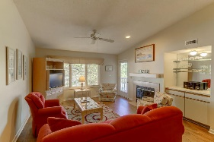
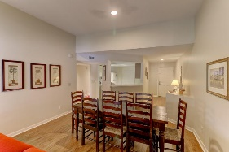
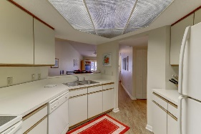
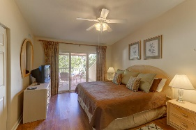
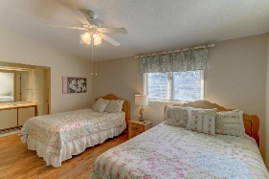
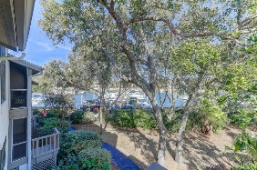
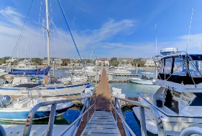
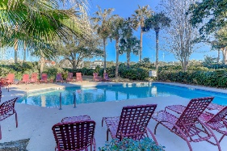
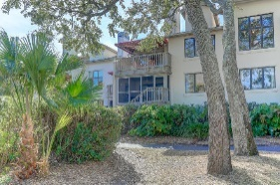


306-C Yacht Harbor Court
Isle of Palms, SC 29451
MLS# 19014106 | $79,000
13 Weeks/Year...No Worry Living...
Experience a True Vacation
Enjoy 13 weeks a year (excluding Dec, Jan and Feb) of absolute relaxation in this lovely 2 bedroom, 2.5 bath villa. This fully furnished unit is a two week, Sunday to Sunday 1/4 share that rotates between 3 owners giving everyone the opportunity to enjoy various holidays. Regime covers Wild Dunes fees, gate passes, taxes, insurance, utilities, maid service, exterior common expenses, and the 306 Yacht Harbor owners have a 'reserve' for replacing furniture and appliances as needed plus access to Beach Owners Cabana (showers, restrooms, and parking). Give yourself the vacation you deserve with the typical worries removed. Enjoy the fireplace, wet bar, your own covered balcony overlooking the beautiful landscaping, private pool (heated seasonally) and hot tub and marina.
Darlene Smith
Office - (843) 886-8110
Mobile - (843) 696-7824
darlenesmith@carolinaone.com
DarleneSmithTeam.com
Carolina One Real Estate
1503 Palm Blvd Ste
Isle of Palms, SC 29451

