Slide 1

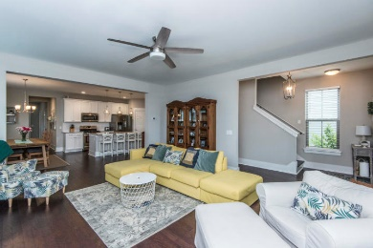
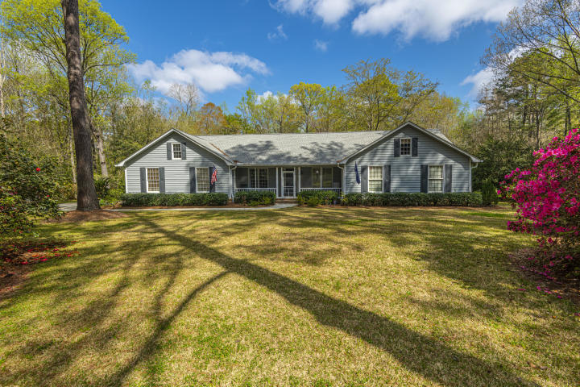
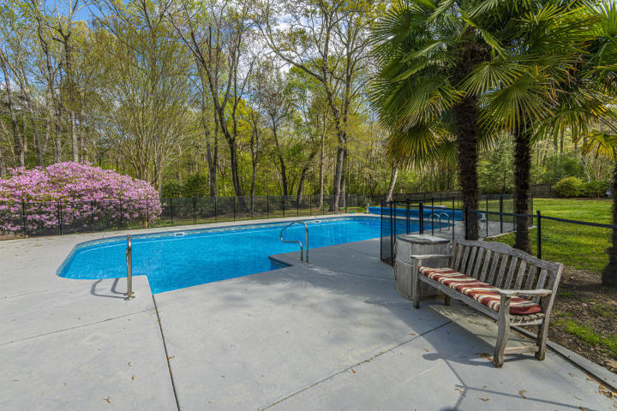
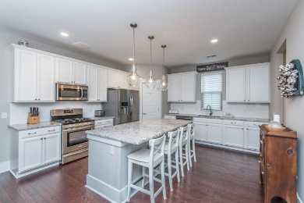
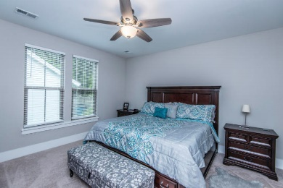
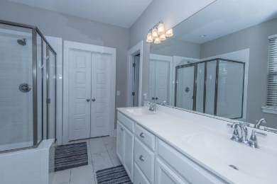
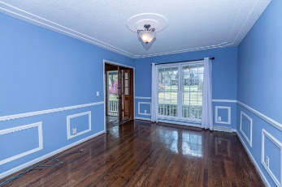
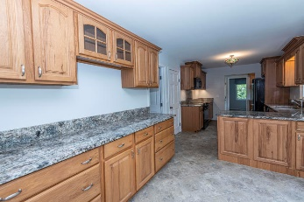
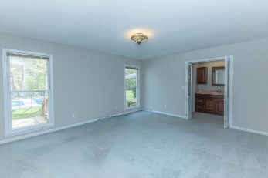
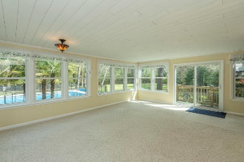
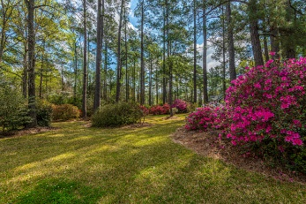


Over 2 Acres! One Story! Salt Water Pool!
306 Huntington Road
Sweetbriar | Summerville, SC 29483 | MLS# 20008138 | $475,000
Are your Buyers looking for Space to "Shelter in Place", but sill be close to town? Then this is the perfect Home for them.!! One story with a bonus room, inground 20 x 40 salt water pool, on over 2 acres! Woods and wetlands for privacy, surrounded by Camellias, Azaleas (gorgeous blooms), palm trees! Your own private oasis! Newer roof, encapsulated crawl space, Rhino Shield painted siding, updated kitchen with custom made cabinets, granite counters, so many upgrades! Sweetbriar is a desirable neighborhood, close to town, but homes on larger lots for space and privacy. Enter this unique home to a spacious foyer looking into the huge family room out to the sunroom with views of the pool and private backyard. To the right find 3 bedrooms and hall bath. Master is spacious with views of fenced backyard. Master bath has been updated with custom cabinets, counter and tile shower. Master has dual closets, walk-in for her, another for him. Back in main area, the formal dining room is to the left of the foyer and open to kitchen for convenience. Kitchen is beautiful! Light and bright and updates make it the perfect place for the chef! Kitchen and eat-in area are open to the family room for all to be involved in family gatherings. Continue through the kitchen to the pantry, mudroom and the laundry room. These areas offer extra closet and storage space and have also been upgraded with beautiful counters and cabinets. The half bath, garage entrance and entrance to the bonus room/4th bedroom are also located here. Bonus room has a closet and storage areas, and could be a 4th bedroom. This home offers space for large gatherings and is perfect for entertaining, or just for quiet time. The sunroom is the ideal place to relax and enjoy the solitude of the location and privacy. When need a little more activity, jump into the pool for laps or to cool down, then onto the hot tub for the ultimate relaxation! The front porch is screened for comfort if want to relax amongst the beautiful foliage at the front of the home. There are so many upgrades and special features of this home, you have to come and see for yourself! Home is freshly painted and carpets newly cleaned.
Call today for a private showing.
Laurie Loparo (843) 442-1290 | laurieloparo@gmail.com
www.lauriesellscharleston.com
Carolina One Real Estate | 873 Orleans Road, Ste 102 | Charleston, SC 29407-5753

