Slide 1
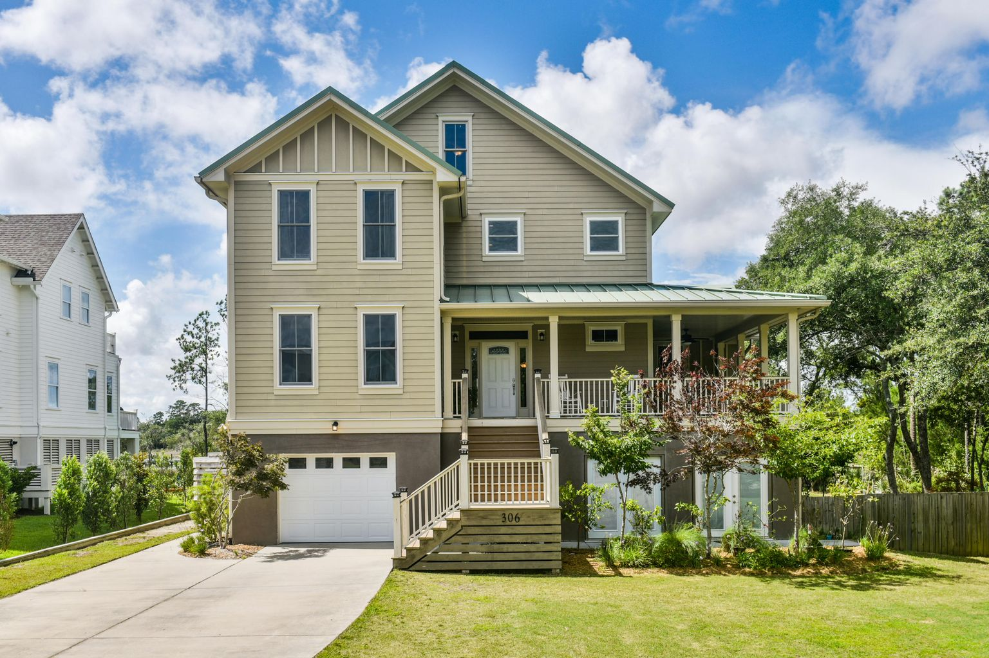
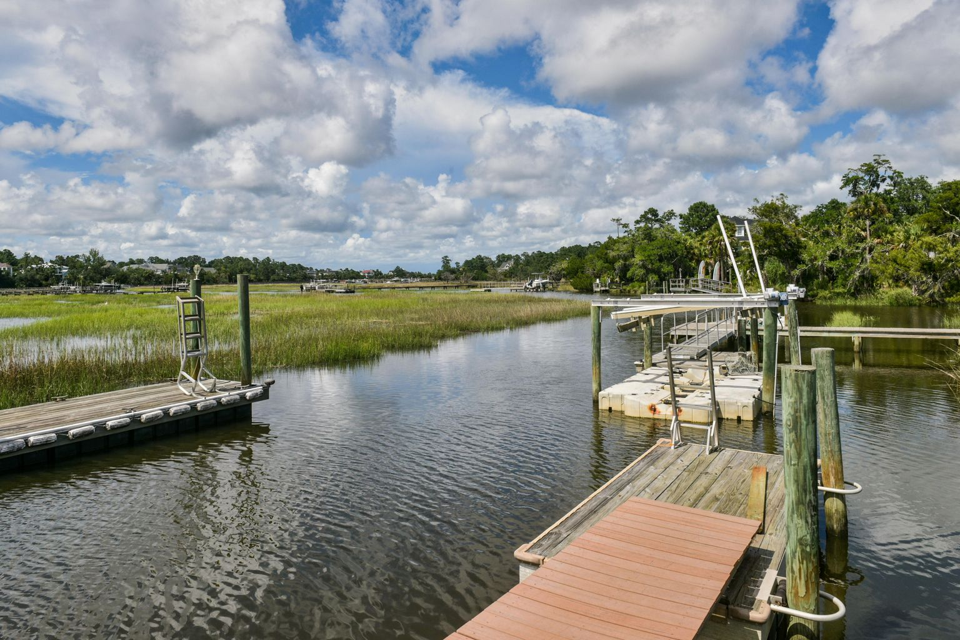
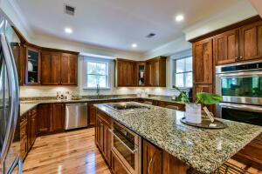
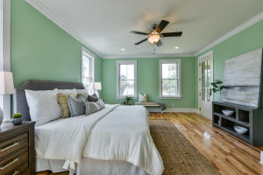
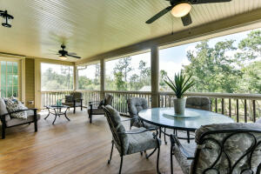
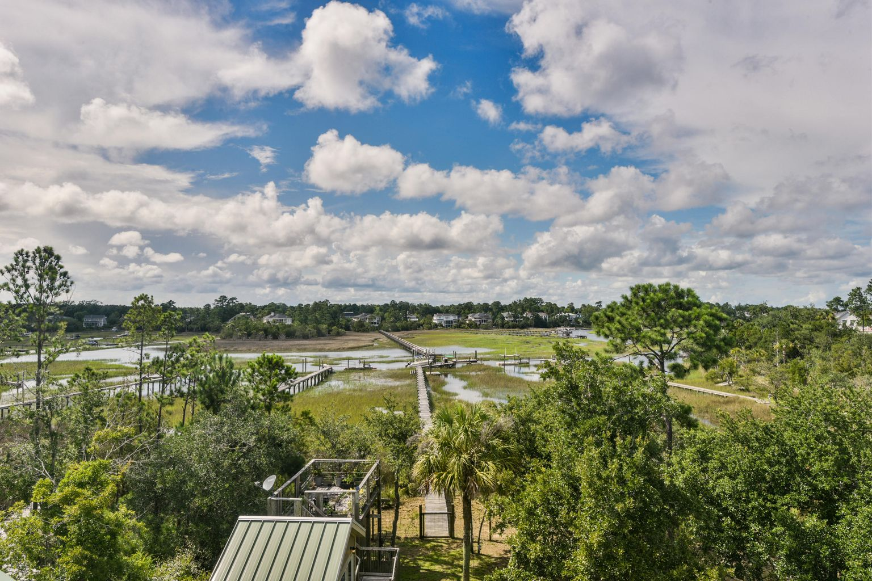


306 Commonwealth Road
Darrell Creek | Mount Pleasant, SC 29466 | MLS# 21017991 | $1,695,000
THIS is your Lowcountry Playground! This custom built home offers a dock, a jet dock, 2 floating docks, a Michael Phelps swim spa with built-in hot tub overlooking the marsh, a ground level Mother-In-Law suite (fully permitted and insured), a wraparound screened porch, hardwood floors throughout and an elevator shaft! The main level has the kitchen, living and dining areas(with surround sound), a master suite with marsh views and screened porch access, and a 2nd bedroom/office with full bath. The next level has 3 additional bedrooms, 2 additional bathrooms and a HUGE loft space with surround sound and wired for a projector (perfect for hangout space/home school space). The upper level is wide open with great marsh views and would be a perfect playroom or dance studio! The ground level has a fabulous guest suite with marsh views, a home gym,a garage for up to 3 cars, plenty of additional space for storing all of your outdoor toys! There is also an additional detached building currently used as an office (fish off your dock on your lunch break!) and would also make a great art studio or playhouse! This home sits on a .6 acre lot and Darrell Creek does allow you to keep your boat in your yard! This house truly has so many incredible features that you must see it! A $3000 lender credit is available and will be applied to closing costs and prepaids if the buyer chooses to use the seller's preferred lender. This credit is in addition to any negotiated seller concessions.
Walk-through video: https://vimeo.com/manage/videos/570159955
Robyn Hall
843-906-5200
robyn.hall@carolinaone.com
Carolina One Real Estate | 2713 Highway 17 North | Mt. Pleasant, SC 29466

