Slide 1
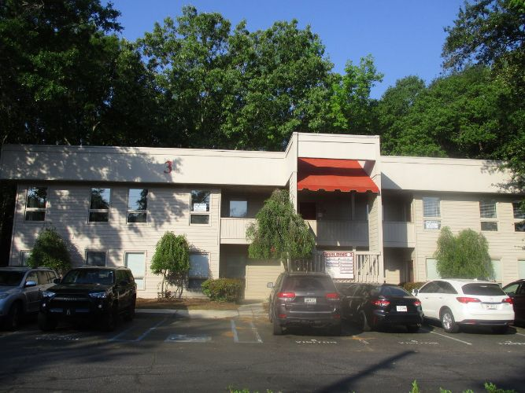
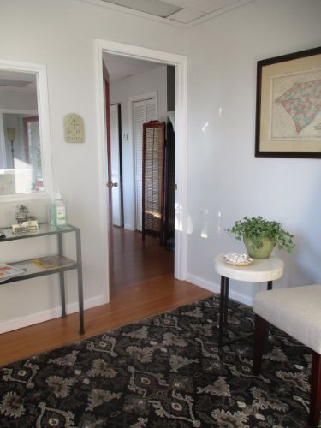
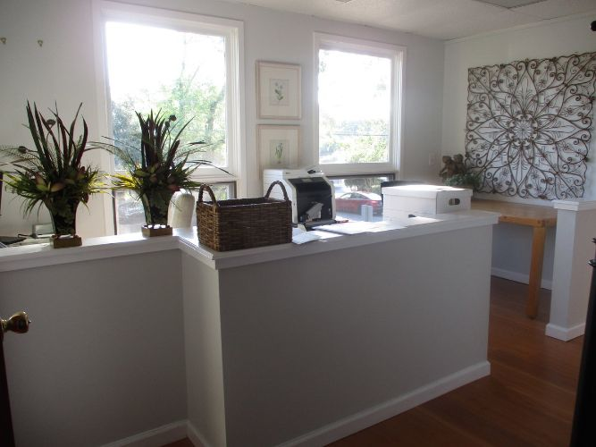
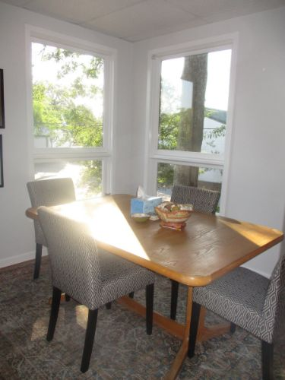
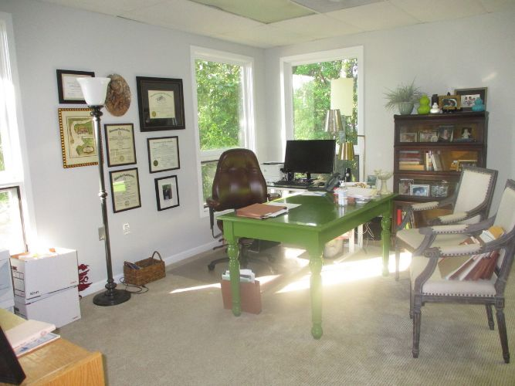
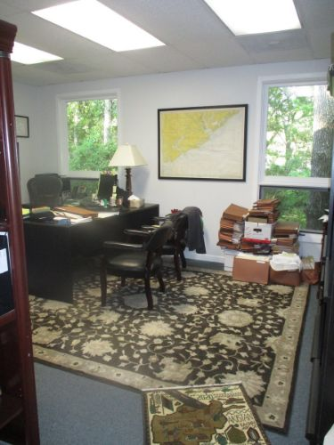
Office for Sale
306 Gamecock Ave
Charleston, SC 29407 | MLS# 30724565 | $169,900
Great opportunity to own a commercial condo unit in Orange Grove Office Park. This upstairs unit has 3 offices along with a foyer, reception area, bathroom, & plenty of parking. Great location near shopping, restaurants, local businesses, & I-26.
Charles Salmonsen
M (843) 224-0300 | O (843) 388-6613 | charles@salmonsen.com
Salmonsen Realty | 864 Lowcountry Blvd Ste B | Mt Pleasant, SC 29464

