Slide 1
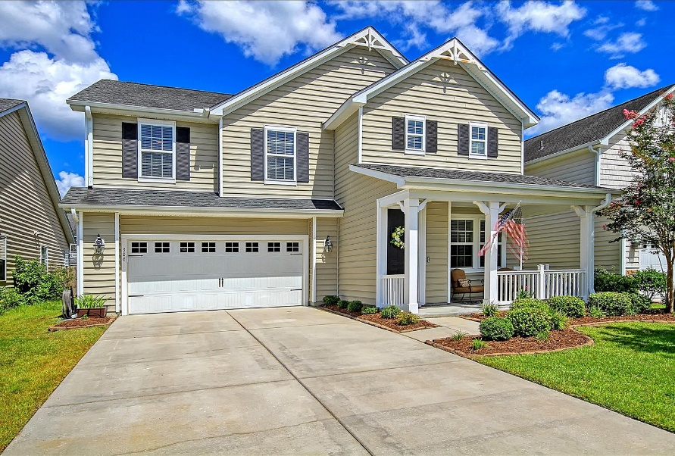
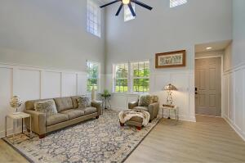
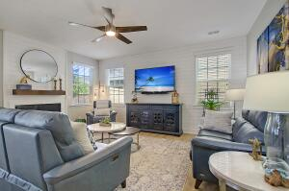
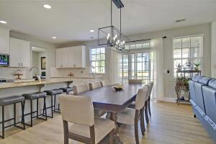
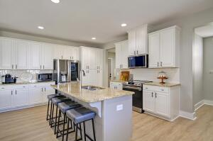
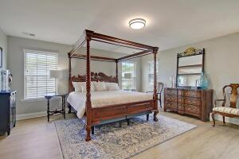
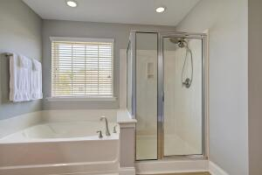
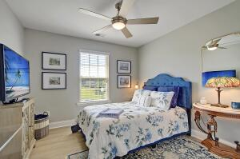
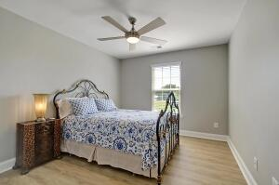
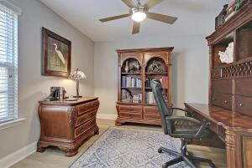
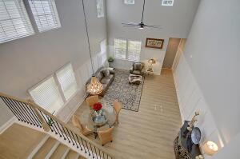
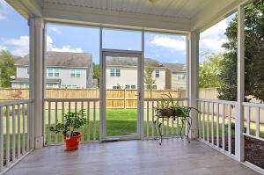
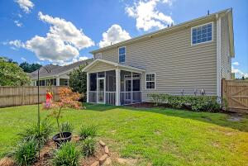
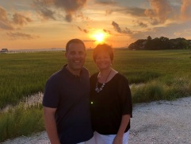

Cane Bay Beauty ~ Pool & Playpark Across The Street!
306 Nuttall Drive
Cane Bay Plantation
Summerville, SC 29486
MLS# 22020068
$465,000
4 Bedrooms | 2½ Baths | 2,730 sf
Looking for a WOW house? Well look no further than 306 Nuttall Drive! You'll be impressed the moment you step foot in front door. Brand new, beautiful LVP flooring throughout, smart home equipment for everything from lighting, thermostats to the front door camera and garage camera! Enter in to the living room and dining room with two story ceilings, tons of natural light and beautiful picture frame wall molding. In the rear of the home, you'll find the stunning kitchen which overlooks the family room. The kitchen has a large island that can seat four comfortably, granite countertops, brand new stainless steel appliances including a GE Hub. The Hub is located over the stove and is the best way to manage your smart home. Plus, you can watch tv, FaceTime, pull up your favorite recipes, check the ring doorbell, listen to music, watch your stovetop from another room to make sure things don't boil over...the Hub does it all! The cabinets in this kitchen have shelf genies installed for optimum storage and easy access with sliding drawers. Off of the kitchen is an office space with a built in desk. Also off the office is a butler's pantry for even more storage as well as the laundry room and access to the garage. The backyard offers a screened in porch and fenced in yard. Lights, that are programmed, line the fence. Head upstairs to the large primary suite. His and hers walk in closets are in the hall on the way to the bathroom. The bathroom offers dual vanities, a large shower, garden tub and private water closet. There are three additional bedrooms upstairs all with good sized closets. Across from this home is green space which offers a play park, pool and dog park! Talk about convenience! This neighborhood is the place to be! Food trucks every week, neighborhood YMCA, golf cart/jogging trails that connect all the subsections to each other as well as the shopping center and schools. New businesses are moving to this area, so many restaurants options, plus you are just a short drive to both downtown Charleston and Summerville! This home is ready for you to move right in!!
Larry & Kathy Mazalatis
Larry Cell 843-693-0529
Kathy Cell 843-693-0159
Office 843-871-9133
AGENTOWNED PREMIERE GROUP | 1800 TROLLEY RD | SUMMERVILLE, SC 29485

