Slide 1
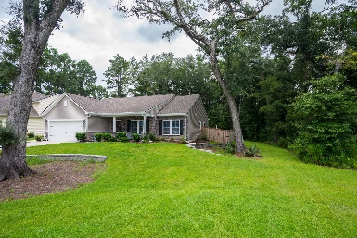
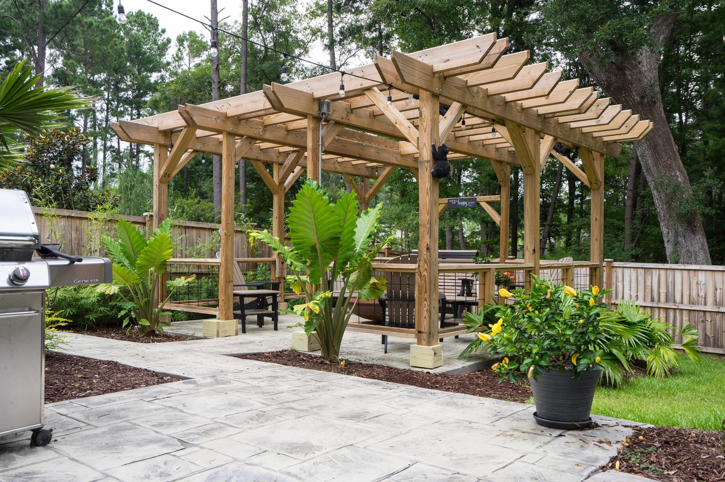
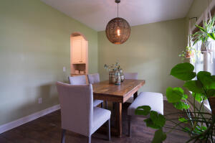
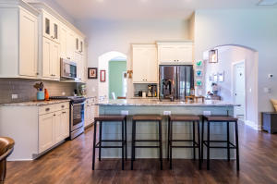
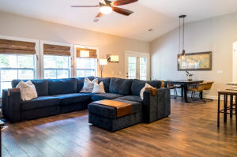
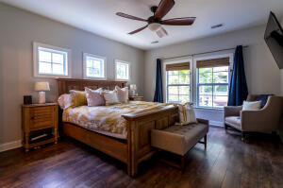
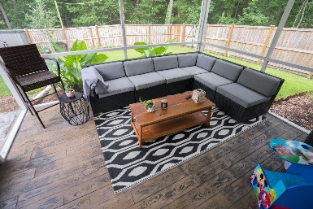
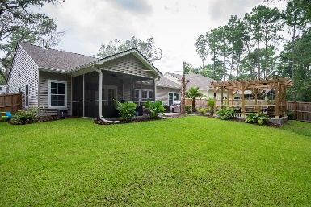


306 Sterlington Way
Grand Bees · Charleston, SC 29414
MLS# 21021300 · $450,000
Back on the Market
PREVIOUS BUYER GOT COLD FEET AND BACKED OUT!
This spacious one story home is turn key! It is gorgeous and has so many upgrades! The kitchen is gorgeous with soft closed cabinet doors and drawers with pull out drawers in some of the cabinets. It also includes an upgraded gas range with a convection oven, subway tile backsplash, shiplap with custom woodwork around the island, a convection microwave, garbage disposal button on the counter for easy access and granite countertops of course! There is no carpet in the home. Instead the flooring is laminate wide plank for easy cleaning which offers a nice flow throughout! The high ceilings also give this home a very open and spacious feeling. The formal dining room is a great size and connects to the kitchen with the butler's pantry. The bathrooms have tile flooring as does the huge laundry room. In the master bathroom there is a 5 foot tile shower with frameless glass doors and two shower heads. And both bathrooms have comfort height toilets as well as comfort height cabinetry. The second bathroom along with the pantry also have auto motion lighting. There is custom wood shelving in the 2nd bedroom closet as well as in the deep pantry. There is also custom shelving in the garage.
There are upgraded ceiling fans and light fixtures throughout with Decora light switches. There are ceiling speakers in the family room wired to a home theater connection. This home also has a ring doorbell and motion sensor lights on the back patio. Outside there is stamped concrete walkway in the front and a stamped stone front porch AND a stamped concrete flooring on the screened in porch and a stamped concrete patio in the backyard. There are speakers on the screened in porch as well that are wired to a home theater connection. The fence has 3 gates and there is custom landscaping with elephant ears, a large mexican fan palm, a large cabbage palm tree, bamboo, and alocasia. The pergola also comes complete with an electrical outlet with string lights that convey and water resistant speakers! There are gutters on the home which is a rare find in the Lowcountry with gutter guards too! There is even plumbing with water and gas lines (not yet hooked up) for the construction of an outdoor kitchen if the new owner chooses. Both the front and back yards are spacious and the lot is very private and backs up to wooded hoa space. There is an instant tankless water heater AND the air conditioning system is upgraded and the interior walls are insulated. There is even a gas or an electric line for the dryer. So many upgrades. This is one-story living at its finest! It is close to everything and the location is superb! You will love the Grand Bees community and this home is within walking distance to the community pool or if you prefer take a golf cart as this is a golf cart friendly community.
Carey Nikonchuk
(843) 276-1701 M
cnikonchuk@gmail.com
www.palmettoproperty.net

