Slide 1
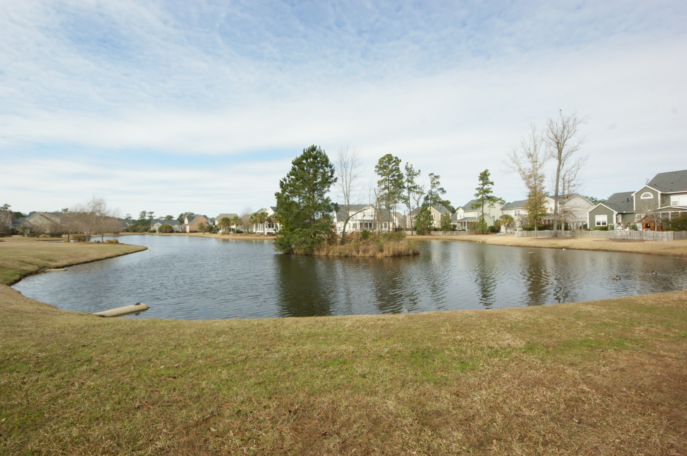
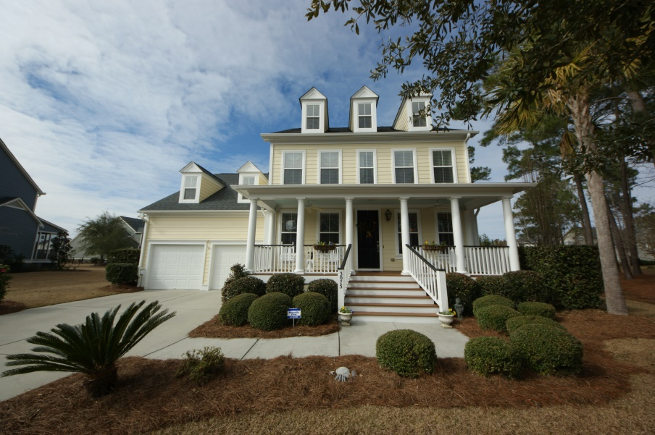
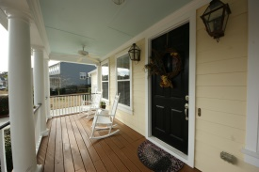
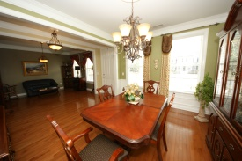
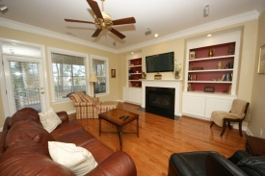
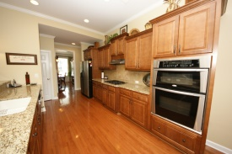
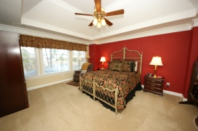
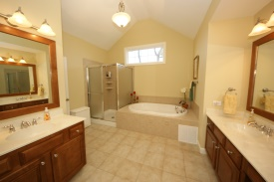
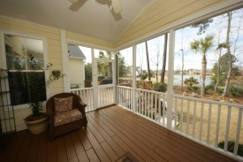
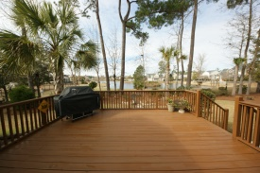
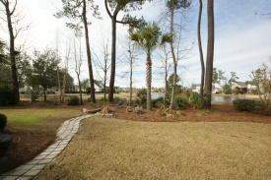
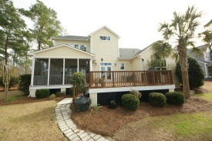
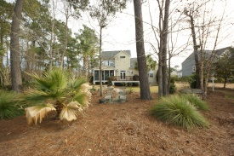
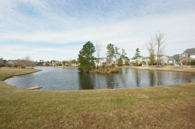


3075 Riverwoood Drive Dunes West Mt Pleasant MLS# 15002456 $585,000
Better Than New!
5+ BRs, Amazing Lot, Upgrades Galore!
TLC and attention to details! Located on one of the best corner lots in the neighborhood. Protected woods to one side and a large pond teaming with wildlife makes this spot unique. As you come onto the full-width front porch, notice the entire exterior including the porches & trim have been professionally painted (5 year warranty!). Owners spared no expense in building their dream home with 3 climate zones and custom upgrades: Charleston gas lanterns, hardwoods on 1st floor and stairs; 8'' crown molding, California closets in Laundry and 3rd fl., fixtures, thermo-sensitive gas fire place, surround sound in all living areas including porches and deck; gas line for outdoor grill and more. The open and bright kitchen with countertop bar is crafted in hardwoods, granite and stainless appliances. Newly installed French doors (lifetime warranty) lead to the deck. A bedroom on the first floor has it's own bath and overlooks the length of the pond. Upstairs, the roomy master suite features a tray ceiling, separate spa tub, glass ceramic shower, tile flooring,and granite and hardwood separate vanities. The views, large windows and ample space, make it a special retreat. Two bedrooms off the hall share a full tiled bath and the 5th bedroom over the garage is extra large with full bath and double closet---for guests, teen suite or media room? Keep going to the third floor where another 400 sft., with lots of natural light from the windows and 3 dormers can be your 6th bedroom or private work loft featuring built ins and a desk space. Extra storage space under stairs, in extra long garage, and in the two bonus areas over the garage and on the third floor. Professionally landscaped and maintained. Well established neighborhood with no new construction going on next door. A rare find. Offered with a 1-year home warranty.
Peggy Morse
Office - (843) 266-1907 | Cell - (843) 860-4953 pmorse@carolinaone.com
Carolina One Real Estate | 3040 Highway 17 North | Mt Pleasant, SC 29466

