Slide 1
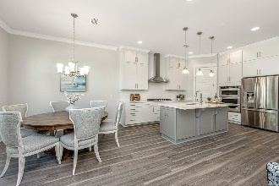
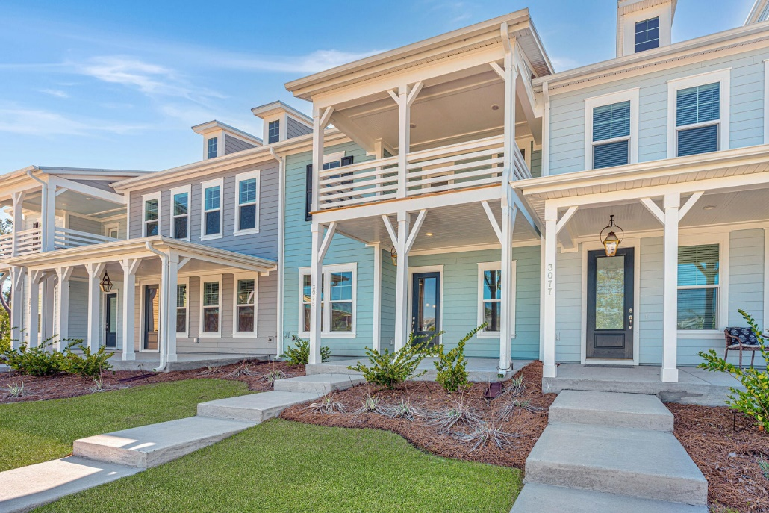
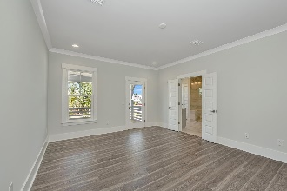
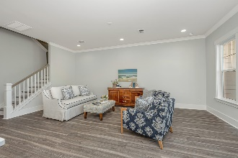
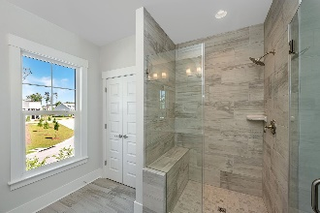
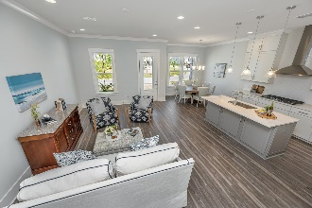
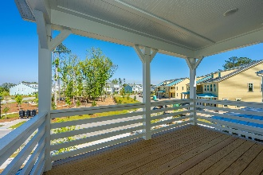
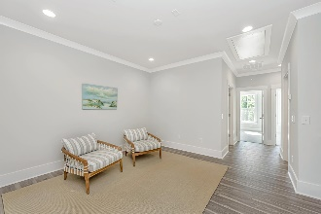
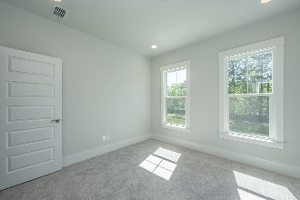
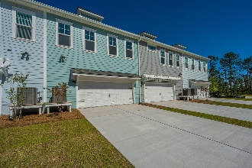
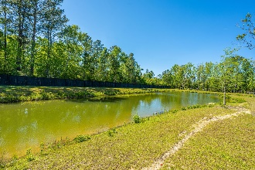
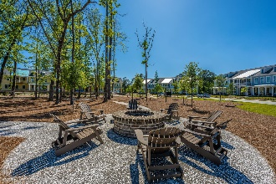


BACK ON THE MARKET!
3075 Sturbridge Road
Dunes West | Mount Pleasant, SC 29466 | MLS# 23008097 | $625,000
Be the first to live in this stunning 3 bed, 2.5 bath townhome nestled in the highly sought-after gated community of Dunes West! This brand new home has never been lived in, offering a pristine living space that is just waiting for you to make it your own. As you step into this luxurious home, you are immediately greeted by soaring 10 Ft. ceilings and an open-concept floorplan that exudes spaciousness. The gourmet kitchen features exquisite quartz countertops, top-of-the-line appliances, and plenty of storage space. The built-in drop zone and powder room near the two-car garage entrance make for a perfect mudroom. Upstairs, you will find a cozy loft area that is perfect for a media room or office space. The primary bedroom is a true retreat, boasting two oversized closets, a spa-like bathroom with dual vanities, a walk-in shower, and a private balcony overlooking the dog park and recreation area. Two additional guest bedrooms, a full bathroom, and a laundry room complete the second level.
As part of the Dunes West community, you will have access to a wide array of resort-style amenities, including tennis courts, swimming pools, a clubhouse, walking trails, a fitness center, and even golf membership options. Plus, with a short drive, you can enjoy the pristine beaches of Isle of Palms and Sullivan's Island, as well as historic downtown Charleston.
Don't miss out on the chance to own this impeccable new construction home in one of the most coveted neighborhoods in the area. Plus, take advantage of a $2,500 Lender Credit towards your closing costs and pre-paids if you use the seller's preferred lender. This is in addition to any negotiated concessions. Schedule your private showing today and discover the epitome of luxury living in Dunes West.
Debbie Rogers
(843) 990-2915
deborah.rogers@carolinaone.com
www.DebbieRogersSellsCharleston.com
Carolina One Real Estate | 2713 Highway 17 North | Mt. Pleasant, SC 29466

