Slide 1
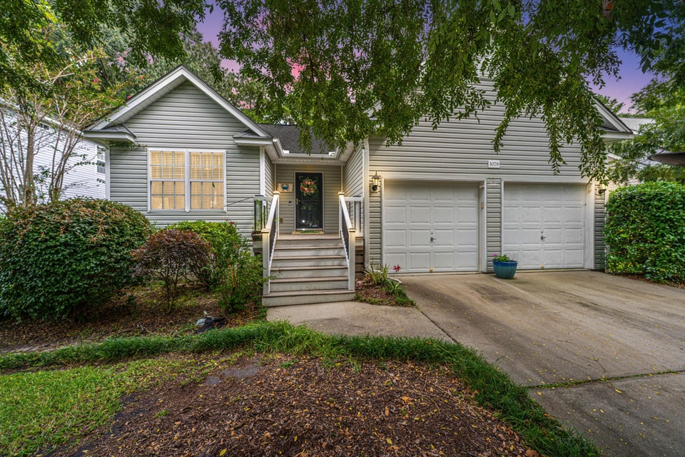
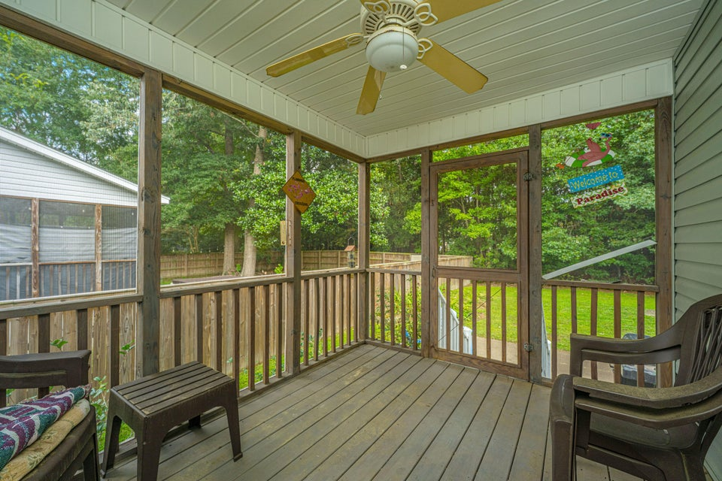
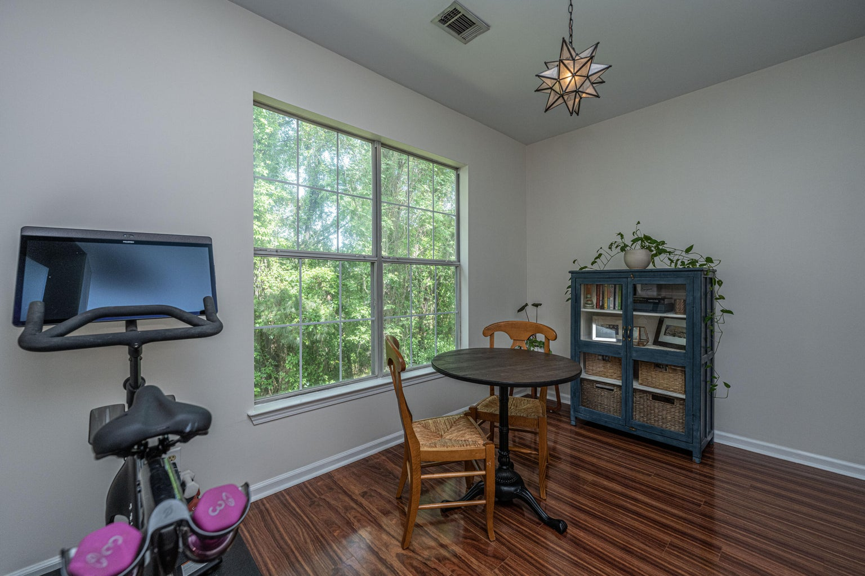
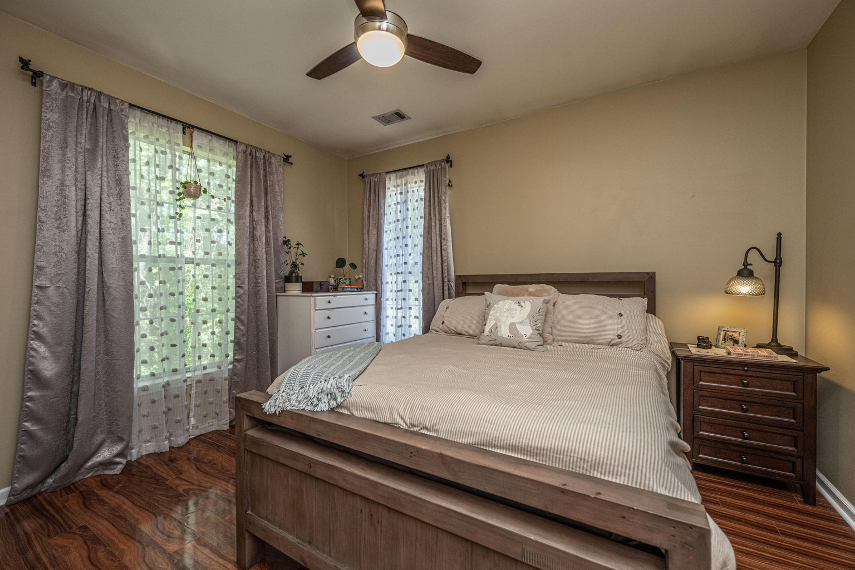



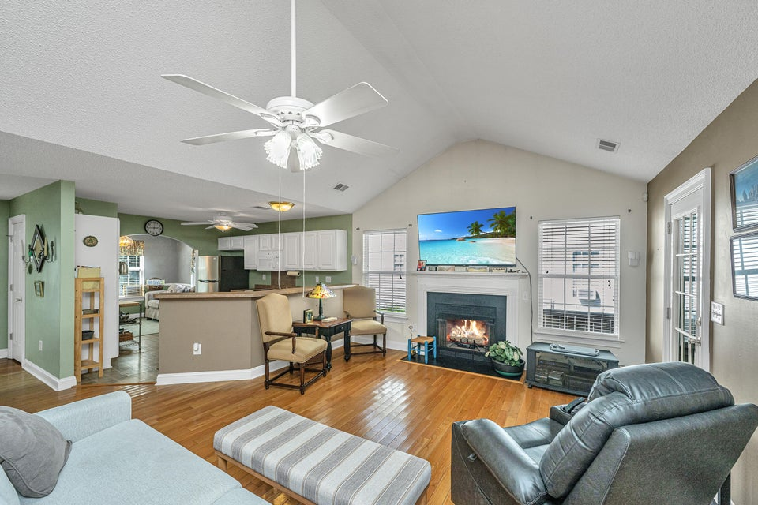
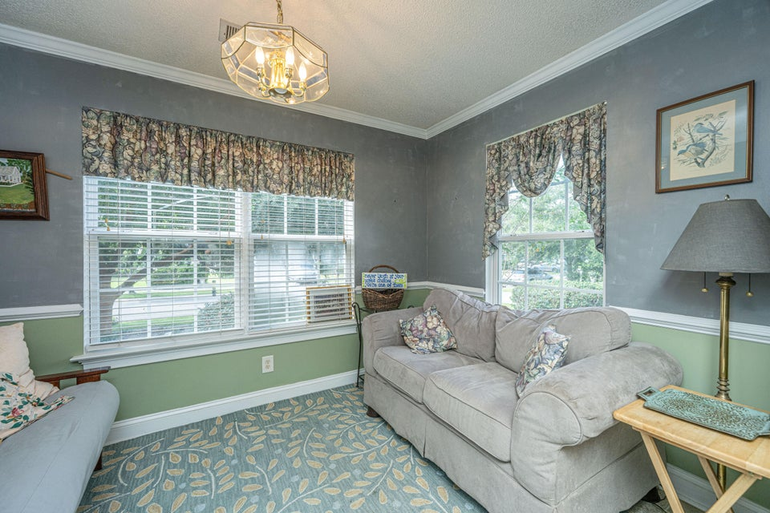
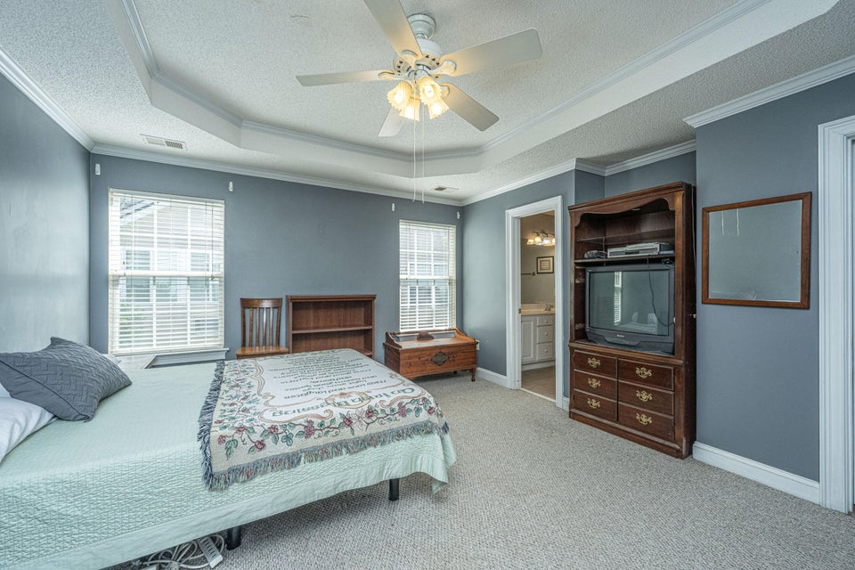
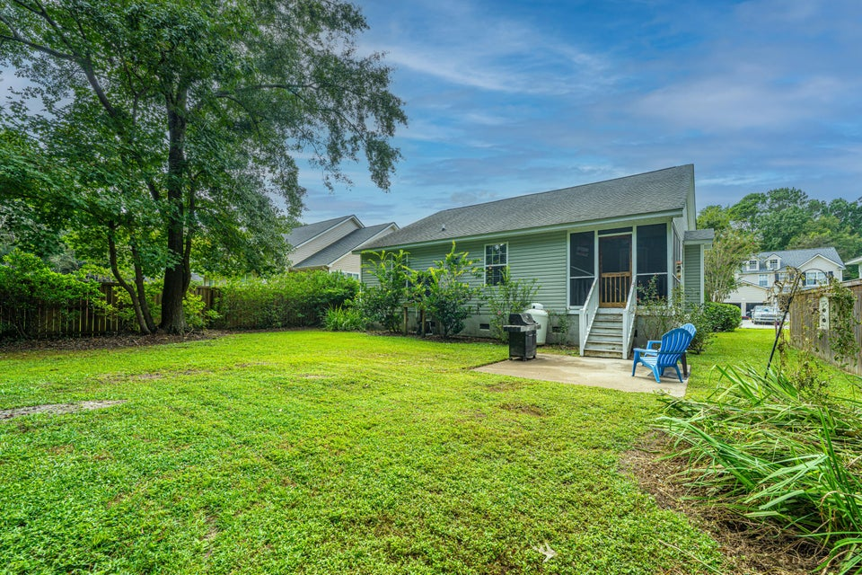

Great Location!!
This stunning 5br, 4.5ba low country custom built home by Simonini Home Builders has been meticulously cared for situated on a .60 acre heavily treed lot on large pond in private gated community of Popular Grove. This spacious , two story, 4721 square foot home features master bedroom suite on the first level, full front porch, beautiful heart pine wood flooring, large entry foyer which separates the private study from formal dining room, open gourmet kitchen with Wolf 6 burner gas stove, built in SubZero refrigerator/freezer, dishwasher, microwave oven and large pantry. Half bath/Powder room under stairway and large utility room for washer and dryer and deep sink and built in cabinets off hallway. The smaller den with gas log fireplace opens to kitchen and breakfast room. The larger fireplace opens to kitchen and breakfast room and offers expansive views of the water year-round. The living room with its second gas log fireplace is great for entertaining away from dining areas. The large master bedroom suite is located on the first level and has travertine tile flooring in the master bath, his and hers walk in closets, separate vanities, soaking tub, and a large separate shower. There is a game room with separate stairs over the two-car garage large enough for a pool table. The second level boasts 4 spacious bedrooms and three bathrooms. On the rear of home is a large screened in porch and open deck overlooking firepit and pond. To reduce maintenance the exposed wood decking has been replaced with Trex decking and exposed rail caps with PVC. Yard has irrigation system and 120-gallon buried propane tank. Sellers just replaced roof with 50 year architectural shingles with transferable warranty. The two electric water heaters have been converted to a single LP gas fired tankless water heater. New epoxy coating on floors and newly finished walls now in two car garage. Neighborhood amenities include Privacy gate, Boat Ramp, Dock facilities, Exercise area, Pool, RV/boat storage and walking/jogging trails. Don't forget the fantastic equestrian center for your horses!
3078 Penny Lane
The Bend at River Rd | Johns Island, SC 29455 | MLS# 25024949 | $449,900
Welcome to your little slice of Johns Island! Nestled in a tucked-away neighborhood near the Stono River, this 3-bedroom, 2-bath single-family home offers the perfect blend of Lowcountry serenity and convenience. The open floor plan is designed for effortless entertaining and everyday comfort. A separate flex space allows room for a dining table, breakfast nook or an additional sitting area. Endless flexibility. The private primary suite offers a peaceful retreat, while two additional bedrooms provide flexibility for family, guests, or even a stylish home office. A two-car garage ensures plenty of storage and parking space. Out back, enjoy your very own private fenced yard, ideal for summer cookouts, gardening, or simply unwinding.
Best of all, the neighborhood offers a peaceful, quiet community feel with minimal HOA fees. And with the Stono River close by, outdoor adventures like kayaking, fishing, and boating are never too far away!
TAKE A VIRTUAL TOUR
4
3
1,844
Robyn Lane 843-222-5599
robynlane01@icloud.com
Jenny Siggelkow 843-901-3494
jcsiggelkow@gmail.com
ERA Wilder Realty
802 Johnnie Dodds Blvd
Mt. Pleasant, SC 29464

