Slide 1
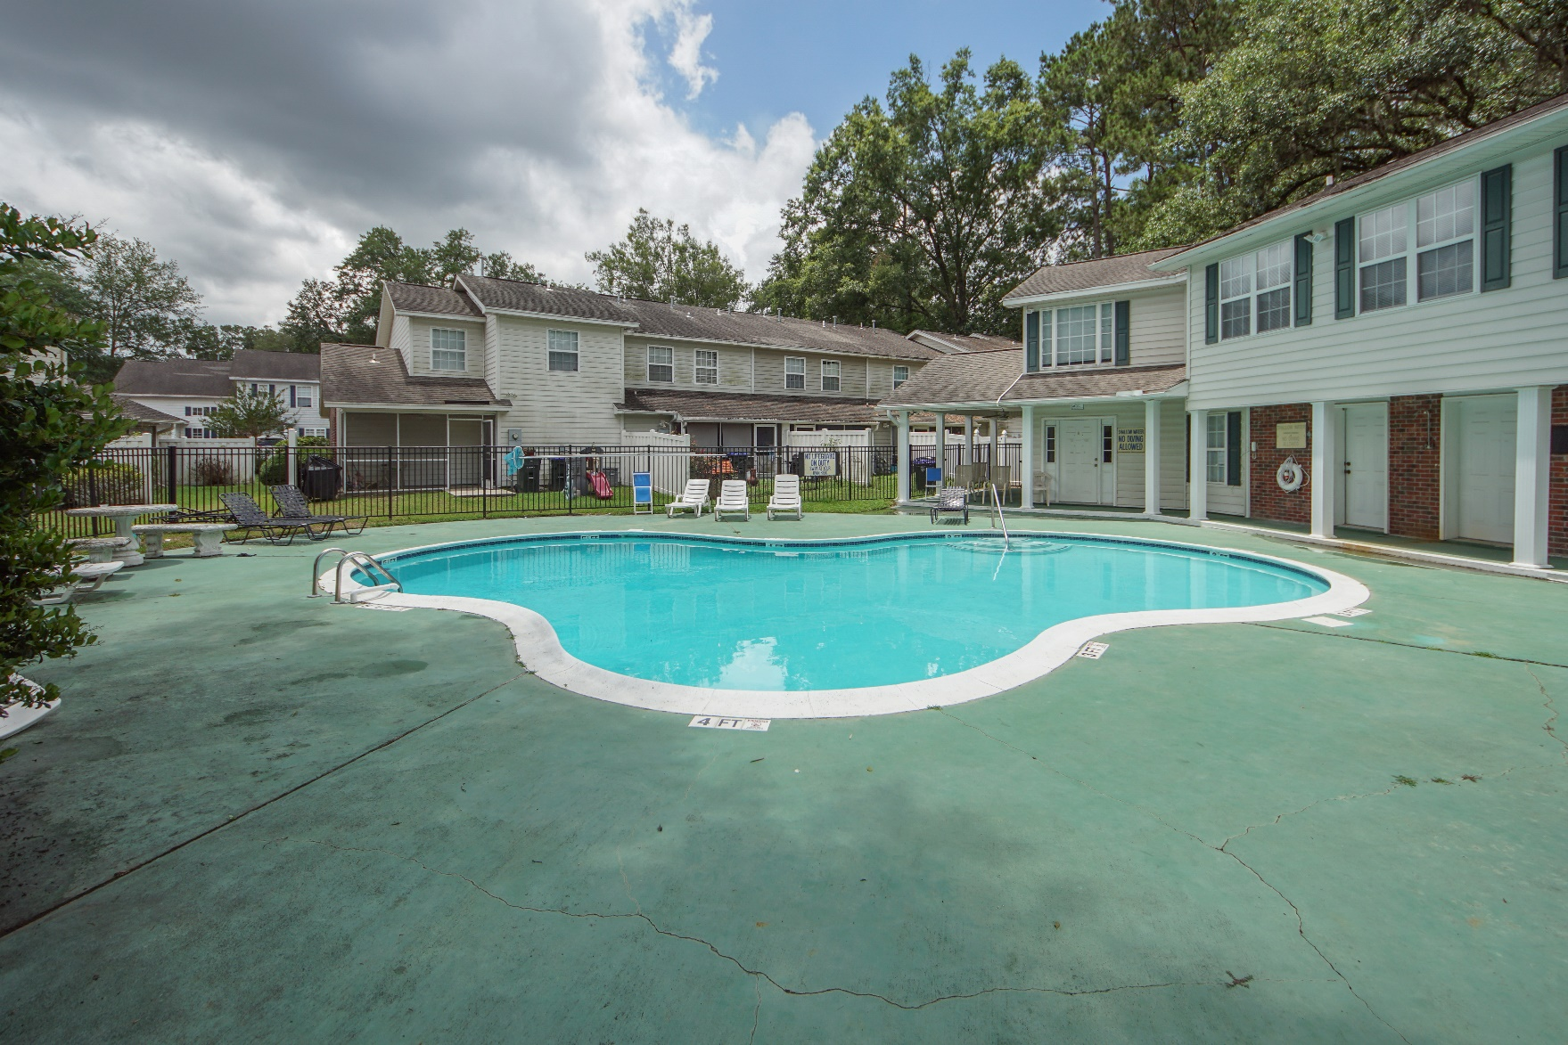
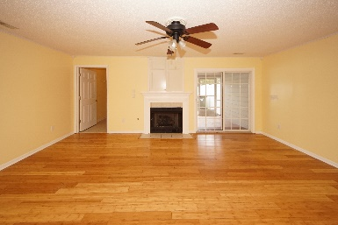
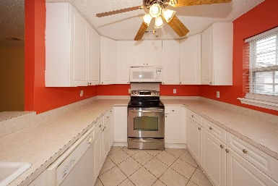
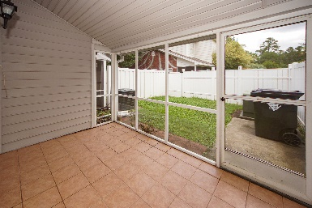


307 Amberwood Drive Corey Gardens :: Summerville, SC 29483 MLS# 19017171 :: $150,000 3 Bed | 2½ Bath | 1,480sf
Great Investment Property
Just Listed!
Move In Ready describes this freshly painted, new carpet town home in Summerville. Open concept is obvious in our photos and this home features a gas fire place, 42" kitchen cabinets, over sized rooms, screened porch, fenced in yard and plenty of windows for natural sunlight. Master bedroom is up stairs, spacious with aesthetic detail and view of the pool. Current owner has made the right upgrades for the new buyer and this unit is across the street from the swimming pool. The location is attractive, minutes from down town Summerville , shopping and restaurants. The HOA provides lawncare, swimming pool, homeowner's insurance on the building, termite bond and exterior maintenance on the roof. Perfect place to call home or great investment property.
Connie White, Broker
843-532-3356
connie@chrepros.com · conniewhiterealestate.com
Charleston Homes · 597 Old Mt. Holly Road · Suite 301 · Goose Creek, SC 29445

