Slide 1
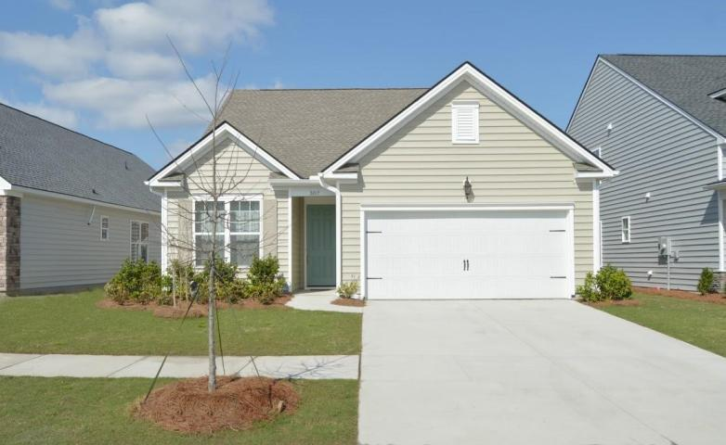
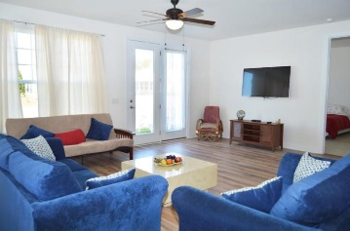
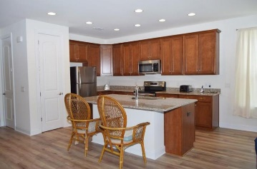
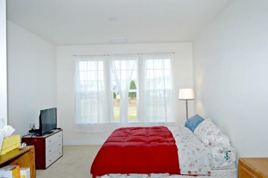
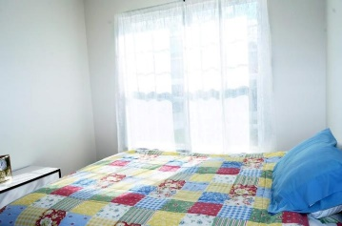
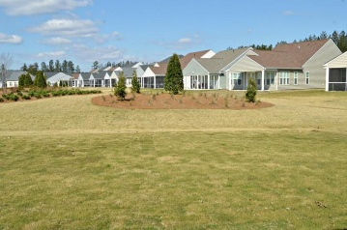
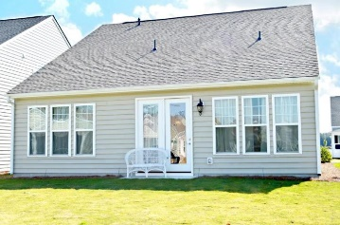
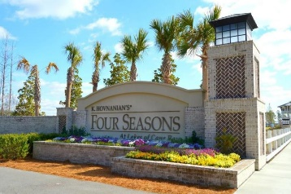
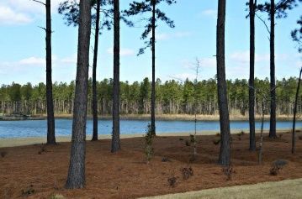


307 Fish Creek Court Cane Bay Plantation ~ Summerville MLS# 18008051 ~ $235,000
Open House Lunch ~ Friday, Oct 3 from 11 - 1
Handyman Special… Bring your hard hats!
Lowest Price in Four Seasons
Live the lake life for the most affordable price at Four Seasons in Cane Bay! Why wait for new construction when you can move right on in! The heart of the community is a private 300+ acre lake system for your enjoyment. Upon entering you will be awed by the picture molding in the entranceway. Durable upgraded laminate flooring adorns the living space, with ceramic tile in both bathrooms. The home is bright and inviting and features a separate dining area and an extended family room opening out into the back yard. The kitchen is a chef's delight with flat top range, granite and plenty of storage. The master bathroom is well appointed and the walk in shower features tile and a bench.
Four Seasons is a community that will feature a 23000 sf clubhouse, 2 outdoor and 1 indoor swimming pools, tennis courts, social hall and much more. Enjoy miles of scenic lakeside biker/hiker trails in this outdoor paradise.
Hillary Jones
(843) 709-4666 hillaryjones@sc.rr.com | www.rogcoastal.com
Realty ONE Group Coastal | 1510 Trolley Rd | Summerville, SC 29485

