Slide 1
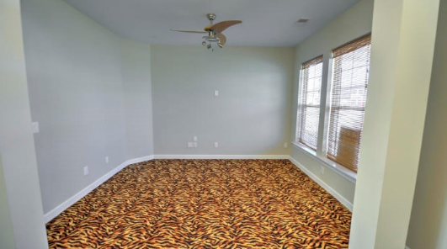
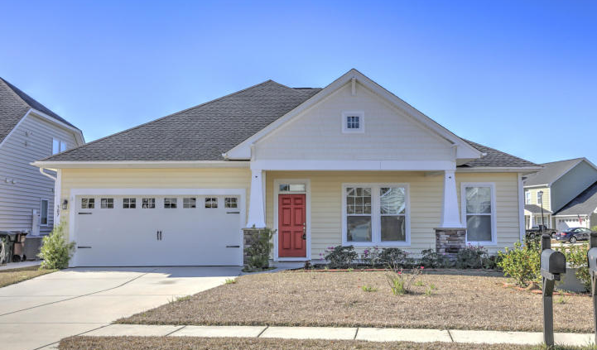
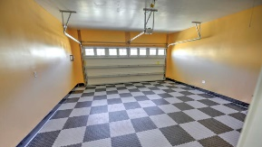
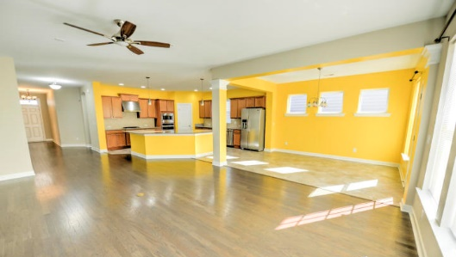
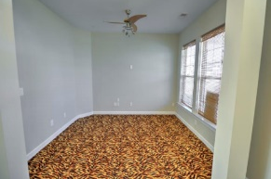
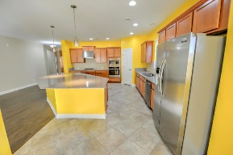
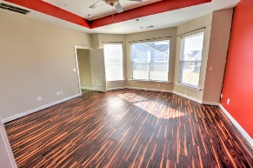
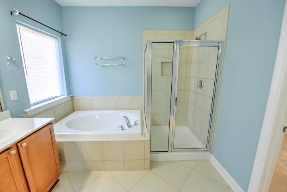
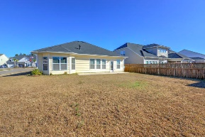


Huge 3 Bedroom & 2 Bathroom Single Story Home
307 Fox Ridge Lane
Foxbank Plantation ~ Moncks Corner, SC 29461 ~ MLS# 20000363 ~ $279,000
Welcome home to your huge single story ranch in the highly desirable Foxbank Plantation! Sitting on a corner lot, this 2016 ranch built by David Weekley screams open floor plan. This home boasts hardwood floors, granite countertops, tons and tons of cabinet & counter space, enormous island, the security system and so much more. The living room has a fireplace and tons of room so you can personalize the layout to your own liking. The master gets a multitude of natural sunlight. The master bathroom has dual vanities, a garden tub, separate shower, and enormous walk-in closet. This home is only 4 years old and still shows like a model home. The amenities in Foxbank Plantation are one-of-a-kind including; a 67 acre lake with dock for fishing, kayaking, etc, resort style pool, fitness center, a park and pocket parks, a children's play park, local and retail businesses, and a dog park. Foxbank Elementary is located towards the entrance of theneighborhood and the middle and high schools are only 9 miles away. Ask about quote to paint the kitchen and master bedroom. Schedule your showing today!
Nick Mazzilli
(843) 640-5575
nick@nickmcharleston.com
www.nickmcharleston.com
Reside Real Estate LLC
155 Wingo Way Unit 421
Mt. Pleasant, SC 29464

