Slide 1
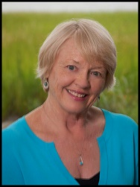
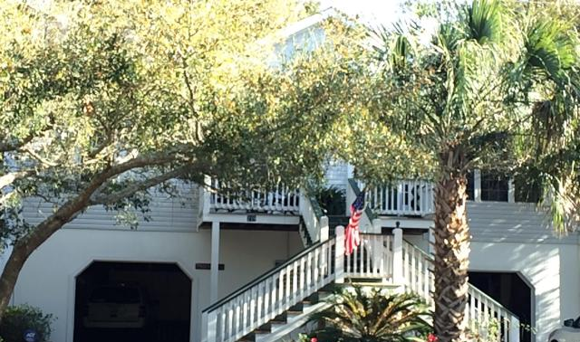
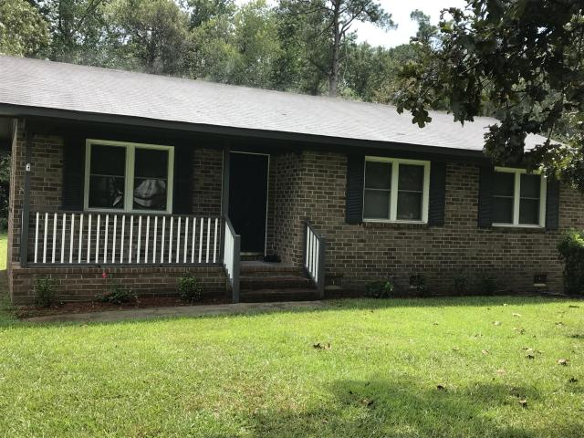
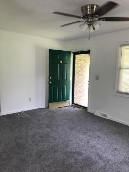
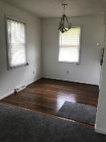
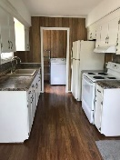
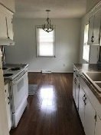
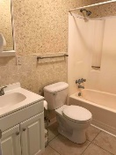
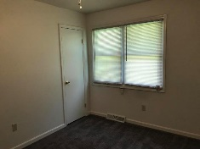
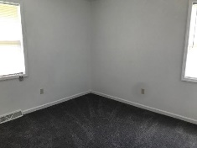
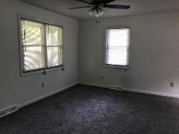
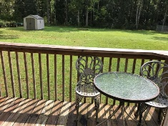
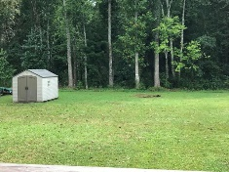
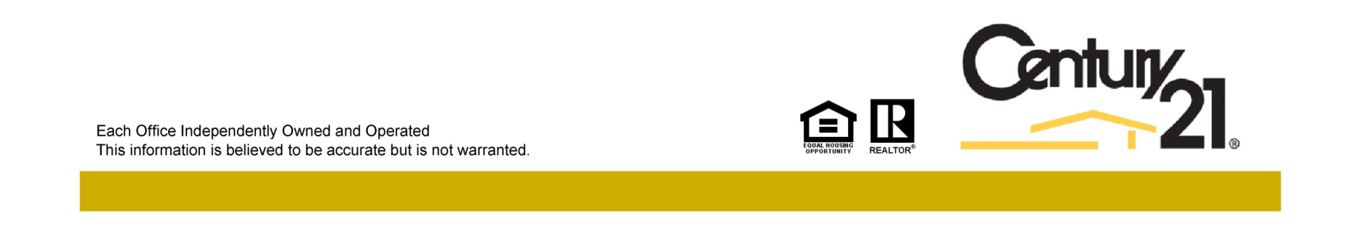
Jane Locke, Realtor
M (843) 819-3508
lockejaneb@aol.com
www.century21properties.com
Sellers need to sell quickly!
307 Twin Lake Dr | Twin Lakes | Summerville | MLS# 18024983 | $145,000
DRAFT
Just imagine having your morning coffee on the deck overlooking your spacious back yard. This home is such a gem - all completely renovated and ready to move in. It has new floors, counter tops, back splash, new toilet and bathroom cabinet, freshly painted, all new electrical, and it sits on almost a half acre. There is a lovely oak tree in the front yard. This home is nestled in a quiet neighborhood close to shopping and schools. It looks so much larger than its square footage. Come check it out as it is certainly a great jewel of a home at a fantastic price. There is municipal water and sewer at the road that can be connected to the home if the buyer wants to do so after purchasing the home.
Century 21 Properties Plus | 3301 Salterbeck St Suite 100 | Mt. Pleasant, SC 29466

