Slide 1

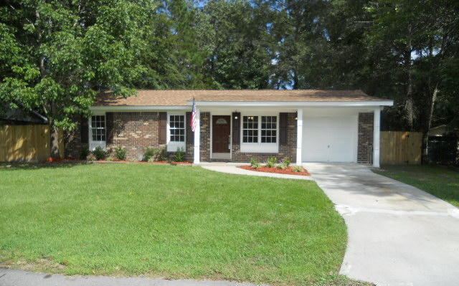
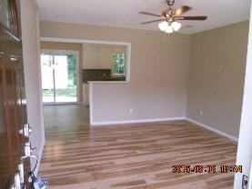
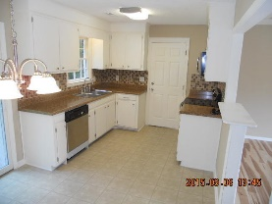
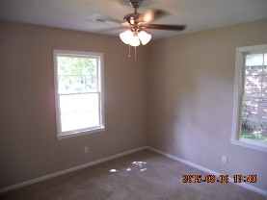
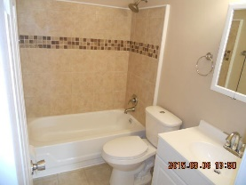
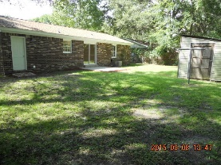
Don C Mason
(843) 364-9090
nibsc@aol.com
Beautiful Move-in Ready Home
307 Water Oak Drive
Woodland Heights | Goose Creek, SC 29445 | MLS# 15023847 | $119,900
WOW!!
Fresh & clean move in ready. Very nice renovation. Brand new paint inside & out. New 12mm Oak Harwood Laminate floors in the family room and hallway. Brand new carpet & padding in the bedrooms. New 6 panel doors throughout with new hardware. All new lights and ceiling fans. New vanity, toilet, light, faucet, and mirror in bathroom. Kitchen wall opened up with a bar top to the family room. A sliding door stepping out onto your freshly poured and stained patio for extra entertainment. The kitchen is like new. All new stainless appliances to include built in micro-wave, smooth top range, and dishwasher. New counter tops and a modern tiled back splash. The garage floor was also painted. Topped off with a 30 year arcitectural shingled roof. finished with professional landscaping.
Real Estate Advocates
Palm Beach Gardens, FL 33418
www.realestateadvocates.com

