Slide 1
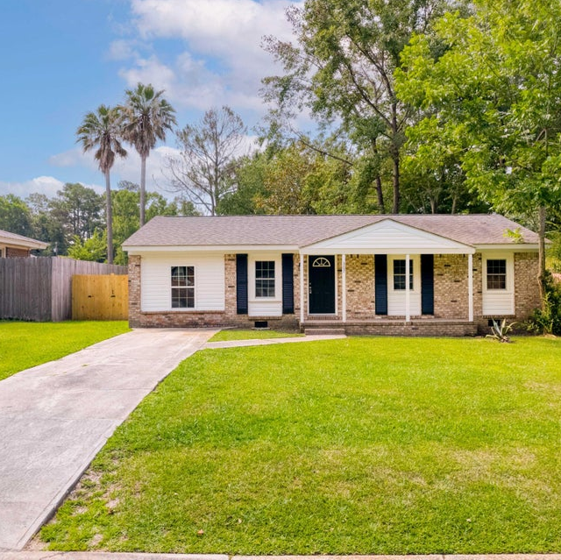
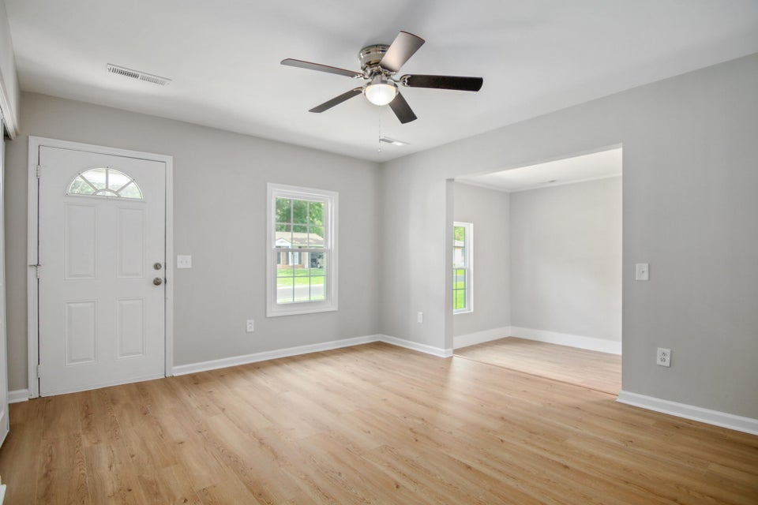
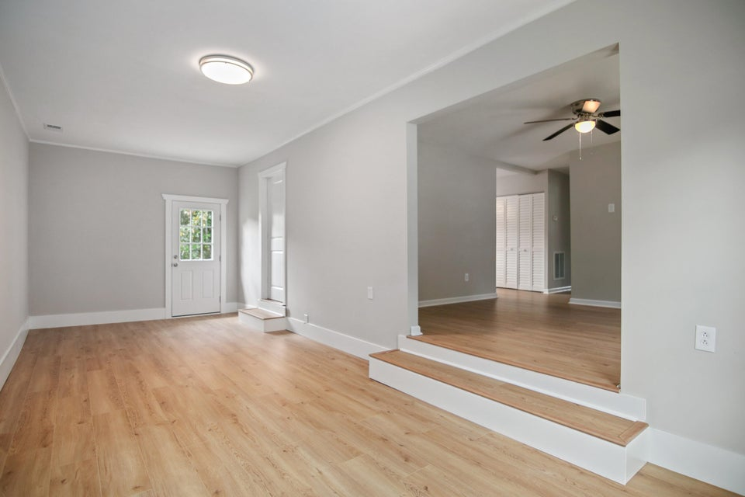
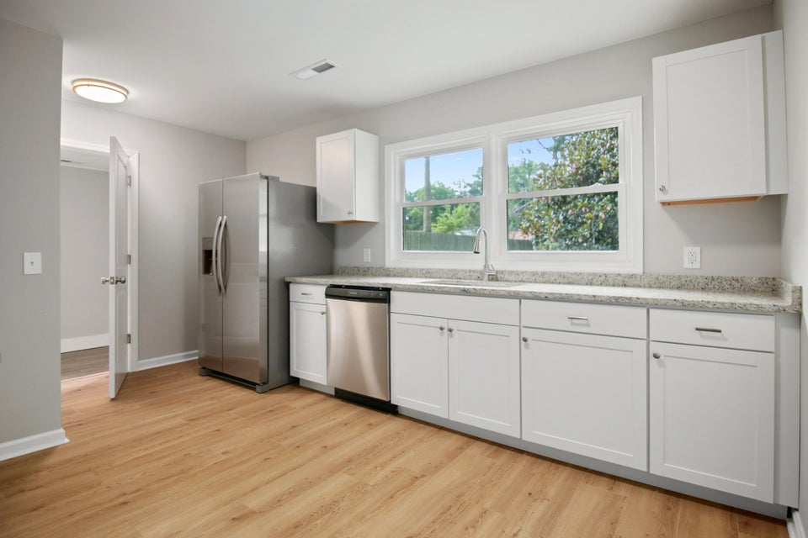
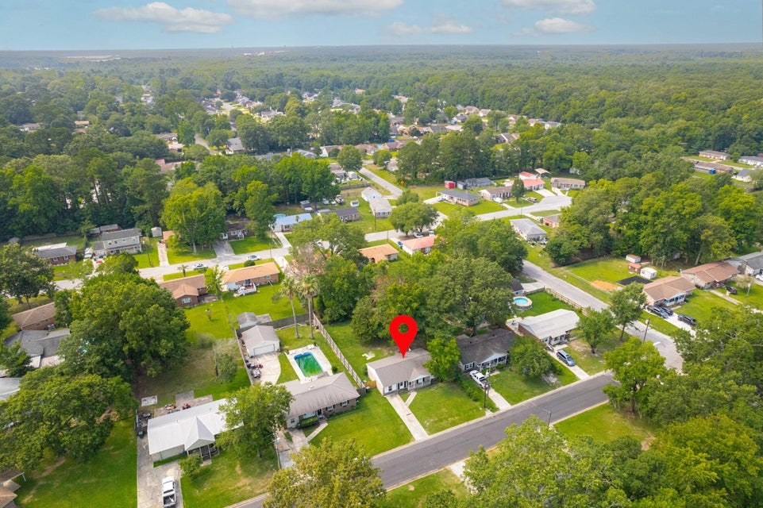

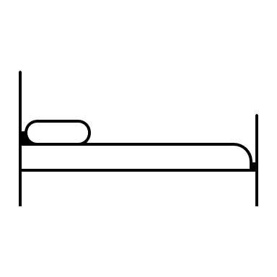


EASILY AFFORDABLE HOME OR RENTAL PROPERTY
307 Birch Avenue
Pineview Hills | Goose Creek
MLS# 24016225 | $290,000
Easily afford comfort and style at 307 Birch Avenue! This move-in ready home has been completely renovated and offers modern upgrades such as new wood laminate floors, new kitchen with shelved pantry, granite countertops, a fridge with ice maker, ceiling fans and new windows to name several. These features contribute to the comfort and style of the home. The house has 3 bedrooms and 2 full bathrooms, providing ample space for individuals needing extra room. The large, enclosed backyard with a beautiful Magnolia tree is a peaceful outdoor setting for relaxation and enjoyment. This property is priced under 300K, making it an attractive option for potential buyers looking for a home that offers both quality and affordability. This is indeed a must-see property!
Susan Stanley
843-323-5573
susancstanley@gmail.com
1,242 SF
3 BEDS
2 BATH

