Slide 1
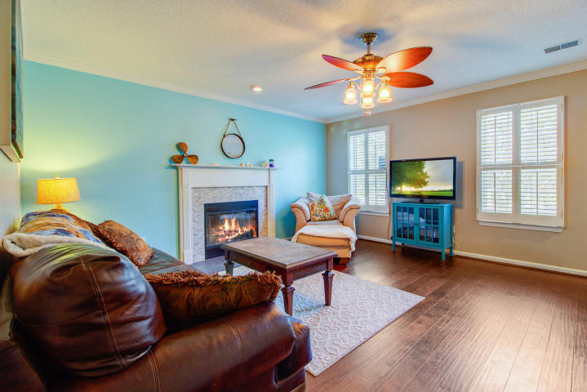
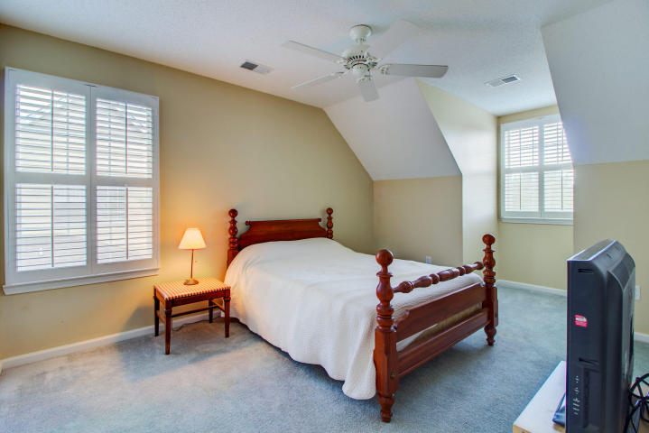
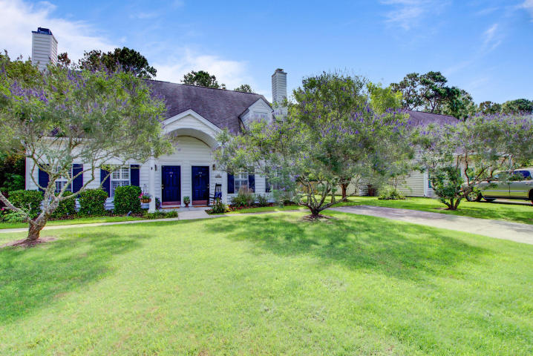
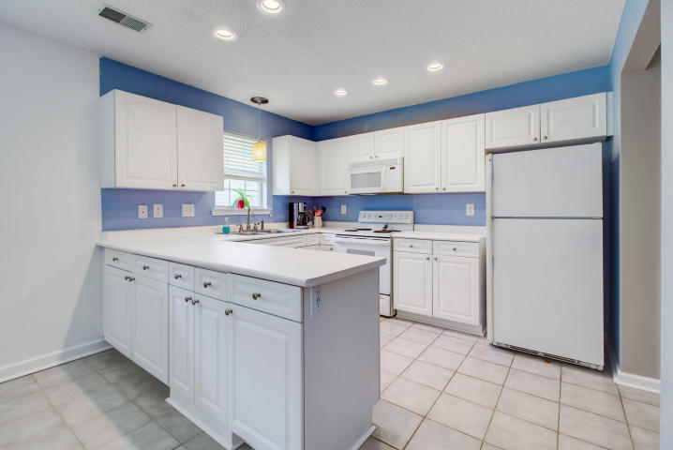
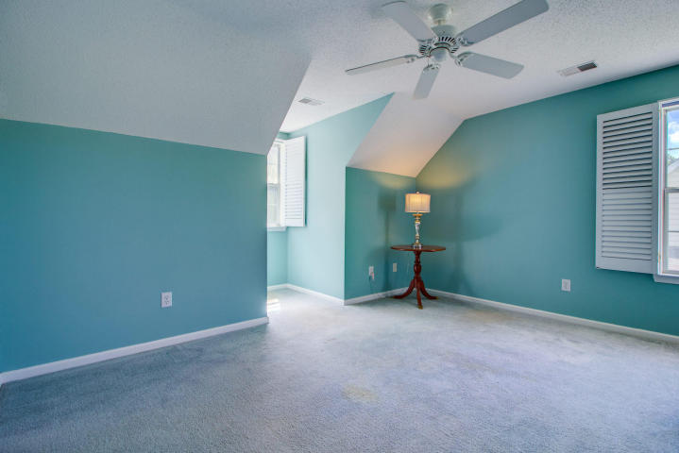
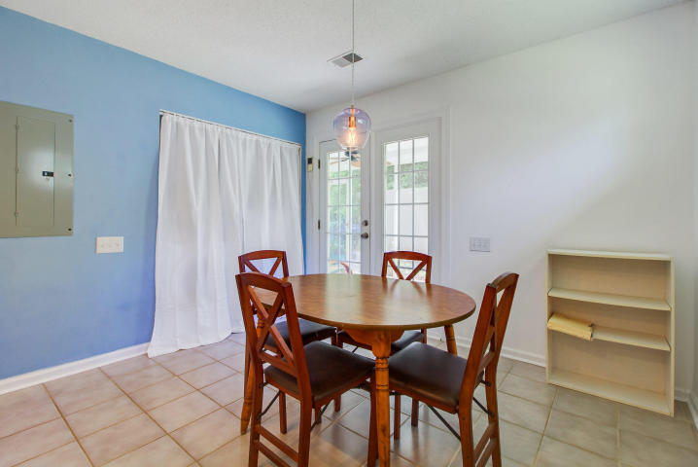
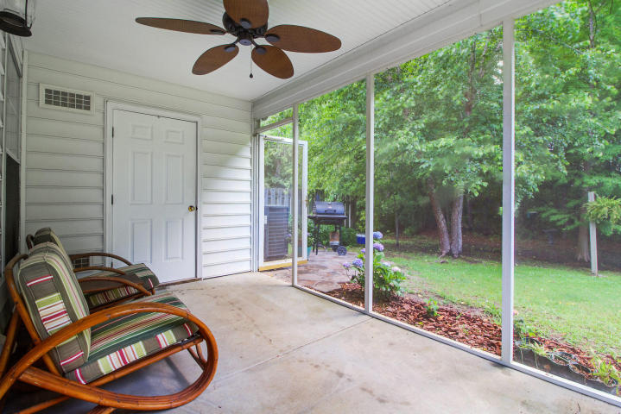
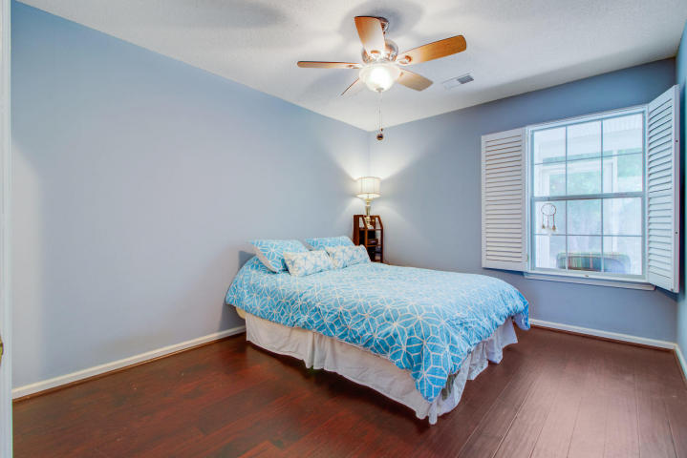
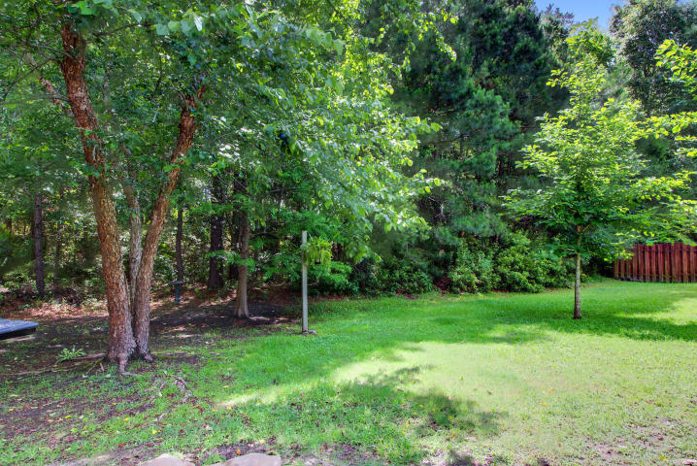


JUST REDUCED!
RARE FIND in The Gates at Park West
3080 Queensgate Way
Park West
Mount Pleasant, SC 29466
MLS# 18015334 ~ $239,000
RARE FIND in The Gates at Park West- a town home / duplex that has never been rented! This meticulously maintained home is ready for its next owner and it is loaded with features that make it a cut above the rest. Upon entry you will notice the beautiful wood floors throughout the family room, hall and master bedroom. They continue up the stairs as well. Plantation shutters dress up each and every window in the home. The stunning fireplace is the perfect focal point of the large family room. Light and bright describe the kitchen, which is super clean, has lots of storage and plenty of countertops for meal preparation. The master is on the main level and looks out over the private rear yard. Sitting on the screened porch, you will enjoy tons of privacy as the neighbors on each side have fenced in their yards while this one looks out to a beautifully wooded lot. The HOA will even mow the lawn so you don't have to! Don't overlook the paver patio which makes for a perfect grilling station all year long. In the screened porch be sure to check out the large utility closet that can accommodate bikes or all your storage needs. Traveling upstairs you will appreciate the full front and rear dormers that truly open up each of the guest bedrooms. Both have sizable walk in closets and are spacious and bright. The shared bath has been updated with an attractive granite top vanity. This home incorporates all of the upgrades offered by the builder and has been nicely updated, too. The AC is merely 2 years old. Residents of The Gates have their own community pool. In addition Park West Amenities include two large pools, a play park, volleyball courts and tennis courts, too. Residents of Park West enjoy miles of biking, walking and jogging paths throughout the community. The convenience of shopping, restaurants, offices, fitness centers, day care facilities and more can't be beat! Students attend award winning schools located in Park West (grades PreK through 8) and Wando High is a short ride away. Young drivers never have to travel on Rt. 17 to get to school! The Town of Mt. Pleasant's Recreation Center at Park West is the site for soccer, volleyball, track and football games for children and teens all over town and is an easy walk or bike ride from this home. For a truly amazing location and a home that is upgraded and move in ready, you need to look no further than 3080 Queensgate Way!
3D Walk thru tour on MLS or go to
https://my.matterport.com/show/?m=y1QPnPpfp3M
Ellen O'Neil
Broker/Owner, ABR, e-PRO, CNE
Charleston Realtor of Distinction
(843) 300-8530
www.EllenONeilProperties.com

