Slide 1
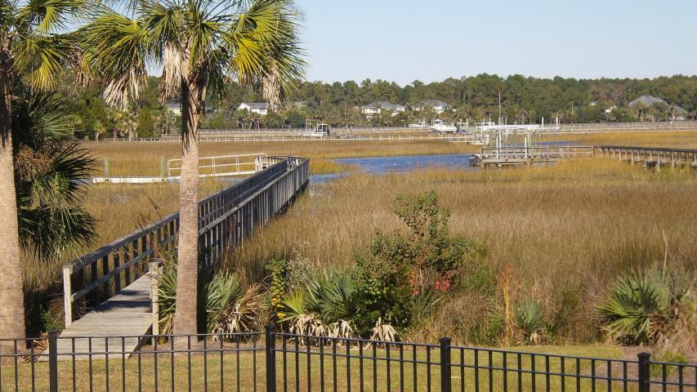
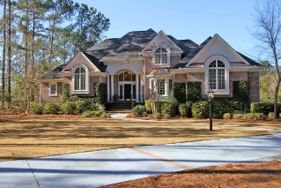
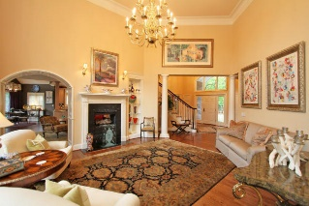
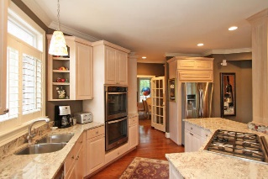
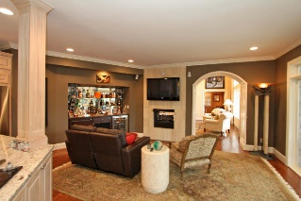
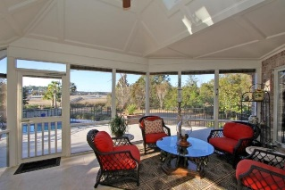
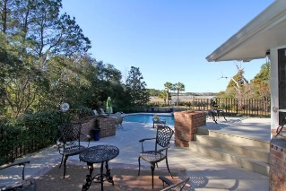
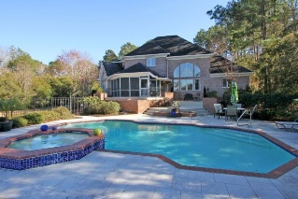
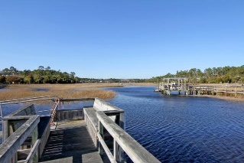


3084 Pignatelli Crescent
Dunes West - Mount Pleasant
MLS# 15004054 - $1,050,000
Panoramic Views and Custom Features
Magnificent waterfront home in the exclusive gated community of Dunes West. Views from almost every room in this home!! Deep-water dock w/floater on Wagner Creek, 4 feet at low tide. Enjoy the panoramic marsh and water views from this wonderful home. This extraordinary home features a custom saltwater in-ground pool with spa overlooking expansive water views. Enter this home through custom doors with restoration glass sidelights and transom. Once inside you will discover the elegance and beauty of a spacious, open floor plan with many exquisite features. Hardwood floors throughout main level with carpet upstairs, large open kitchen with adjoining hearth room. The kitchen has New Whirlpool appliances, granite countertops, Dacor 5 burner gas stove top, and double ovens (convection/steam oven). You will also enjoy the double sided fireplace with one side in the Great Room and the other in the Hearth Room having floor to ceiling Travertine tile in the Hearth Room. Wonderful tiled screened in porch off the kitchen with great outdoor living space. GE monogram stainless grill for outdoor entertaining. Exquisite master bedroom suite on 1st floor with luxurious master bath. This spa bath with Barrel Ceiling has a Jacuzzi tub, large walk in shower with a curved glass block wall and generous custom, walk in master closet. An additional bonus room upstairs has been completed for a fitness room, studio, etc., an office downstairs that includes custom cabinetry and water views, The extraordinary landscaping makes this estate home one of a kind, full irrigation with separate water meter. Three car garage with lots of shelving and storage. The home also has a 4' crawl space with dehumidifier system as well as a Rinnai Tankless hot water heater. The main floor HVAC system has a 10 year warranty till 2019. Dunes West is a waterfront golf community, gated, with clubhouse, tennis center, boat ramp, pools, fitness center, and more...Experience your dream in this wonderful waterfront home!!
Darlene Smith
Office - (843) 886-8110
Mobile - (843) 696-7824
darlenesmith@carolinaone.com
DarleneSmithTeam.com
Carolina One Real Estate
1503 Palm Blvd Ste
Isle of Palms, SC 29451

